Slide 1
大气污染防治行动计划
The Action Plan on Prevention and Control of Air Pollution
Prepared for the 2013 CCICED Annual Meeting
Hao Jiming
Nov. 13, 2013
Notes:
Regional Air Quality Integrated Control System Research

Slide 2
提 要
Outline
《行动计划》制定的背景
Background of the action plan
《行动计划》的主要特色
Features of the action plan
对加强大气污染防治工作的建议
Recommendations for future efforts

Slide 3
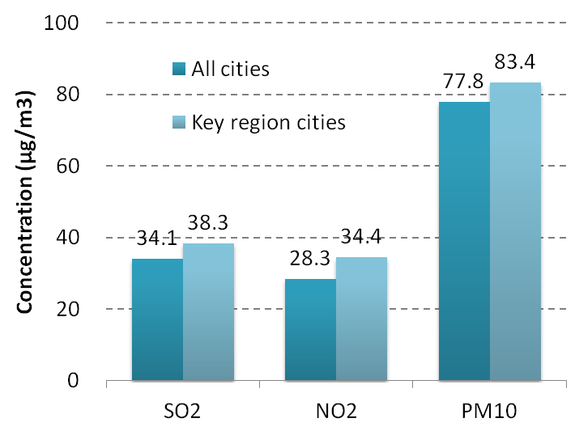
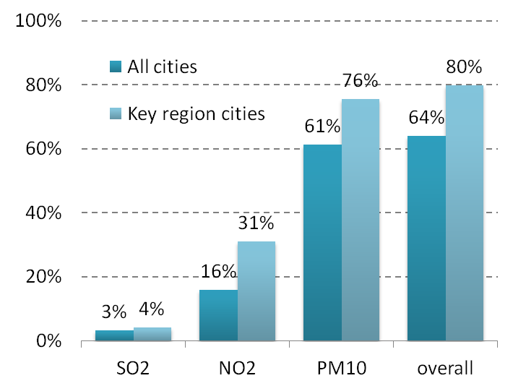
超过60%的城市不能达到新空气质量标准
Over 60% cities fail to comply with NAAQS (GB3095-2012）
2010-2012年平均浓度
2010-2012 annual concentration
2010-2012年平均浓度超标城市比例
Non-attainment cities

Slide 4
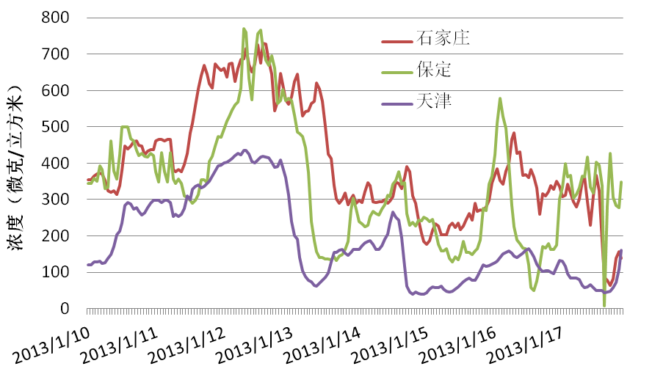
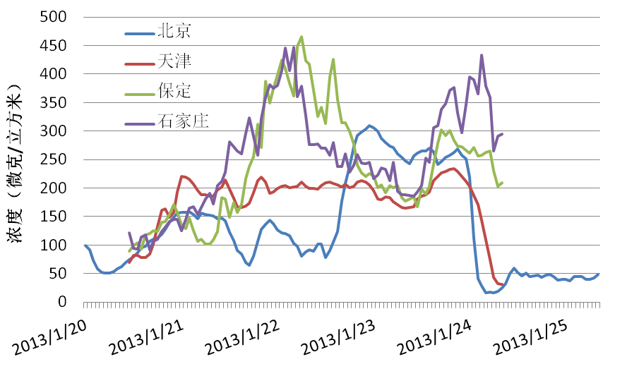
今年1月东部地区出现了长时间大范围的严重灰霾污染
Heavy haze pollution took place in Jan 2013
影响范围大
Area
130万平方公里
1.3 million km²
持续时间长
Duration
3周
~3 week
浓度高
Concentration
浓度爆表
Over 500 μg/m³
暴露人口多
Exposed population
超过8亿
Over 800 million

Slide 5
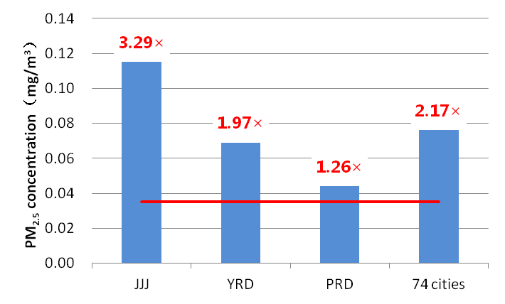
全国城市环境空气中的颗粒物浓度距达标有明显差距
A wide gap between PM concentration and the standards
2013年上半年PM_{2.5}浓度
PM_{2.5} concentration in the
1st half of 2013
空气质量标准
Standard
2013年上半年，三大区域仅有2城市能达到PM_{2.5}年均值标准，京津冀平均浓度超标高达3.3倍
Only 2 cities in JJJ, YRD and PRD complied with the PM_{2.5} standards, and the average PM_{2.5} concentration in JJJ area is as 3.3 times high as the standard limit value.
2013年前三季度，实施新标准的74个城市中，仅有6个城市能达到PM_{2.5}年均值标准
Only 6 cities out of 74 (with PM_{2.5} measurements) complied with the PM_{2.5} standards

Slide 6
党中央和新一届政府高度重视大气污染防治工作
The Party and the government pays high attention on AP control
在第七次全国环保大会上对大气污染防治工作等提出明确要求
The requirements on air pollution control at the 7th National Conference on Environmental Protection
党的“十八大”提出建设生态文明和美丽中国的目标
Promote ecological progress and build a beautiful country, from Report to the Eighteenth National Congress of the Communist Party of China
进一步加强空气污染防治，修订并发布空气质量标准，抓紧做好增加ＰＭ_{２.５}监测指标的准备，鼓励各地根据污染特征、经济发展水平等分期实施，逐步与国际标准接轨。
Strengthen air pollution control. Amend the new ambient air quality standard. Start to prepare PM2.5 monitoring. Integrate with international standard step by step.

Slide 7
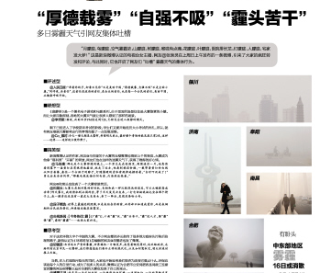
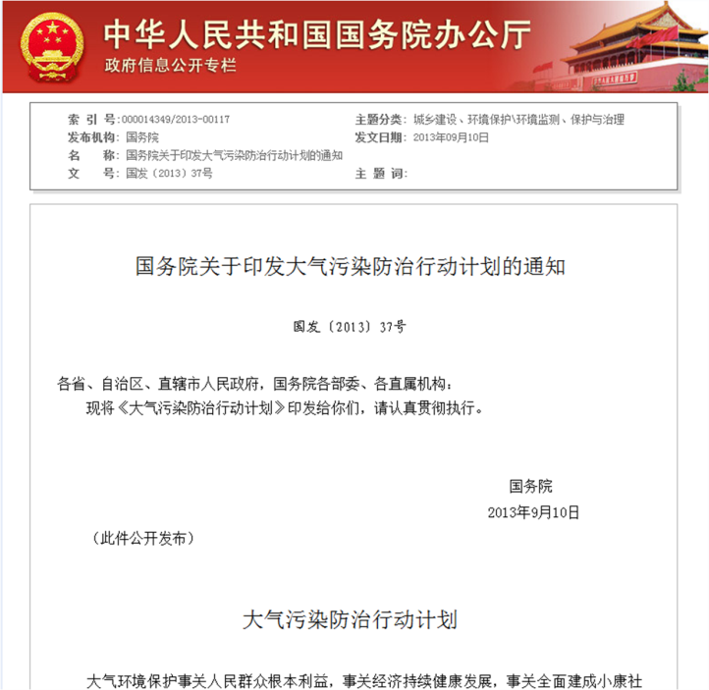
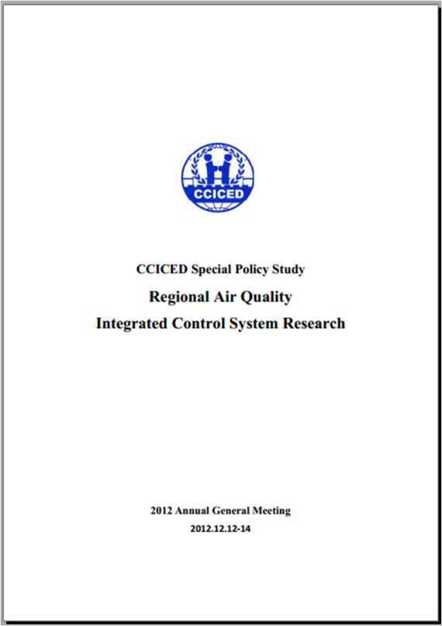
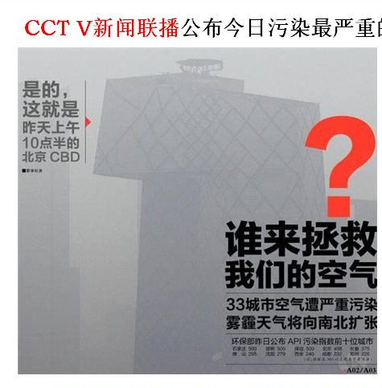
政府制定行动计划，迅速响应了群众的关切
The government make swift response to public concern
人民关注
Public concern
专家建议
Recommendations
Notes:
国务院统筹、顶层设计。作为统筹稳增长、调结构、促改革……抓手

Slide 8
提 要
Outline
行动计划制定的背景
Background of the action plan
行动计划的主要特色
Features of the action plan
对加强大气污染防治工作的建议
Recommendations for future efforts

Slide 9
1. 建立在国家战略高度的顶层设计
1. A top-level design featuring national strategy
奋斗目标 / Objectives
  经过五年努力，全国空气质量总体改善，重污染天气较大幅度减少；京津冀、长三角、珠三角等区域空气质量明显好转。
  5 years: better air quality and much less heavy pollution days national-wide, and significantly improved air quality in JJJ, YRD and PRD.
  力争再用五年或更长时间，逐步消除重污染天气，全国空气质量明显改善
  Another 5 years or more: eliminate heavy pollution episodes, and significantly improved air quality national-wide .
具体指标/Indicators for the next 5 years
  到2017年，全国地级及以上城市in PM₁₀比2012年下降10%以上，优良天数逐年提高。
  10% reduction in PM₁₀ concentration national-wide .
  京津冀、长三角、珠三角等区域细颗粒物浓度分别下降25%、20%、15%左右，其中北京市细颗粒物年均浓度控制在60微克/立方米左右。
  25%, 20% and 15% reduction in PM_{2.5} concentration for JJJ, YRD and PRD respectively. Annual concentration of PM_{2.5} to be around 60 μg/m³ .

Slide 10
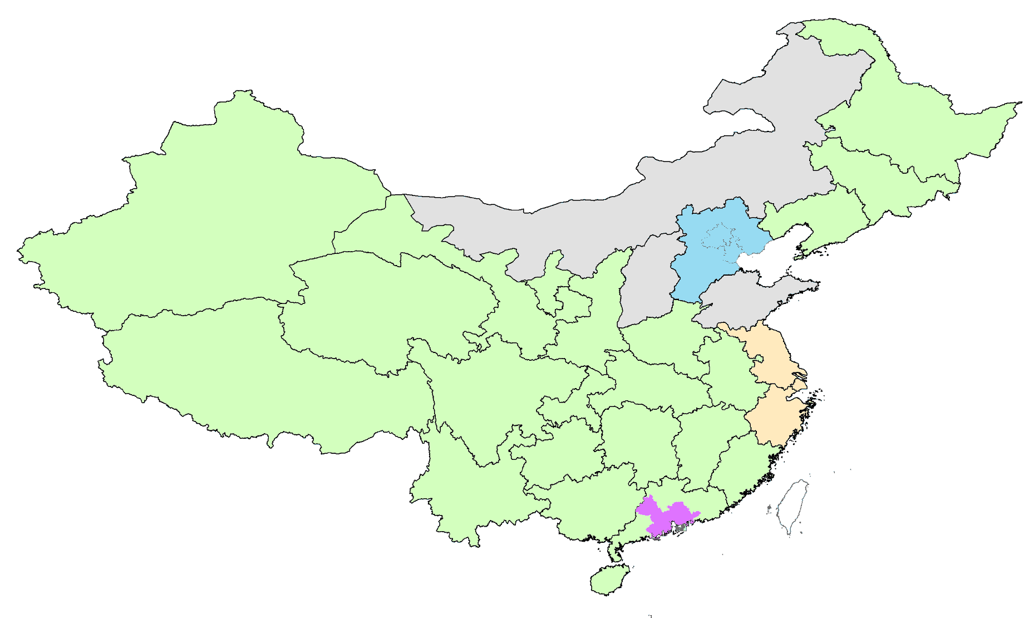
2. 突出了分区控制，分类指导的思想
2. Differentiated targets for different regions
晋蒙鲁：支持京津冀实现目标
Shanxi-Shandong-Inner Mongolia: support JJJ
京津冀：PM_{2.5}浓度下降25%
JJJ： 25% reduction on PM_{2.5} concentration
长三角：PM_{2.5}浓度下降20%
YRD： 20% reduction on PM_{2.5} oncentration
其他：PM₁₀浓度下降10%
Others： 10% reduction on PM₁₀ concentration
珠三角：PM_{2.5}浓度下降15%
PRD： 15% reduction on PM_{2.5} concentration

Slide 11
3. 关注了大气污染产生的重要因素： 加快产业结构调整
3. Speed up industrial restructure to reduce emissions
SO₂、NO_{X}、烟粉尘和VOCs排放量符合要求成为环评审批前置条件
EIA for new projects constrained by emissions budget of SO₂, NO_{X}, PM and VOCs
提高环保、能耗、质量等标准，促进“两高”行业过剩产能退出
Higher standards on emissions control, energy saving and product quality to promote elimination of outdated high-pollution capacity
提前一年完成“十二五”期间21个重点行业的落后产能淘汰目标任务
Achieve the 12th FYP eliminating goal for 21 sectors one year earlier

Slide 12
3. 关注了大气污染产生的重要因素： 加快能源清洁利用
3.Speed up supply and use of cleaner energy
优化能源结构/Better energy structure
推进煤炭清洁利用/Cleaner use of coal
增加清洁能源供应/More supply of cleaner energy
2017年，全国煤炭比重降低至65%以下；京津冀、长三角、珠三角煤炭消费量负增长
Lower the ratio of coal to national energy consumption to 65% or below by 2017. Reduce coal consumption in JJJ, YRD and PRD
到2017年，原煤入选率达70%以上；减少原煤散烧
70% or more raw coal to be washed by 2017. Restrict use of raw coal by small boilers and stoves
新增天然气干线管输能力1500亿立方米以上
New NG transmission pipeline with capacity over 150 billion cubic meter

Slide 13
3. 关注了大气污染产生的重要因素： 加快能源清洁利用
3. Speed up supply and use of cleaner energy
新增加1500亿立方天然气供应量，如果用于替代部分燃煤工业锅炉耗煤，预计可减排：SO₂ 359-579万吨；NO_{x} 60-160万吨；烟尘 134-272万吨。
If additional supply of natural gas (about 150 billions m³) is used to replace part of coal fired industrial boilers (e.g. less than 20 t/h), the potential of pollutants reduction will be SO₂ 3.59-5.79 Mt,
NO_{x} 0.6-1.6 Mt, PM 1.34-2.72 Mt。
排放因子 Emission Factor |  |  |  | 备注 Remark
 | SO₂ | NO_{x} | PM
燃煤工业锅炉 industrial coal-fired boiler kg/t | 10-16 | 3-5.7 | 3.8-7.5
燃气工业锅炉 industrial gas-fired boiler kg/10k·m³ | 5.53 | 33.15 | 2.21 | 燃气工业锅炉新标准 New standards of industrial gas-fired boiler
Notes:
燃煤工业锅炉热效率，%
70%
锅炉节能结束管理监督规程
燃气工业锅炉热效率，%
88%
锅炉节能结束管理监督规程
煤炭发热量，38931kJ/kg
劳保所，工业锅炉主要大气污染物控制技术路线研究研究报告
天然气发热量，38931kJ/m³
中国能源统计年鉴2012的折算标准
天然气耗量，亿m³
1500
煤炭耗量，亿吨
3.67

Slide 14
3. 关注了大气污染产生的重要因素： 加快能源清洁利用
3. Speed up supply and use of cleaner energy
热电联产替代工业锅炉减排显著
Emission reduction of combined heat and power generation replacing industrial boiler
经测算，20t/h以下燃煤工业锅炉的耗煤量约为2.66亿吨。
根据等量置换原则，计算污染物减排潜力，预计可减排：SO₂:234-394万吨，NO_{x}：25-97万吨，烟尘：93-193万吨.
If part of coal fired industrial boilers(eg. <20 t/h) is equivalently replaced by thermoelectric coal fired units, the possible pollutants reduction will be:
SO₂: 2.34-3.94 Mt, NO_{x}: 0.25-0.97 Mt, PM: 0.9-1.93 Mt, if reaching the new emission standard
排放因子 Emission Factor | 数值 Number |  |  | 备注 Remark
 | SO₂ | NO_{x} | PM
燃煤工业锅炉 industrial coal-fired boiler kg/t | 10-16 | 3-5.7 | 3.8-7.5
热电联产 combined heat and power generation kg/t | 1.54 | 2.67 | 0.35

Slide 15
3.关注了大气污染产生的重要因素： 强化机动车污染防治
3. Enhance vehicle emissions control
控制大城市机动车保有量/Control vehicle inventory of big cities
北京、上海、广州等特大城市严格限制机动车保有量
Control vehicle population of megacities strictly， such as Beijing, Shanghai, Guangzhou
提升燃油品质/Improve fuel quality
2015年底前，京津冀、长三角、珠三角等区域内重点城市供应硫含量不大于10ppm的车用汽、柴油；2017年底前，全国供应硫含量不大于10ppm的车用汽、柴油
Gasoline and diesel with 10ppm sulfur content by the end of 2015 for key areas, and by the end of 2017 for others.
加快淘汰黄标车/Speed up the elimination of yellow label vehicles
到2015年，基本淘汰京津冀、长三角、珠三角等区域内的500万辆黄标车。到2017年，基本淘汰全国范围的黄标车
Eliminate 5 million yellow label vehicles in JJJ, YRD and PRD by 2015, and eliminate yellow label vehicles in the whole nation by 2017.

Slide 16
3.关注了大气污染产生的重要因素： 强化机动车污染防治
3.Enhance vehicle emissions control
加强机动车环保管理/Enhance environmental management of vehicles
加强在用机动车年度检验，对不达标车辆不得发放环保合格标志，不得上路行驶
enhance vehicles annual inspection. substandard vehicles are forbidden to grant qualified environmental label and run on road.
加快推进低速汽车升级换代/Advance upgrade and update of low speed vehicles
自2017年起，新生产的低速货车执行与轻型载货车同等的节能与排放标准
New production low speed trucks carry out the same energy conservation and emission standard with light duty trucks since 2017.
大力推广新能源汽车/Generalize new energy vehicles
公交、环卫等行业和政府机关要率先使用新能源汽车，鼓励个人购买。北京等城市每年新增或更新的公交车中新能源和清洁燃料车的比例达到60%以上
Promote new energy vehicles in public transportation and service, and encourage personal purchase with financial subsidies. The proportion of new energy clean fuel vehicles from new buses of Beijing, Shanghai, Guangzhou reached 60% .

Slide 17
4. 体现了4个重要转变
4. Evolvement of philosophy on air pollution control
控制目标
Goal
控制对象
Pollutants
控制手段
Sectors
管理模式
Approach
总量控制
Emissions
硫、氮、尘
SO₂/NO_{X}/
smoke
工业点源和机动车
Point sources and vehicles
属地管理
Territorial management
质量改善
Air quality
多种污染物
Multi-pollutants
多污染源综合控制
Multi-sectors
区域联防联控
Territorial management+ regional cooperation

Slide 18
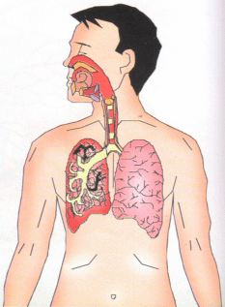
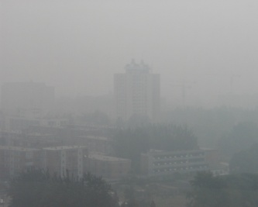
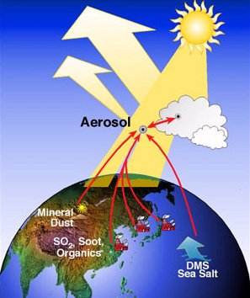
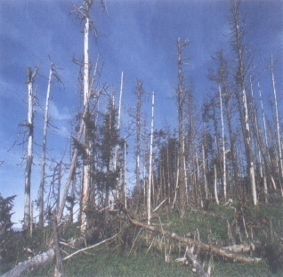
多污染源、多污染物的综合控制 Integrated air pollution control by multi-sector and multi-pollutants approach
固定源
Stationary point sources
(Power plants, industrial sources, etc.)
移动源
Mobile sources
(On-road & off-road)
面源
Area sources
(Commercial, residential, natural)
PM
SO₂
NH₃
NO_{x}
VOC
PM_{2.5}
O₃
Acid rain
公共健康
Public Health
能见度
Visibility
气候
Climate
生态系统
Eco-system

Slide 19
京津冀、长三角区域联防联控工作协调机制
Regional collaboration mechanism for JJJ and YRD
协调解决区域内突出环境问题
Coordinate
组织实施环评会商、联合执法、信息共享、预警应急等工作
Organize impact assessment, enforcement, info sharing and emergency response
通报工作进展
Deliver progress report
研究确定阶段性工作要求、工作重点和主要任务。
Develop stage implementation plans and tasks
国务院
有关部门
Ministries
省级
人民政府
Provincial
governments

Slide 20
5. 针对京津冀提出了特别要求
5. Rules for the implementation of action plan in JJJ
京津冀+晋蒙鲁
Beijing-Tianjin-Hebei + Shanxi-Inner Mongolia-Shandong
高于全国平均水平的污染治理要求
Higher standards on pollution abatement performance
强化钢铁、水泥等行业的落后产能淘汰
Extra requirements on phasing out backward processes in iron & steel and cement industries
煤炭消费总量减少8300万吨
Coal consumption to reduce by 83 million tons
强化联防联控和监督考核机制
Highlighted regional collaboration, supervision and evaluation

Slide 21
地区制定针对性的措施：（1）北京清洁空气行动计划
Beijing’s action plan for clean air
8大污染减排工程：源头、能源、交通、产业、末端治污、城市精细化管理、生态、应急
Emission control measures addressing 8 aspects: city’s capacity, energy, transportation, economic structure, end-of-pipe control, fugitive source, ecology, and emergency response
6大实施保障措施：法规体系、经济政策、科技支撑、组织领导、落实责任、考核问责
Supporting measures from 6 directions: legislation, economic policy, science & technology, organizing, clear responsibility and assessment
三大全民参与行动：企业自律、公众自觉、社会监督
3 campaigns to encourage involvement: enterprise self-discipline, public participating and public supervision

Slide 22
地区制定针对性的措施：（2）上海清洁空气行动计划
Shanghai’s action plan for clean air
目标：2015年PM10达标，SO2、NO2年均浓度在国家要求基础上进一步下降，PM2.5年均浓度控制在50微克/立方米；2017年，PM2.5年均浓度比2012年下降20%以上
Targets： 2015, PM10 , SO2 and NO2 (equal or better than NAAQS) , PM2.5: 50 ug/m3; 2017, PM2.5 20% lower than in 2012, other pollutants meet the NAAQS.
措施：（一）优化能源结构，深化燃煤污染防治
（二）加快产业结构调整，加强工业污染防治
（三）积极发展绿色交通，加大机动车船污染控制力度
（四）规范建设行业管理，提升污染防治水平
（五）强化农业污染治理，减少面源排放
（六）推进社会生活源整治，加快VOCs等污染治理
Emission control measures addressing 6 aspects: energy, economic structure, end-of-pipe control, transportation, agriculture source, area source, and VOCs control

Slide 23
提 要
Outline
行动计划制定的背景
Background of the action plan
行动计划的主要特色
Features of the action plan
对加强大气污染防治工作的建议
Recommendations for future efforts

Slide 24
达到既定目标任务艰巨，需要付出巨大努力
A very large challenge calls for enormous efforts
为达到既定目标，需要多污染物减排幅度远超过远超过以往任何时期
Sharper emission reductions of air pollutants (than 11th FYP and 12th FYP) needed in order to meet the air quality target
三大重点区域所需实现的减排比例更高
Much more reductions needed in the three key regions (JJJ, YRD and PRD)
污染物减排目标百分比的比较
Emission reductions needed for action plan vs. 11th and 12th FYP
 | SO₂ | NO_{X} | PM | VOCs
(to guarantee) action plan | >15% | >20% | >20% | >7%
12th FYP | >8% | >10% | N/A | N/A
11th FYP | >10% | N/A | N/A | N/A

Slide 25
建议1：进一步强调节能对大气污染防治的协同效益
Recommendation 1: pursue co-benefits from energy saving
提高工业生产过程中的能源利用效率
To boost energy efficiency of industrial producing
加强材料研发和管理，强化建筑节能
To enhance building energy conservation with new material and good management practice
减少交通油品消耗
To reduce fuel consumption in transportation sector
中国工业产品能耗与国际先进水平的差距
Gap of energy efficiency in industrial sector
单位能耗 Energy efficiency (kgce/t) | 中国 China | 国际先进 International advanced level | Gap (%)
钢铁 Steel producing | 625 | 550 | 13.6
水泥 Cement producing | 151 | 118 | 28.0
乙烯 Ethylene producing | 1003 | 629 | 59.5

Slide 26
建议2：科学谋划，有序推进城镇化
Recommendation 2: continue urbanization with scientific plan
在城镇化过程中考虑产业和能源调整要求：严格产业准入，控制落后产能扩张；强化基础设施建设，保障清洁能源供给
To prioritize demand of industrial and energy restructure during urbanization: Restrict entry of outdated industrial process, and secure supply of cleaner energy
科学进行城市规划：合理规划城市规模，慎重发展千万人口级的城市；控制城市煤炭消费量，以减少燃煤污染
To scientifically make urbanization plan: Restrict the scale of the cities, and develop cities with 10 million population with discretion; Control use of coal and according pollutions
合理规划城市布局：优化交通系统，以减少机动车污染
Formulate the city layout: optimize the public transportation and reduce vehicle emissions
关注O₃污染问题：随着对PM污染控制的逐渐深入，关注重点区域日益严重的O₃污染问题
To pay attention to O₃ pollution: Prepare for actions to address O₃ pollution, especially for the key regions.

Slide 27
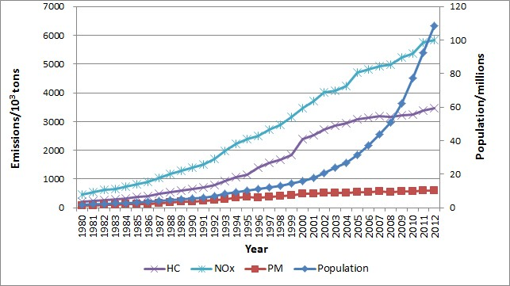
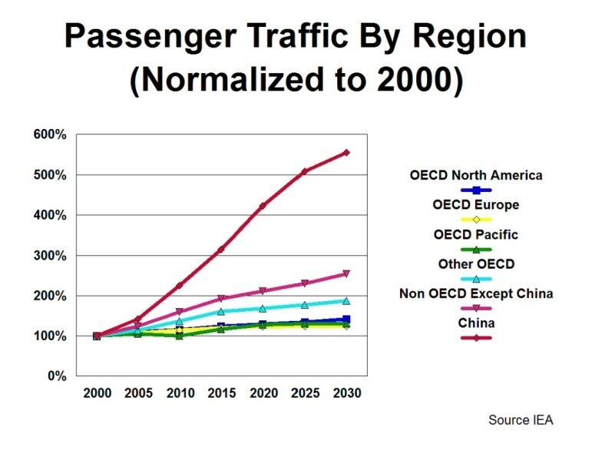
建议3：进一步推进移动源污染防治
Recommendation 3: further efforts to control mobile emissions
妥善应对机动车保有量快速增长的压力
To curb emissions with fast growth of vehicle population
积极推动非道路移动源污染防治。
Promote pollution prevention of non-road mobile source positively
机动车快速增长在很大程度上抵消了减排成果
Emission reduction offset by increase of vehicle population
交通需求还将大幅增长
Great potential on transportation demands

Slide 28
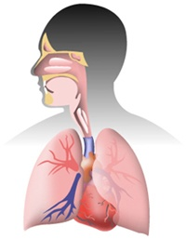
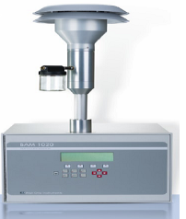
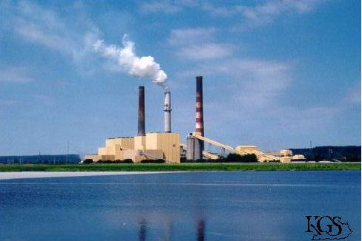
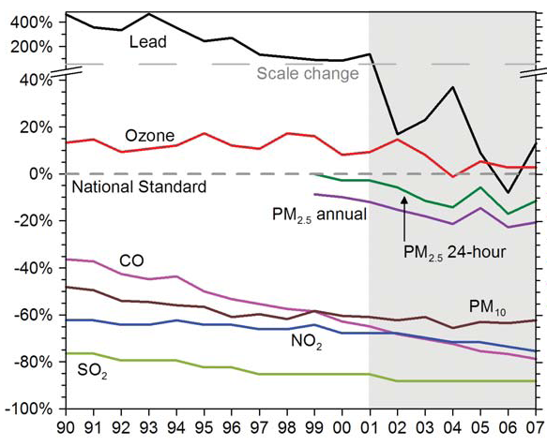

建议4：空气质量改善需要长期持续努力，并循序渐进
Recommendation 4: A long-term strategy needed for AQ improvement
Determine Emission Reduction Targets
Establish Goals
建立环境目标
确定减排目标
Scientific Research
科学研究
Control Strategies
控制措施
On-going Evaluation
跟踪评估
Implementation Programs
项目实施

Slide 29
Thank You !

