Slide 1
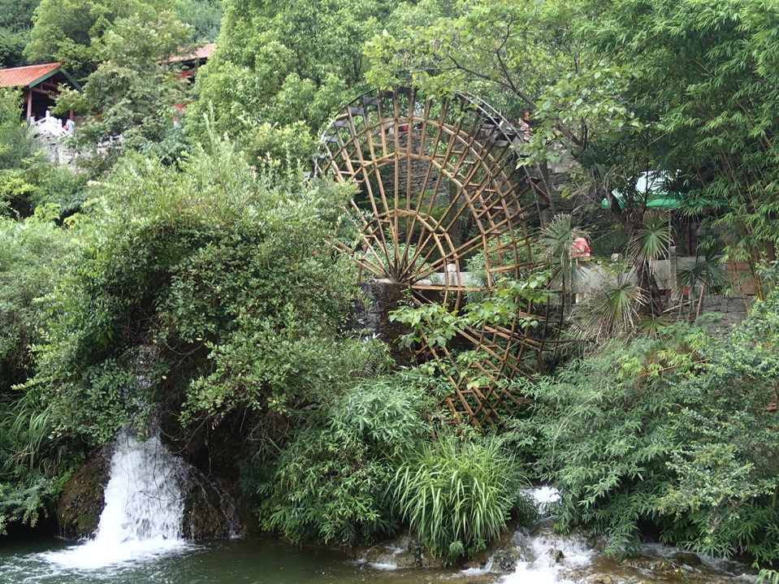
Environment & Society 环境与社会
2013 CCICED ISSUES PAPER
国合会2013年关注问题报告

Slide 2
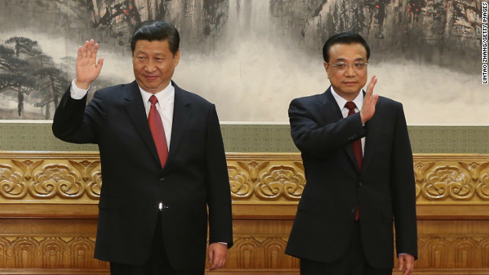
Gree
President Xi Jinping Premier Li Keqiang
GREEN LEADERSHIP STARTS AT THE TOP
绿色领袖从顶层开始

Slide 3
“We have to understand that to protect the environment is to preserve our productivity…”
-- Xi Jinping, 24 May 2013 6th Study Session of Political Bureau on Ecological Civilization
“我们必须明白，保护环境就是保护我们的生产力…”
－ 习近平在2013年5月24日第六次政治局生态文明学习班上的讲话
Businessweek (Bloomberg) China's Leaders Talk Reform: Will They Walk the Talk?
Dexter Roberts on May 28, 2013

Slide 4
3 LEVELS 三个层面
Ecological
Civilization
Green
Development
Environment
Protection
生态文明
绿色发展
环境保护

Slide 5
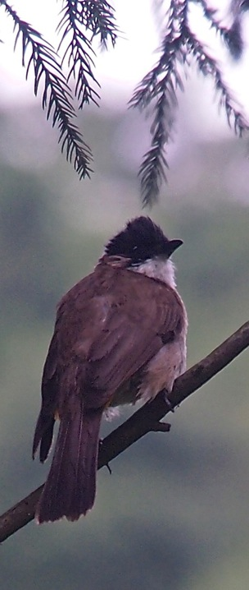
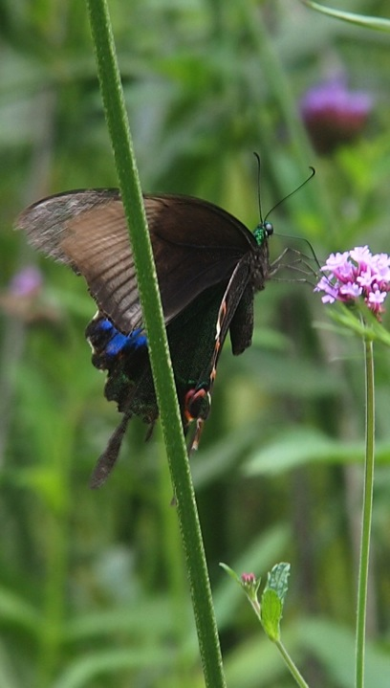
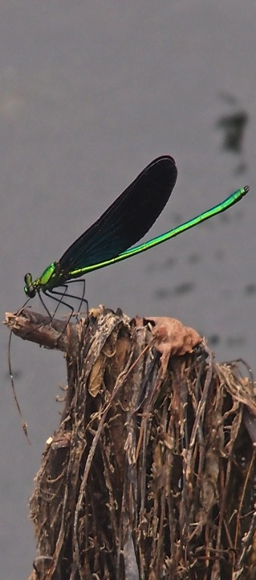
“RESPECT NATURE” “尊重自然”

Slide 6
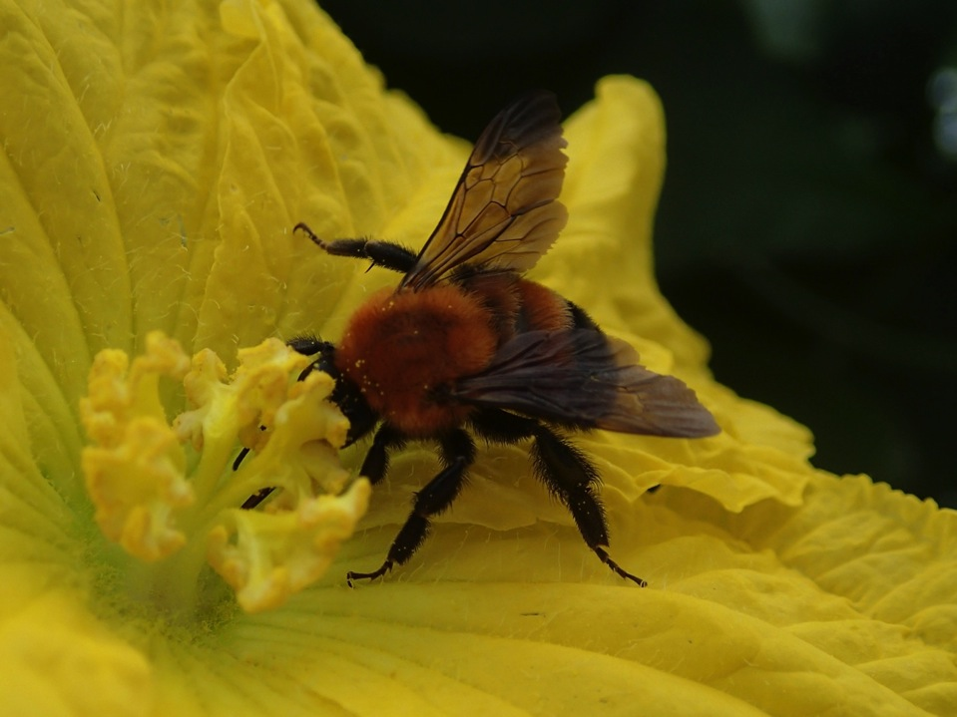
POLLINATOR 授粉体

Slide 7
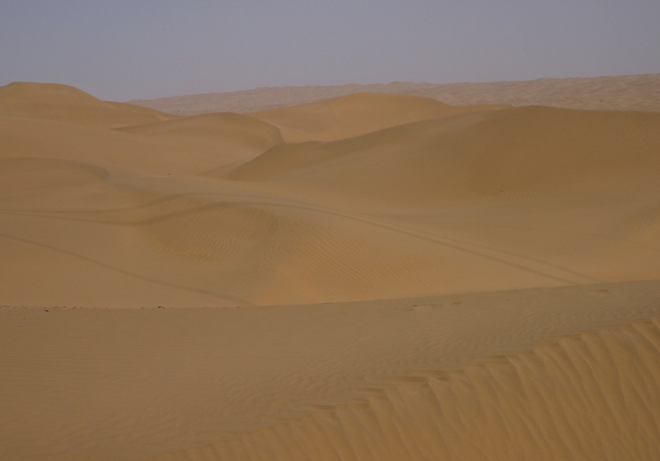
TAKLAMAKAN DESERT 塔克拉玛干沙漠

Slide 8
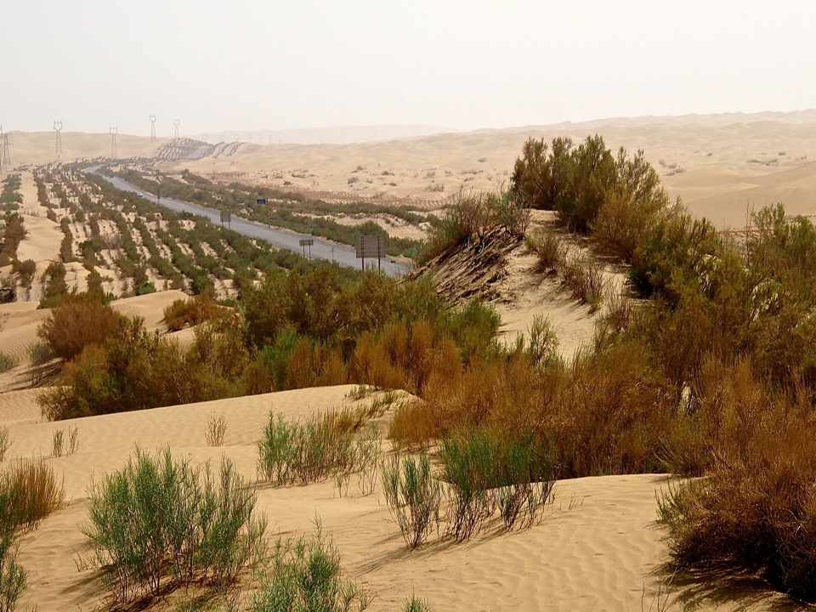
“GREAT GREEN WALL” “绿色长城”

Slide 9
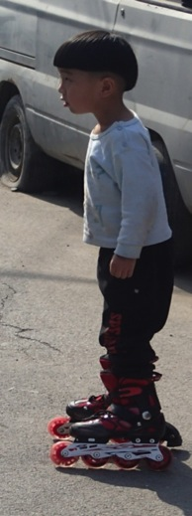
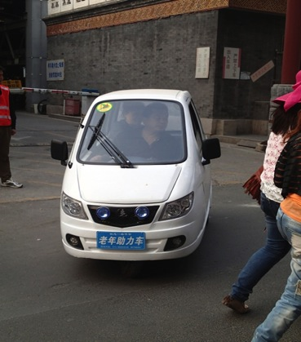
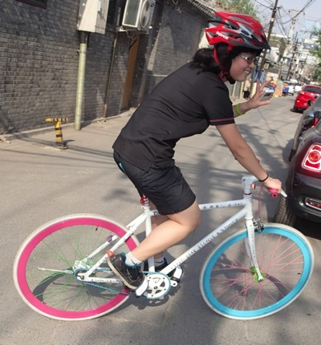
GREEN MOBILITY 绿色出行

Slide 10
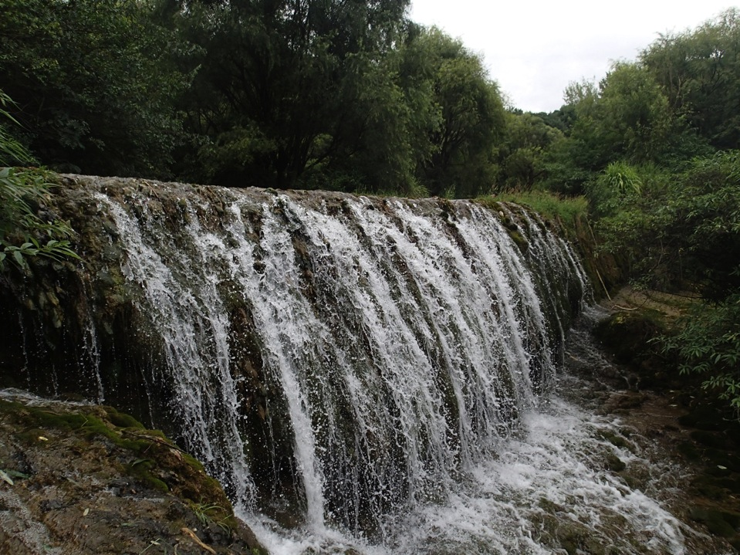
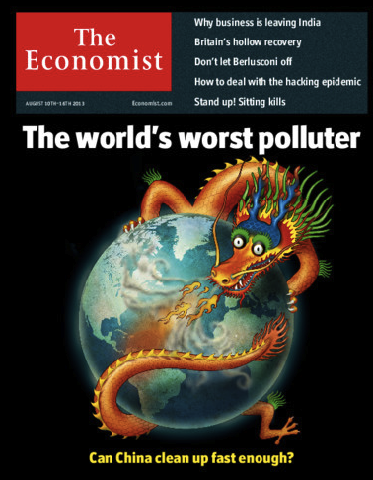

Slide 11
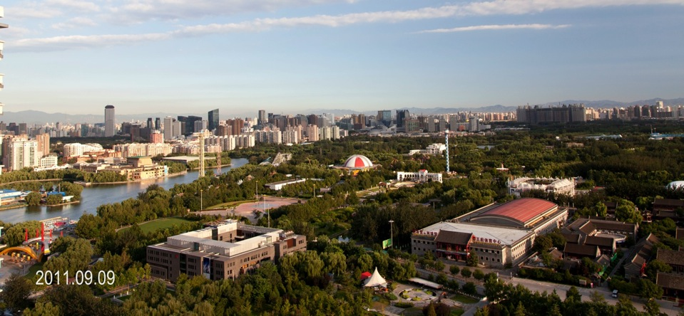
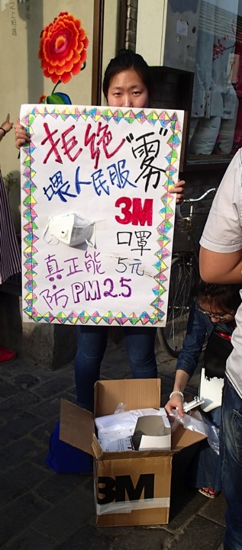
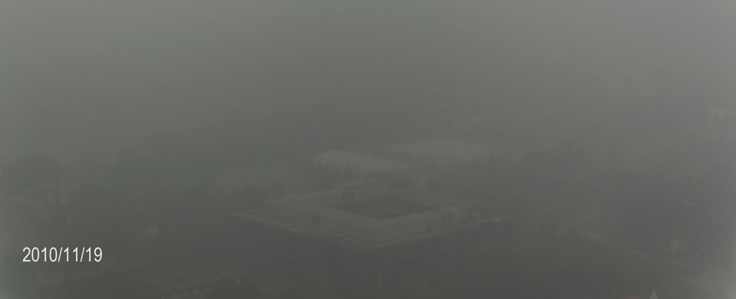
“Blue Sky Day”
“蓝天日”
PM2.5 > 750

Slide 12
CHINA’s ENVIRONMENTAL CRISIS 中国的环境危机
Development outpacing environmental protection efforts
发展步伐超越环境保护努力
New threats 新的威胁
Weak Environment & Development institutions 环境与发展机构不得力

Slide 13
TRANSFORMATIVE CHANGE 变革
“Ecologically Respectful Consumer & Conserver Society”
“尊重生态的消费者与保护型社会”
“Green Growth, Economy & Development” “绿色增长、经济与发展”
“New Path of Environmental Protection”
“环境保护新道路”

Slide 14
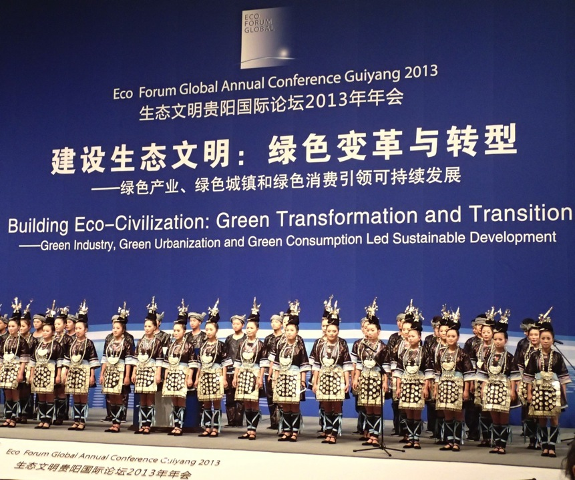
Needed: Long-term vision and strategy to guide national and local green development

Slide 15
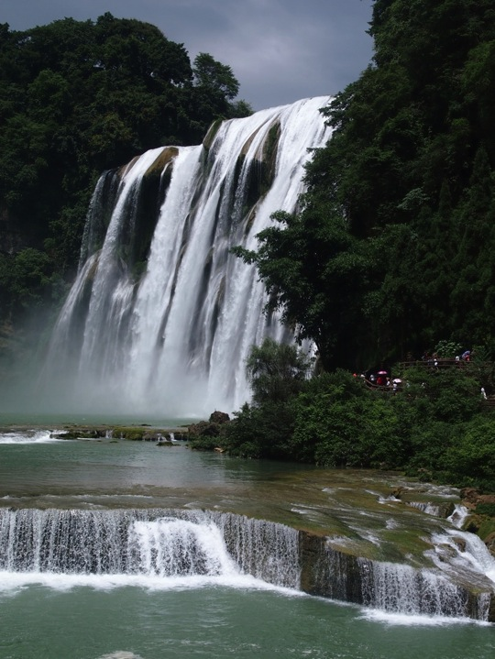
Guizhou
Province
贵州省
Pilot for Green Decisions
绿色决策示范

Slide 16
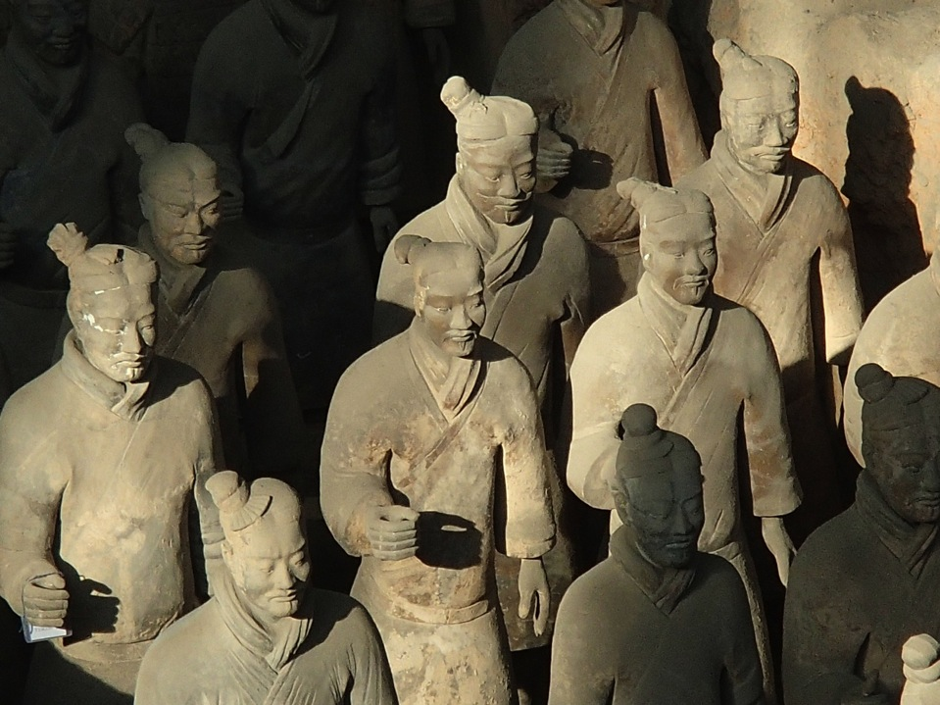
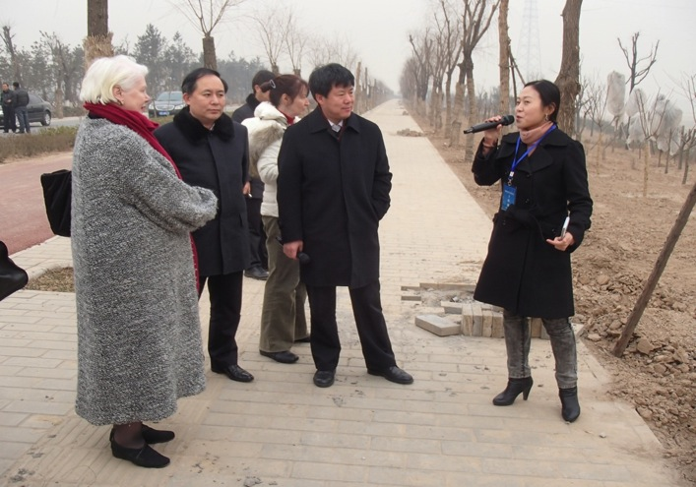
10 ISSUES 十大关注问题
TF Meeting Xi’an January 2013
2013年1月西安课题组会议

Slide 17
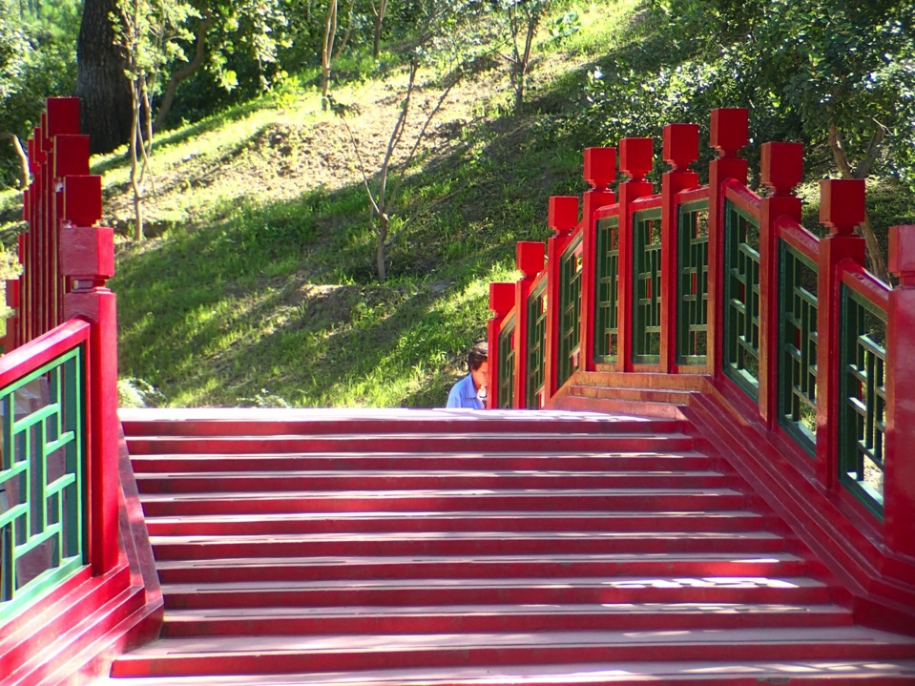
MANAGING GAPS 管理差距
Rising Expectations - ‘Wants and Needs’
提升的期待 － '欲望和需要’
Environmental Perception & Realities
对环境的感知和现实
Trust & Credibility
信任和信誉

Slide 18
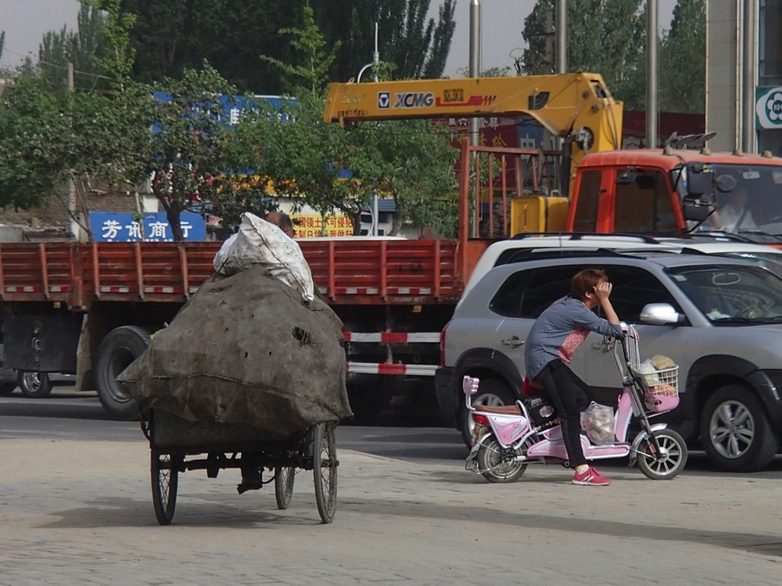
BALANCING VALUES 平衡价值观
Traditional Chinese values
传统中国价值观
Contemporary social values
现代社会价值观
International influences
国际影响

Slide 19
IMPROVED GOVERNANCE 改进了的管理
“Inclusive, Effective & Efficient”
“包容、有效及高效率”
“Environmental Crisis is a Crisis of Governance”
“环境危机是管理危机”
“Whole of Government Approach”
“政府全面行动”

Slide 20
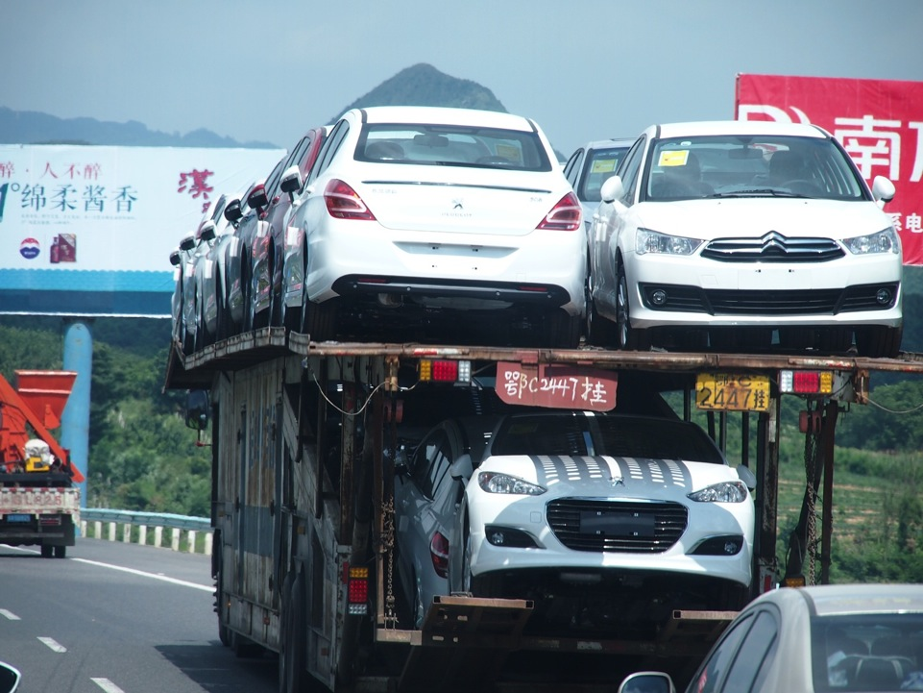
TRANSFORMATIVE CHANGE 变革
Social, economic & environmental links
社会、经济与环境间的联系
Confusing signals
混乱的信号

Slide 21
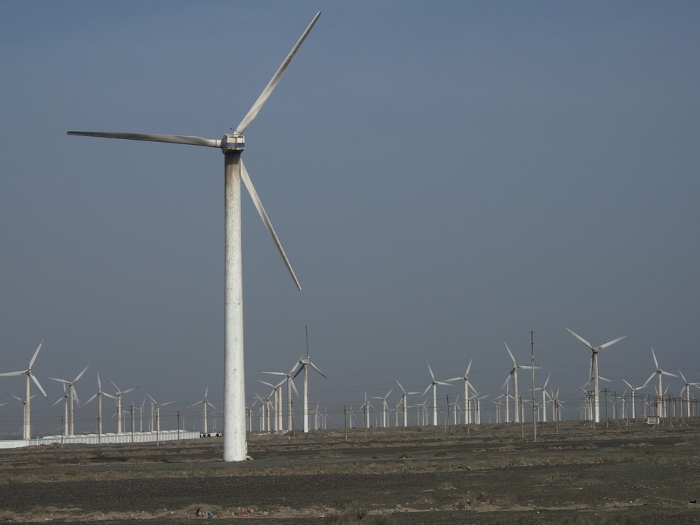
FISCAL/TAX REFORM 财政／税收改革
Solutions not possible without reform
没有改革就无法解决问题
Health, quality of life, ecological services
健康、生活质量、生态服务
Investment effectiveness
投资的效益

Slide 22
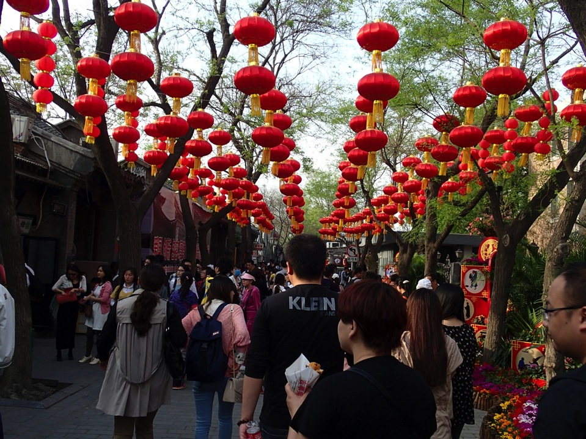
CHOICES & PARTICIPATION 选择和参与
Public Participation & Development Supervision by Public
公共参与和公共发展监督
Sustainable Consumption Choices
可持续消费选择

Slide 23
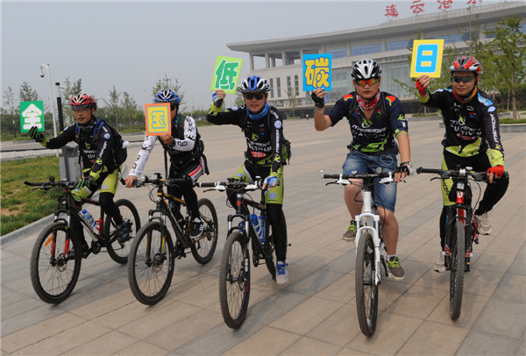
FIRST LOW CARBON DAY 17 June 2013
2013年6月17日，第一个低碳日
Lianyungang, Jiangsu 江苏连云港
http://usa.chinadaily.com.cn/china/attachement/jpg/site1/20130617/0023ae6cf3691329166708.jpg

Slide 24
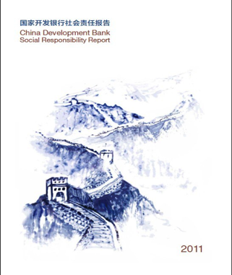
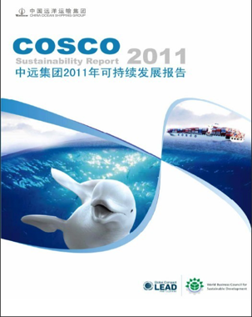
CSR & CER 企业社会责任与环境责任
Voluntary action too slow & weak gov’t action
自愿行动太慢、政府行动不力
http://www.csr-china.net

Slide 25
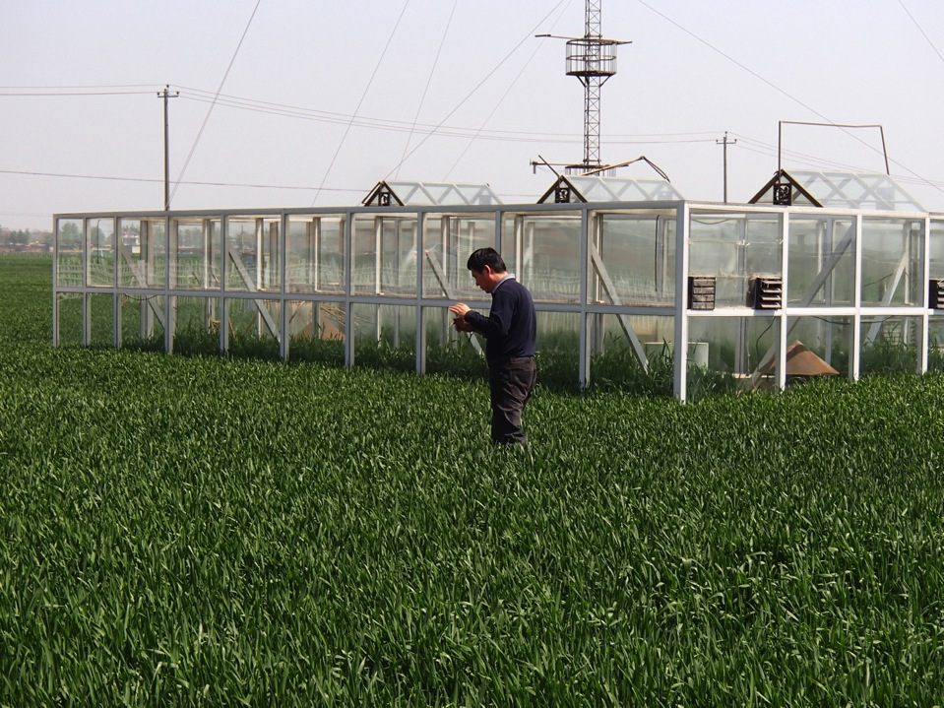
Agriculture Impacts 对农业的影响
Positive effects are possible (reforestation)
可能获得的积极成效（造林）
Negative impacts from crop & livestock production on soil, air & water
农作物和家畜生产对土壤、空气和水的消极影响
Water demand unsustainable
水需求不可持续
Out-migration social effects
外移人口的社会效应

Slide 26
‘NEW STYLE URBANIZATION’ ‘新型城镇化'
Need for compact urban design
需要密集型城镇设计
Green mobility strategy urgently needed
急需绿色出行战略
New quality of life demands
对生活质量的新要求
Ecological redlining; Low Carbon Cities
生态红线划定；低碳城市

Slide 27
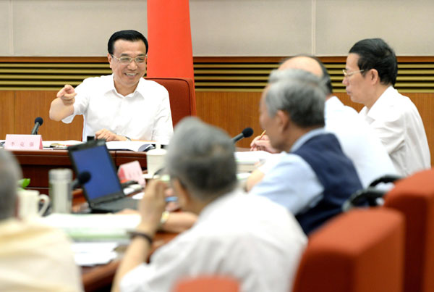
Xinhua 30 Aug 2013
“China will take an urbanization path that incorporates the ideas of green & efficient growth”
“中国将走绿色观念与高效增长相结合的城镇化道路”

Slide 28
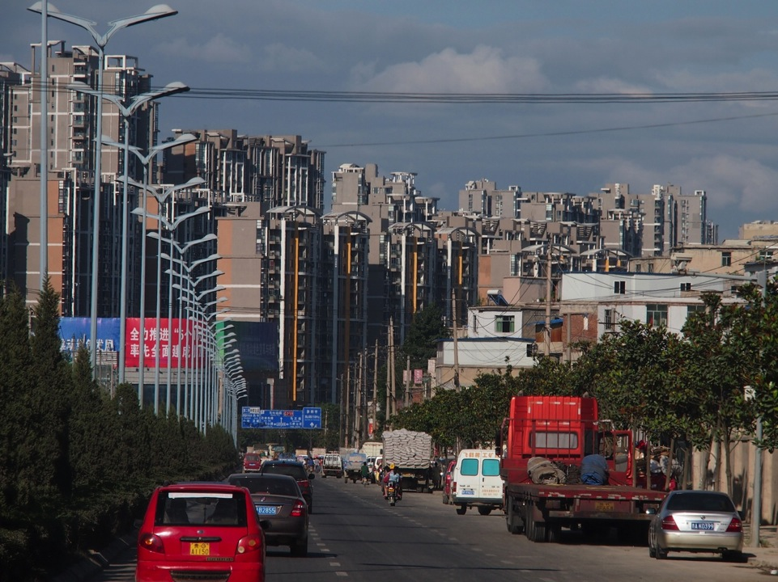

Slide 29
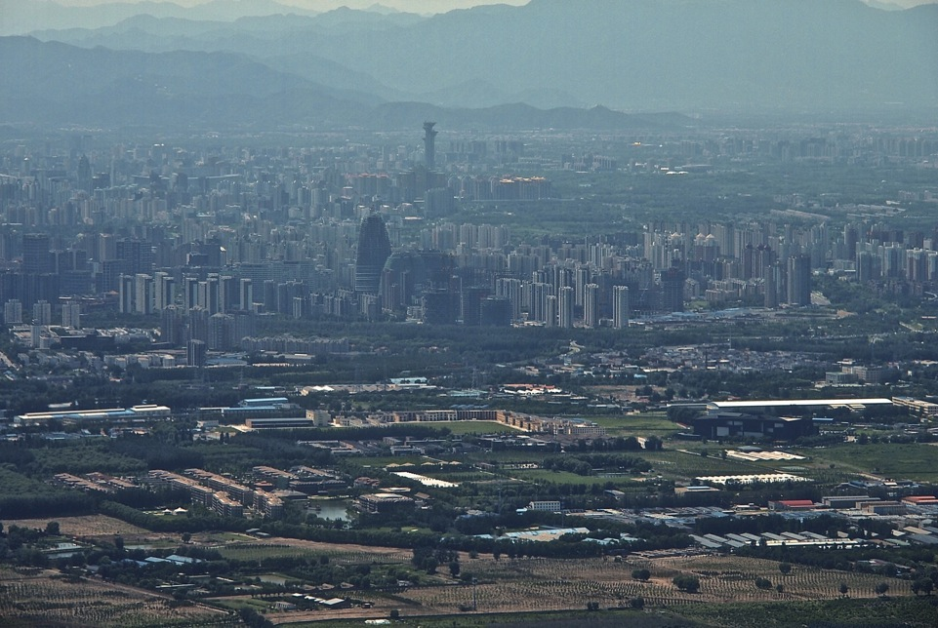
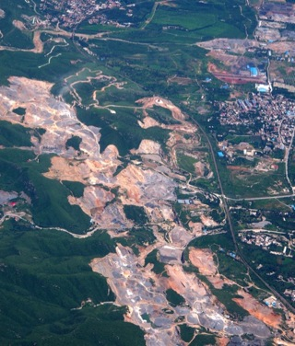
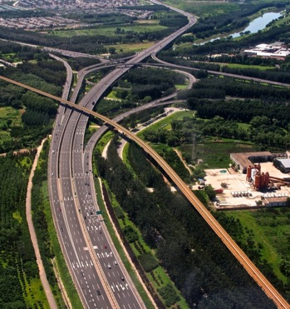
Ecological Redlining 划定生态红线

Slide 30
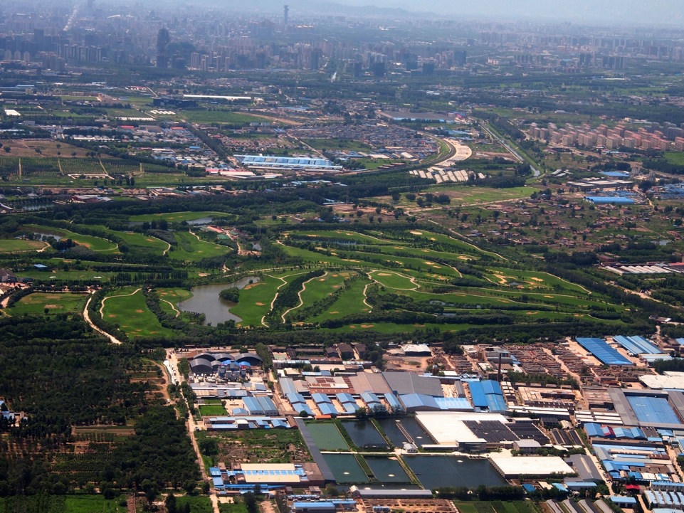

Slide 31
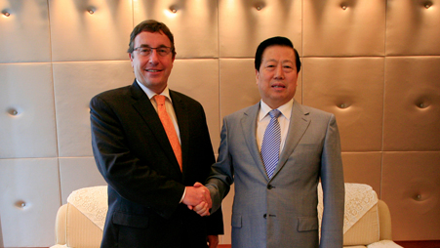
INT’L - CHINA ALIGNMENT 中国与国际接轨

Slide 32
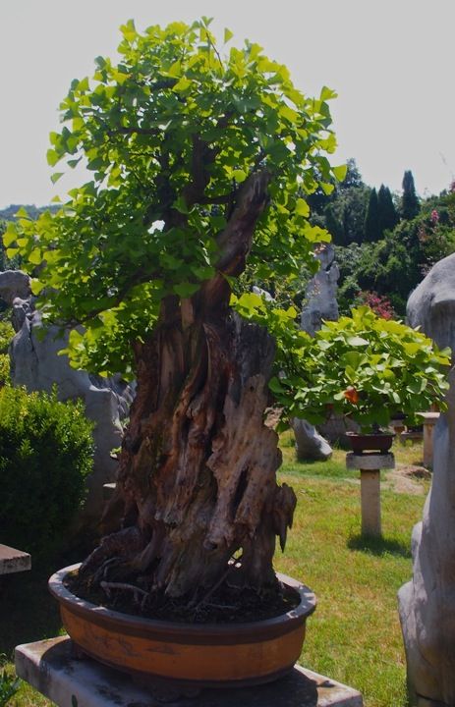
Thank You!
谢谢
All photos by Art Hanson, unless otherwise noted

