Slide 1
大气污染防治行动计划绩效评估与区域协调机制研究
Performance Evaluation on the Action Plan of Air Pollution Prevention and Control and Regional Coordination Mechanism
郝吉明 Jiming Hao¹⁾, 麦克·沃尔什 Michael P. Walsh²⁾
1) 清华大学 Tsinghua University
2) 国际清洁交通委员会 International Council on Clean Transportation
2014年12月1-3日, 北京 Dec 1-3, 2014, Beijing

Slide 2
汇报内容 Outline
项目背景和主要实施过程
Project Background and Implementation Process
《行动计划》绩效评估指标与方法体系研究
Study on Performance Evaluation Indicators and Methodology System for the Action Plan
“十三五”与2030年大气污染防治目标与路线图
Air Pollution Prevention and Control Targets and Roadmap for the 13th FYP and 2030 Long-term Plan
区域大气污染防治协调机制国际经验
Study on International Experiences of Coordination Mechanism for Regional Air Pollution Prevention and Control
区域大气污染防治协调机制与政策研究
Coordination Mechanism and Policy Study for Regional Air Pollution Prevention and Control
主要研究结论与政策建议
Major Research Conclusions and Policy Recommendations
Notes:
2

Slide 3
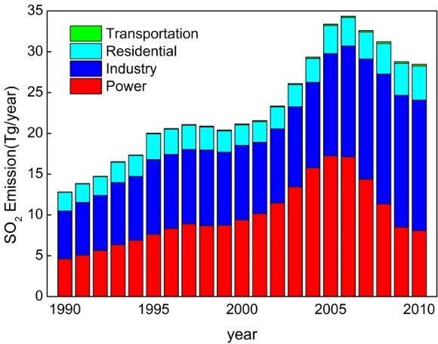
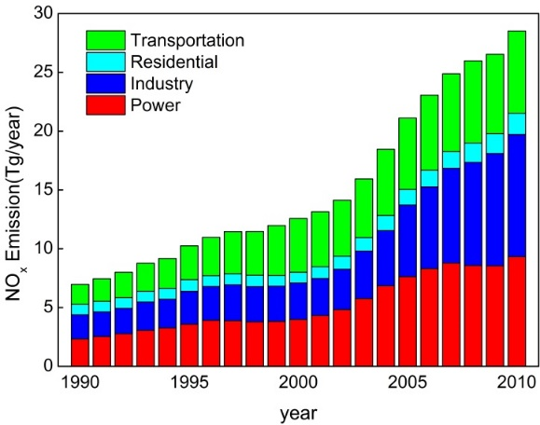
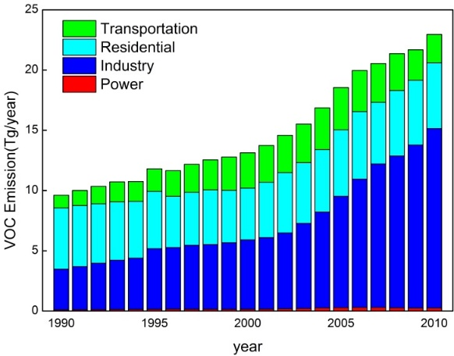
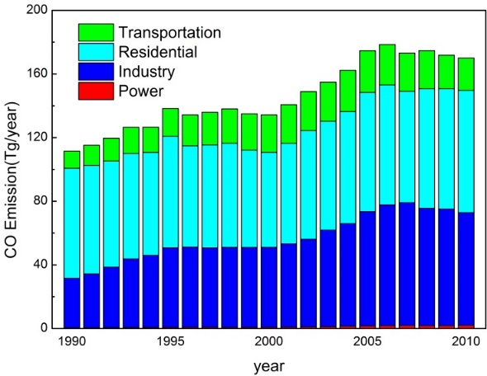
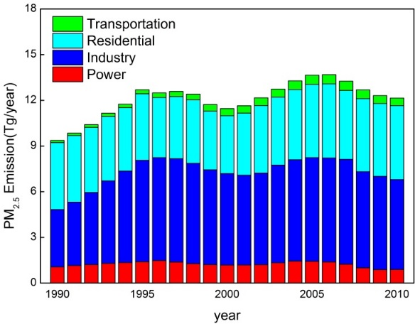
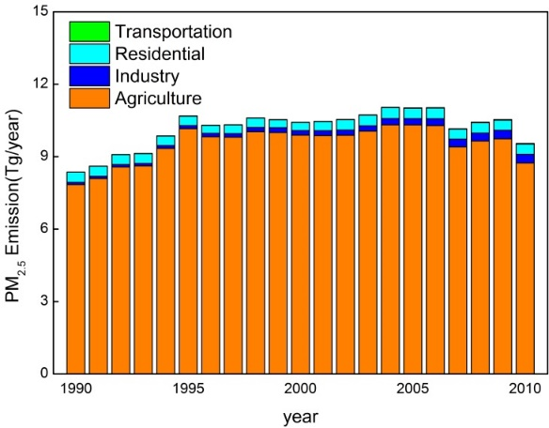
研究背景 Background
主要大气污染物排放量巨大 Huge emissions of major air pollutants
SO₂
NO_{x}
VOC
CO
PM_{2.5}
NH₃
我国主要大气污染物排放量迅速增长，都已升居世界第一
China becomes the world’s largest emitter of major pollutants.
2012年, 我国SO₂、NO_{X}等排放量与美国1990年排放水平相当，若削减至美国2009年排放水平，则分别削减60%、45%
The SO₂ and NO_{X} emissions of China in 2012 are comparable to the level of the U.S in 1990, a reduction by 60% and 45% respectively is needed to reach the U.S. level in 2009.

Slide 4
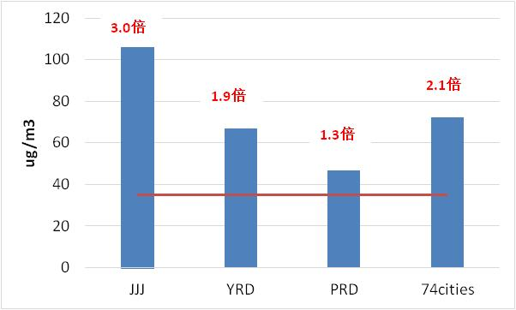
研究背景 Background
全国大气污染形势极为严峻: PM_{2.5}浓度距达标差距较大
A wide gap between PM_{2.5} concentration and the standard
首批开展PM_{2.5}监测的74个城市中，有71个不达标
71 cities out of 74 (started PM_{2.5} monitoring since 2013) fail to comply with the PM_{2.5} standard.
京津冀区域PM_{2.5}平均浓度为二级标准的3.0倍
Beijing-Tianjin-Hebei region (JJJ): 3 times the level of Grade-II standard
长三角区域PM_{2.5}平均浓度为二级标准的1.9倍
Yangtze River Delta region (YRD): 1.9 times the level of Grade-II standard
珠三角区域PM_{2.5}平均浓度为二级标准的1.3倍
Pearl River Delta region (PRD): 1.3 times the level of Grade-II standard
74个城市PM_{2.5}平均浓度为二级标准的2.1倍 74 cities: 2.1 times the level of Grade-II standard
2013年PM_{2.5}浓度超标情况
PM_{2.5} concentration in 2013
数据来源于中国环境监测总站
Source: China National Environmental Monitoring Center

Slide 5
党中央和新一届政府高度重视大气污染防治工作
High attention paid by the Party and the government to AP control
党的“十八大”提出建设生态文明和美丽中国的目标
Promote ecological progress and build a beautiful country, from Report to the 18th National Congress of the Communist Party of China
在第七次全国环保大会上对大气污染防治工作等提出明确要求
Requirements on air pollution control at the 7th National Conference on Environmental Protection
  进一步加强空气污染防治，修订并发布空气质量标准，抓紧做好增加PM_{2.5}监测指标的准备，鼓励各地根据污染特征、经济发展水平等分期实施，逐步与国际标准接轨。
  Strengthen air pollution control. Amend the new ambient air quality standard. Start to prepare PM2.5 monitoring. Integrate with international standard step by step based on local pollution characteristics and the level of economic development.

Slide 6
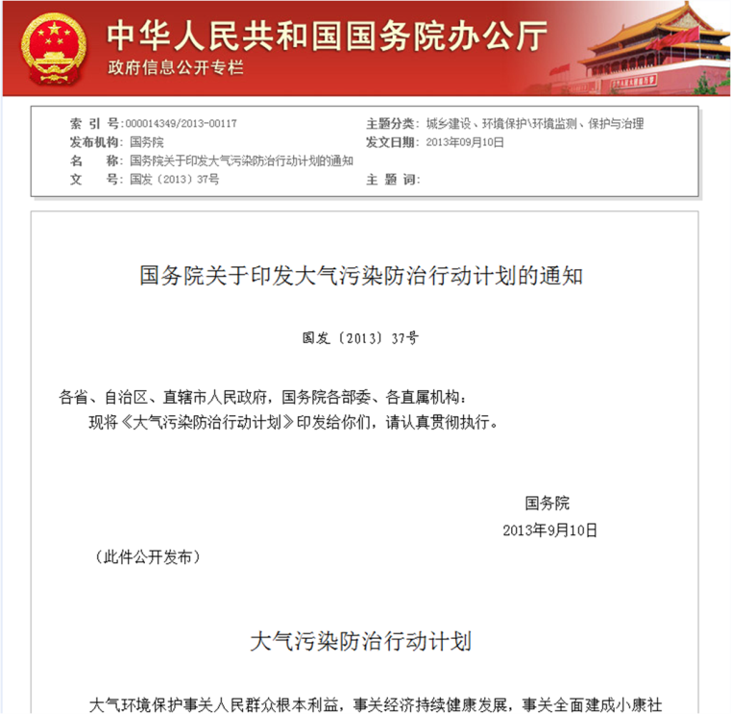
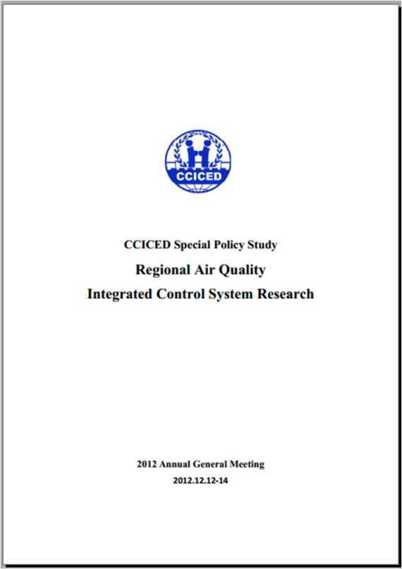
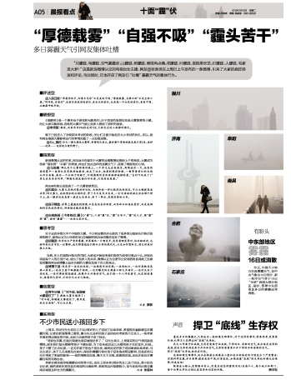
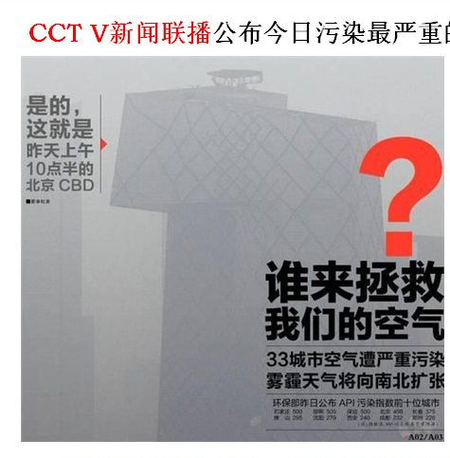
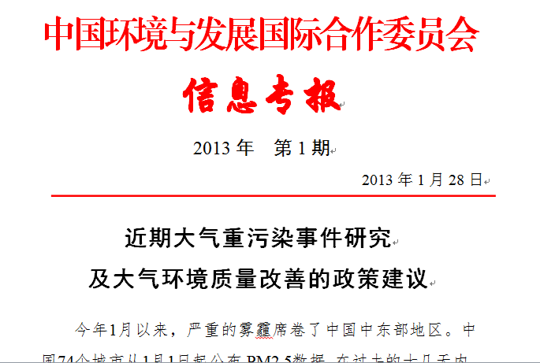
新一届政府制定行动计划，制定了严格的措施
Action Plan and stringent measures developed by the government
人民关注
Public concern
专家建议
Recommendations

Slide 7
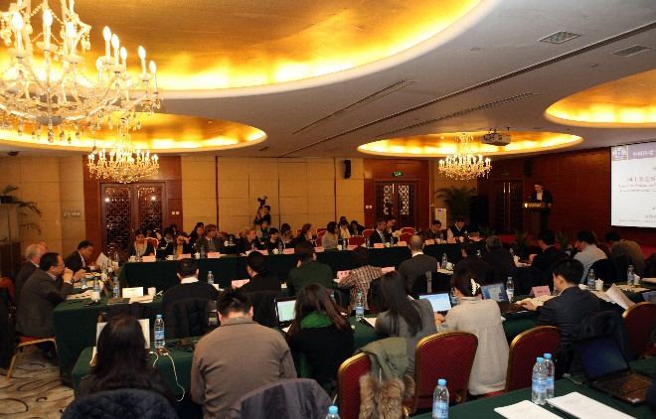
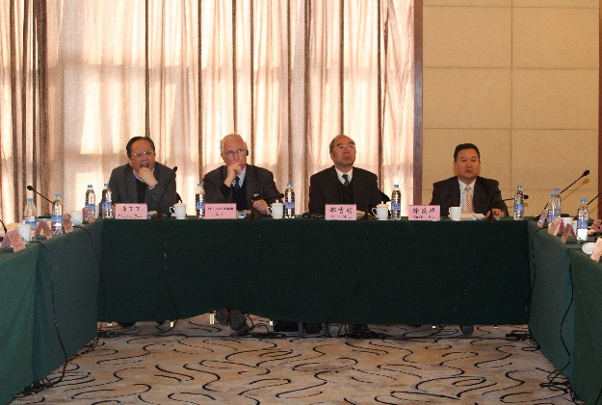
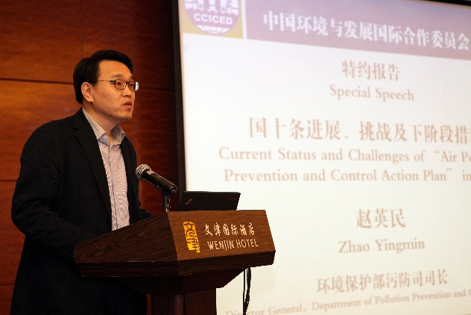
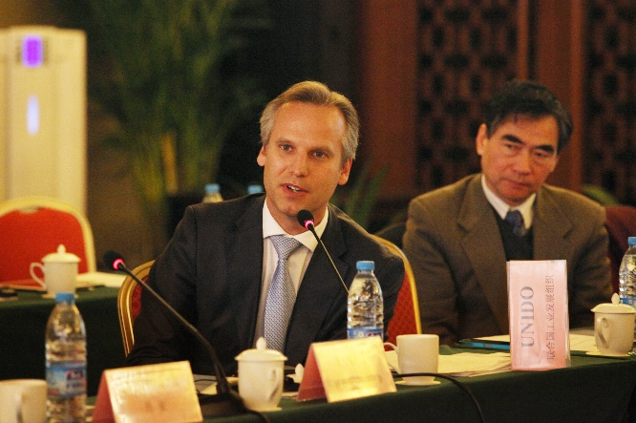
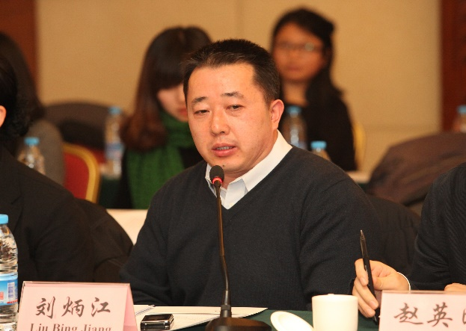
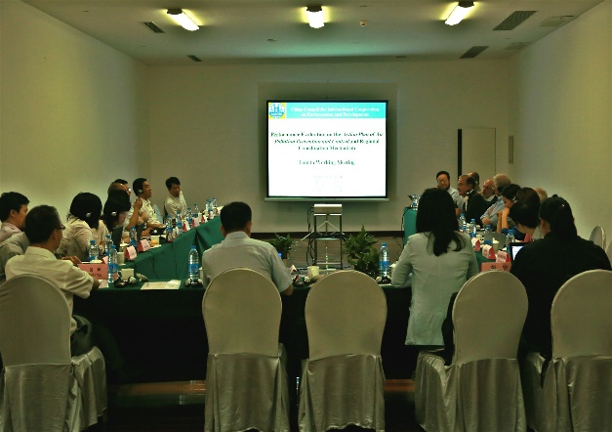
项目主要实施进程 Progress of the Project
2月项目启动会暨第一次工作会议 Feb, the kick-off/first working meeting in Beijing
5月项目第二次工作会议 May, the second working meeting in Beijing
7月项目第三次工作会议 Jul, the third working meeting in Washington DC
8月项目第四次工作会议 Aug, the fourth working meeting in Beijing
期间多次内部技术专家讨论会 Several internal project meetings in Beijing

Slide 8
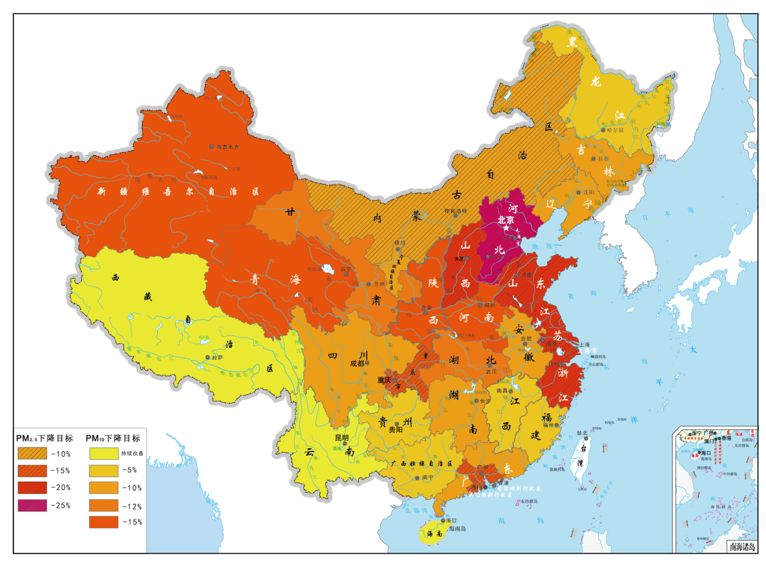
研究内容1）《行动计划》绩效评估指标与方法体系研究
1) Task 1: Study on Performance Evaluation Indicators and Methodology System for the Action Plan
以签订目标责任书的形式确定了2017年31个省空气质量改善目标
Letter of target signed on AP targets for 31 provinces
目标分档原则
Principles for classification
各地社会经济发展现状
Current social and economic development
结合当地空气质量现状
Current air quality
目标分档类型
Types for classification
重点与非重点地区
Key areas and non-key areas
PM_{2.5}四档；PM₁₀五档
4 levels for PM_{2.5} and 5 levels for PM₁₀
为了推动责任落实，需要建立有效的《行动计划》实施绩效评估指标与方法体系，以评估和帮助指导各地《行动计划》的实施。
Performance evaluation indicators and methodology system is required for the implementation of the Action Plan.

Slide 9
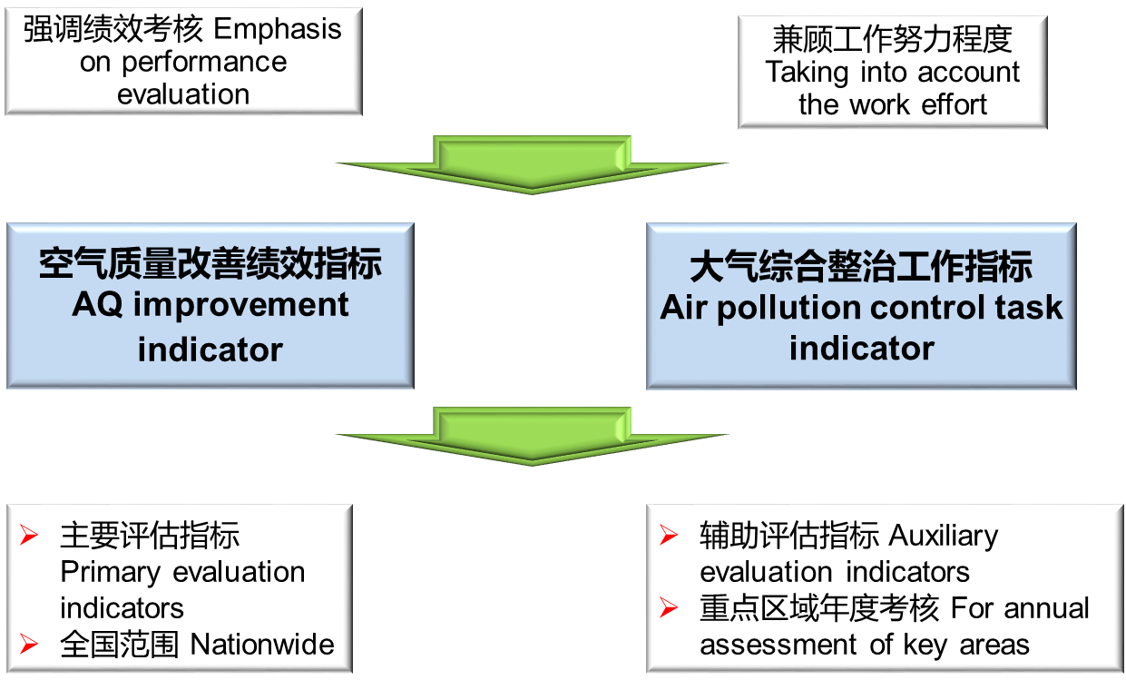
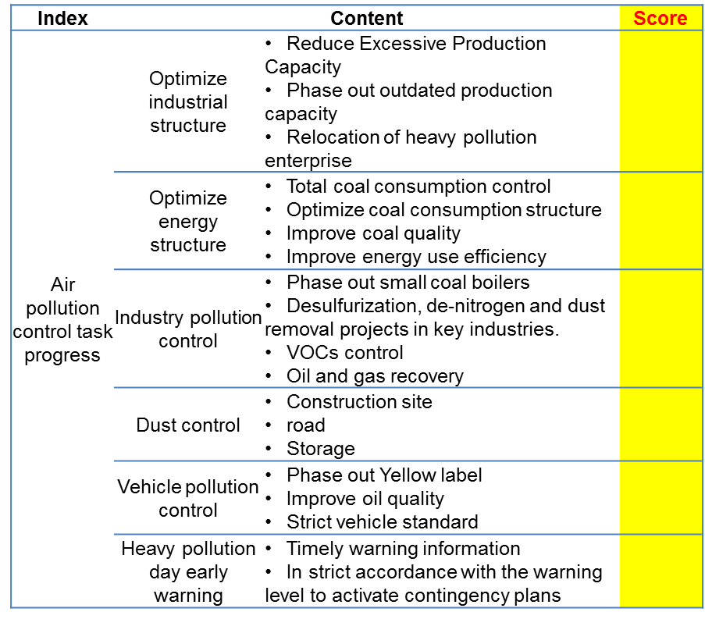
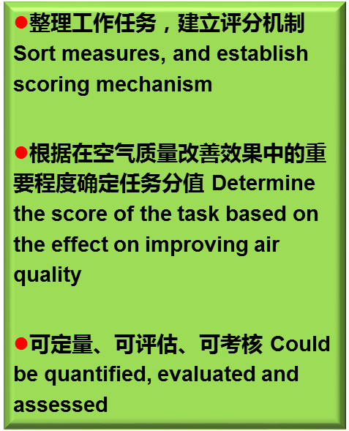
研究内容1）《行动计划》绩效评估指标与方法体系研究
1) Task 1: Study on Performance Evaluation Indicators and Methodology System for the Action Plan
《行动计划》的预评估 Pre-evaluation
《行动计划》措施
Measures
Emission reduction evaluation
AQ improvement effect evaluation by model
Strengthen or improvement recommendation
《行动计划》实施进展的追踪评估 Dynamic/Track evaluation/Post evaluation
AQ improvement evaluation
Progress of air pollution control
AQ reaches target?
Implement the air pollution control task?
Strengthen control measures
Recommendations on measures to implement
If not meeting the goal, why?
Air pollution control task indicators

Slide 10
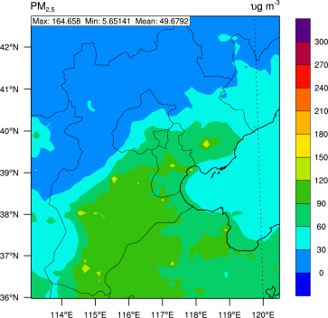
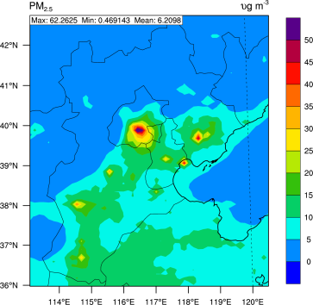
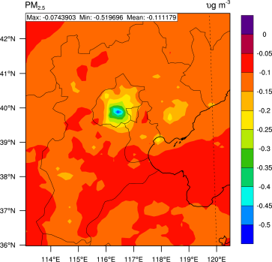
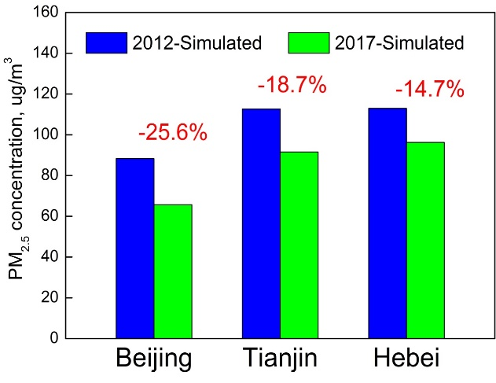
研究内容1）《行动计划》绩效评估指标与方法体系研究
1) Task 1: Study on Performance Evaluation Indicators and Methodology System for the Action Plan
京津冀预评估案例分析 A pre-evaluation of 2013-2017 Action Plan for Jing-Jin-Ji
模拟结果显示，现有能定量减排的政策措施落实后，北京PM2.5浓度降幅明显，但天津市和河北省仍存在达不到2017年浓度降低25%的风险。
Preliminary simulation results based on existing policies and measures which could be quantitatively analyzed show that the Beijing PM_{2.5} concentrations reduce significantly, but Tianjin and Hebei are at risk of failing to reach the target.
现在的资源、能力建设等基础尚不能支持政策措施全面落实到位，后续需进一步强化多源多污染物的协同控制力度。
The resources, capacity building and other infrastructure are not yet available to fully support the implementation of all measures, more stringent controls are necessary.
2017 2012 - 2017 (2017-2012) / 2012
Notes:
10

Slide 11
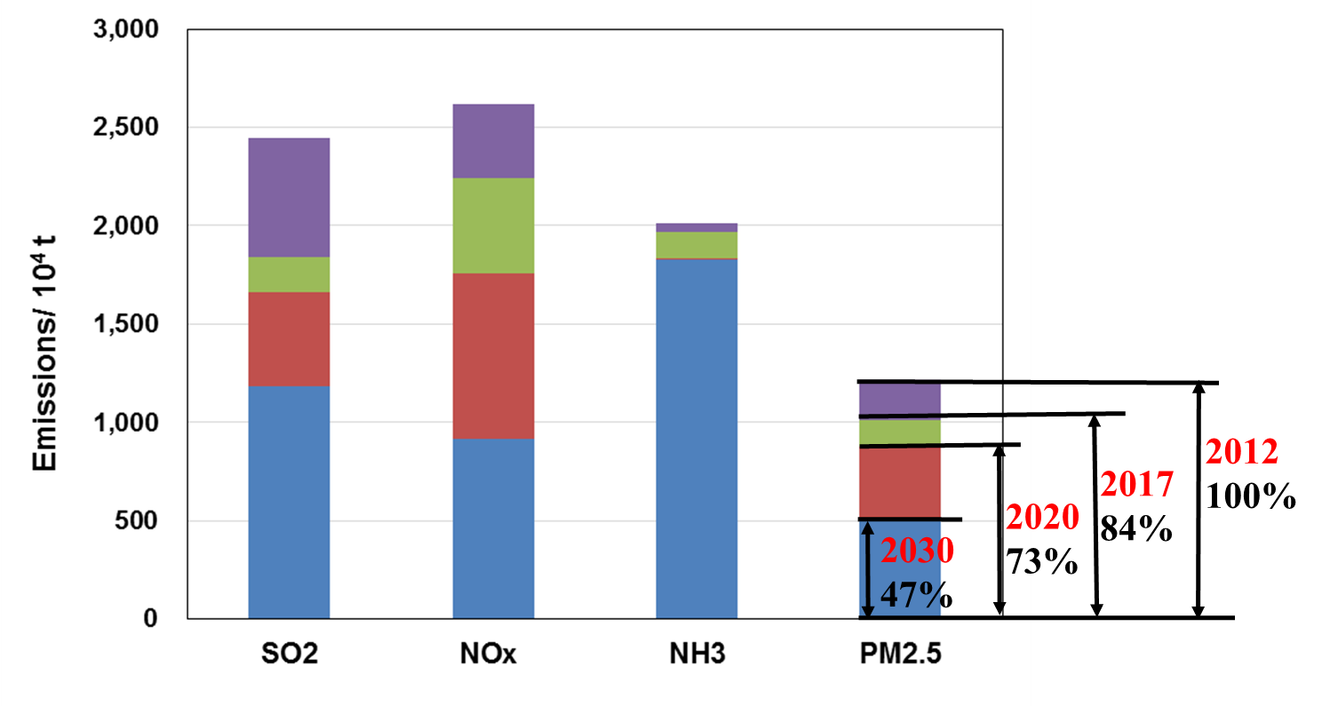
研究内容2）“十三五”与2030年大气污染防治目标与路线图
2) Task 2: Air Pollution Prevention and Control Roadmap for the 13th FYP and 2030 Long-term Plan
基于2030年空气质量达标的全国污染物排放量控制目标：以2012年为基准，2030年全国SO₂、NO_{X}、一次PM_{2.5}和VOCs排放量应分别削减52%、65%、57%和39%，NH₃排放量有所下降。
Emission reduction target in China: by 2030, the emissions of SO₂, NO_{X}, PM_{2.5} and VOCs in China should be reduced by 52%, 65%, 57%, and 39% compared with those of 2012. The emissions of NH₃ should decrease slightly.

Slide 12
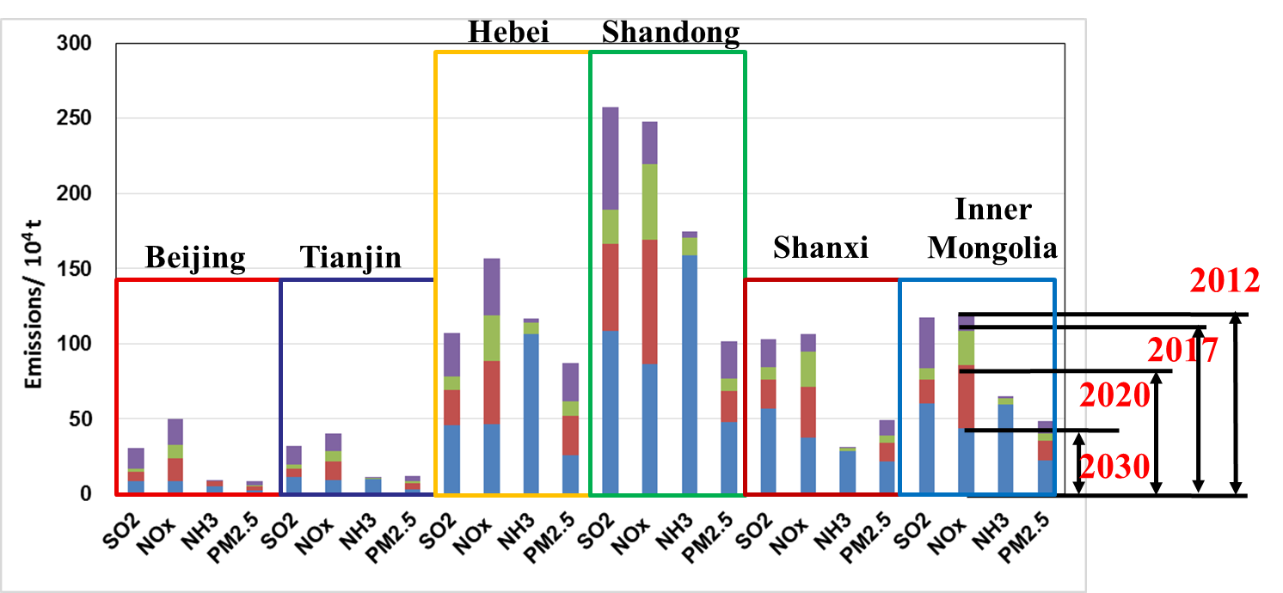
研究内容2）“十三五”与2030年大气污染防治目标与路线图
2) Task 2: Air Pollution Prevention and Control Roadmap for the 13th FYP and 2030 Long-term Plan
对于污染严重的重点区域，应采取更严格的控制力度：例如京津冀地区2030年SO₂、NO_{X}、PM_{2.5}、VOC和NH₃的排放量至少应分别削减59%、72%、70%、44%和21%，且周边山东等省需同步严格控制。
We should intensify emission control in heavily polluted areas. For example, SO₂, NO_{X}, PM_{2.5}, VOC and NH₃ emissions in the Beijing-Tianjin-Hebei Region in 2030 should be reduced by at least 59%, 72%, 70%, 44%, and 21% respectively.

Slide 13
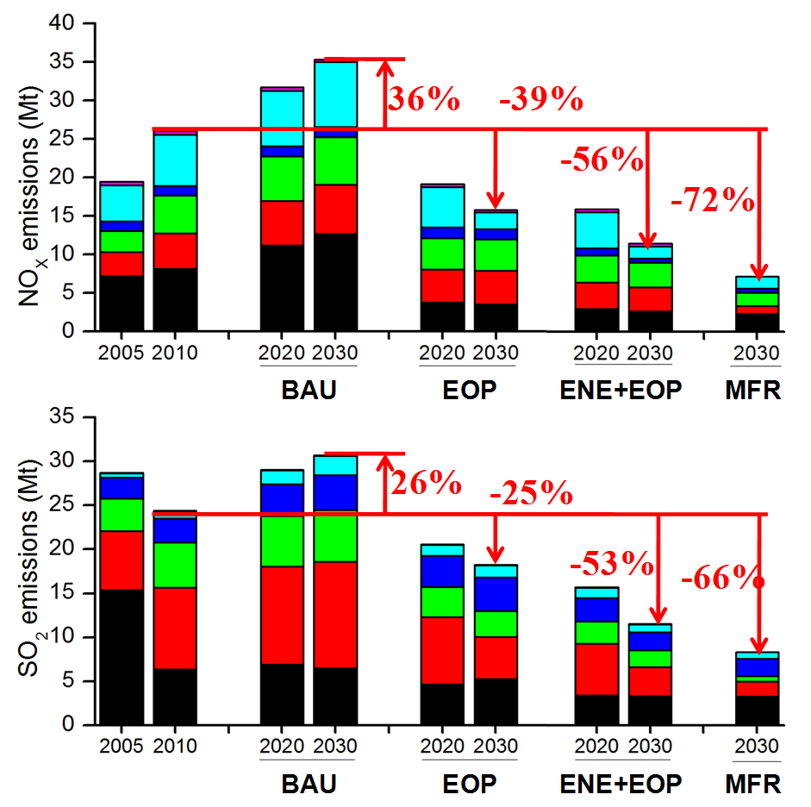
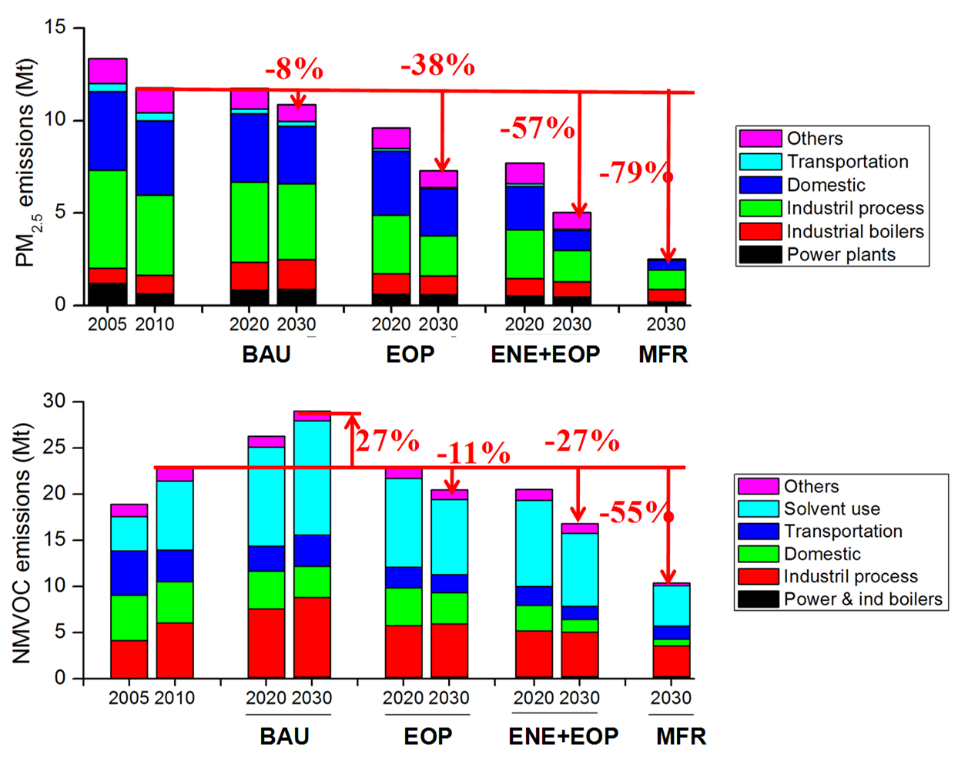
研究内容2）“十三五”与2030年大气污染防治目标与路线图
2) Task 2: Air Pollution Prevention and Control Roadmap for the 13th FYP and 2030 Long-term Plan
Emission Control
Pathways
要实现2030年空气质量达标需采取非常严格的控制情景 Either ENE+EOP or MFR scenario need to be adopted to achieve the air quality target by 2030 in China.
1) Business as usual, 趋势照常情景 (BAU); 2) End-of-pipe control, 末端治理情景 (EOP)
3) Alternative energy policy + End of pipe control, 可持续能源+末端治理情景 (ENE+EOP)
4) Maximum Feasible Reduction, 最大减排潜力情景 (MFR)

Slide 14
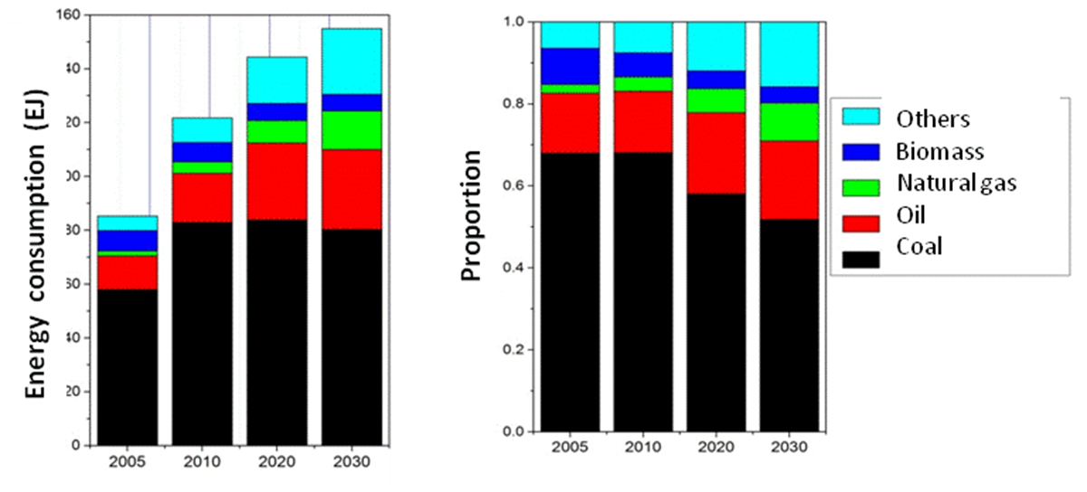
研究内容2）“十三五”与2030年大气污染防治目标与路线图
2) Task 2: Air Pollution Prevention and Control Roadmap for the 13th FYP and 2030 Long-term Plan
煤炭清洁高效可持续利用 Clean, efficient and sustainable use of coal
  煤炭优先用于电厂等大型燃烧设备，推进小型燃煤锅炉和炉灶的淘汰，推广集中供热
  着力提高煤炭利用效率：燃煤电厂的平均热效率由2010年的36%提高到2030年的42%；工业锅炉、炼铁高炉、水泥生产、炼焦炉和砖瓦窑单位产品的能耗从2010年到2030年分别降低24%、13%、16%、44%和27%
加速能源结构调整，提升清洁能源比例 Speed up the adjustment of energy structure; increase the use of clean energy
  到2030年，全国煤炭占能源消费比例不超过50%
  2030年天然气、核能、可再生能源（不包括生物质）占比应达到25%
强化多源、多污染物的协同控制 Strengthen the coordinated control on multi-sources and multi-pollutants
Notes:
14

Slide 15
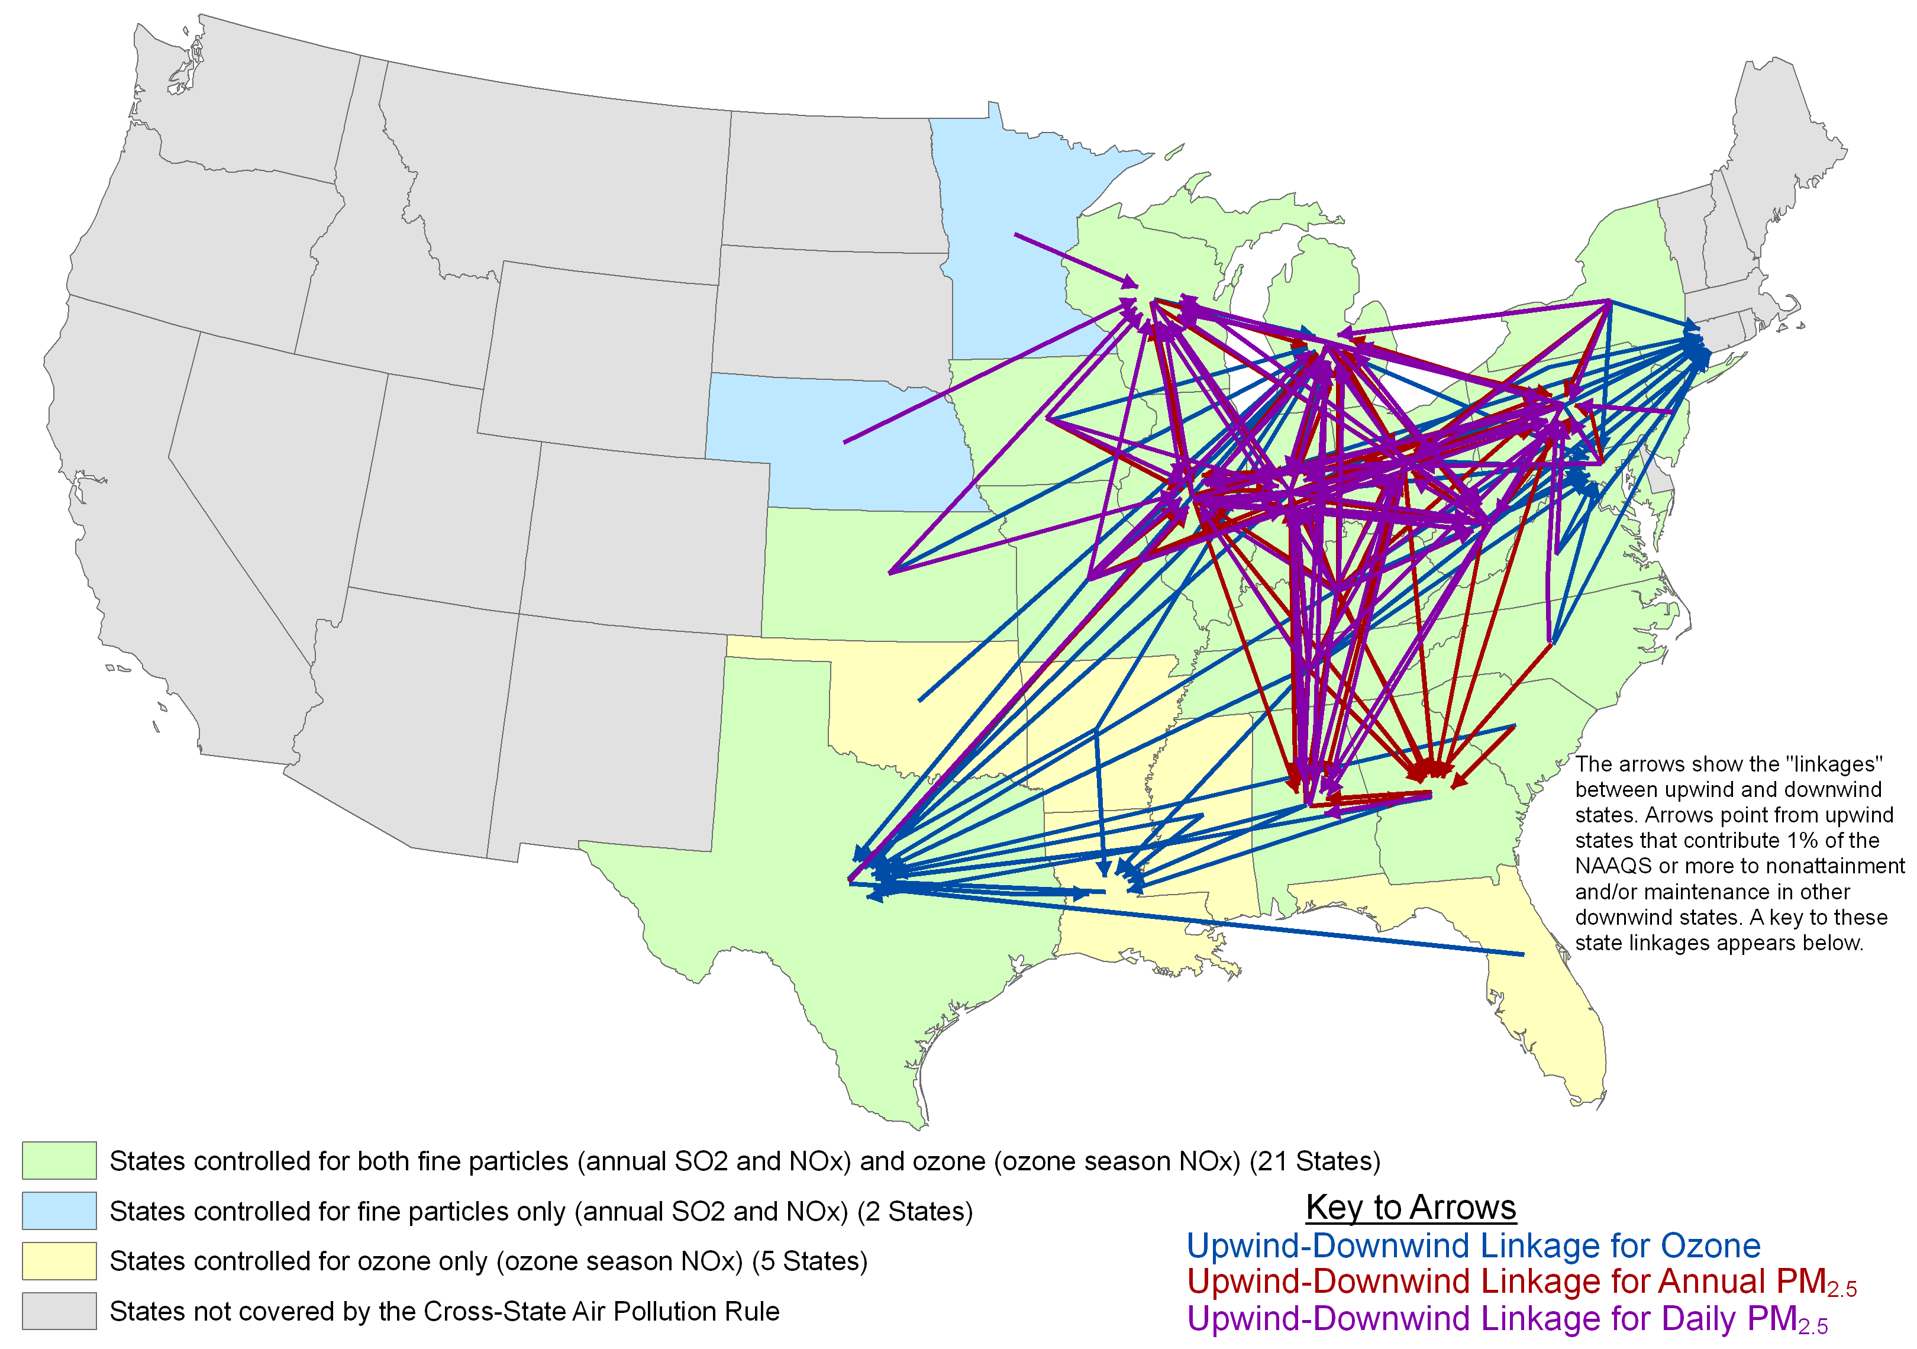
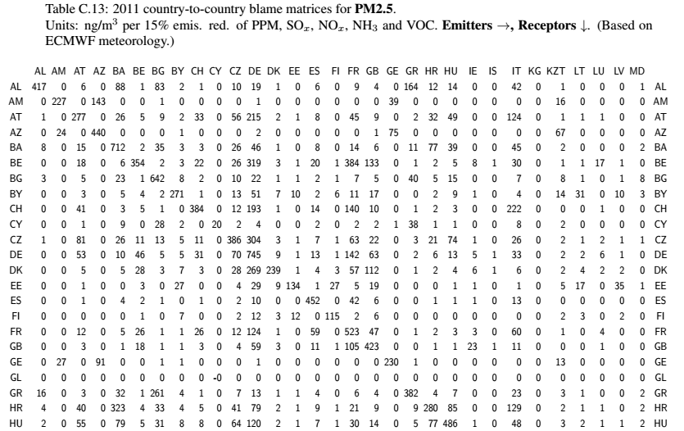
研究内容3）区域大气污染防治协调机制国际经验
3) Task 3: International Experiences of Coordination Mechanism for Regional Air Pollution Prevention and Control
区域空气质量管理的国际经验 Regional air quality management
Source: USEPA
美国建立区域性的规划机构（RPO）协调区域大气污染防控 EPA and states and other stakeholders created regional planning organizations to foster regional coordination and cooperation.
Source: EMEP, 2013
欧洲1979年签署“长距离越境空气污染公约”，减排政策的制定建立在定量化跨界输送分析基础之上。
CLRTAP, emission reduction policy built on the basis of quantitative analysis of cross-border transport.
Establish emission tracking systems
Improve regional modelling capabilities
Build capacity for air quality management
Notes:
15

Slide 16
研究内容3）区域大气污染防治协调机制国际经验
3) Task 3: International Experiences of Coordination Mechanism for Regional Air Pollution Prevention and Control
中国应实施强有力的区域协调计划，确保空气污染地区内所有相关方进行密切协调 China should adopt a strong regional program to assure close coordination by all parties whose emissions contribute to the air quality in a given air shed
  Facilitate coordination and cooperation among provincial and municipal air and energy officials.
  Build capacity through training, and sharing experiences and lessons.
  Bring consistency to emission data, monitoring networks and methods, and modeling analysis.
  Leverage resources.
为实现最佳的减排成本效益，欧美采用了多部门协同控制方法，中国也应该采用这种方法 Integrated multi-sectorial policy approaches have been used to cost-effectively reduce emissions in Europe and the US and should be used in China - SO₂, NO_{X}, PM and VOCs emissions should be reduced through: (i) energy efficiency improvements (decoupling between GDP and energy consumption), (ii) changes in fuel input, i.e., substitution of coal by cleaner fuels, and (iii) dedicated end-of-pipe emission control measures, with strict enforcement mechanisms.
  Stationary sources: Minimum performance standards based on the best available emission control technologies which are not excessively costly, should be required for all new major sources and any major sources undergoing significant modification or relocation. In polluted areas, local authorities should be authorized to impose even stricter standards.
Notes:
16

Slide 17
研究内容3）区域大气污染防治协调机制国际经验
3) Task 3: International Experiences of Coordination Mechanism for Regional Air Pollution Prevention and Control
  Mobile sources: While local vehicle emission standards can accelerate early progress, motor vehicles especially commercial vehicles travel across political boundaries; therefore, national vehicle emission requirements should be sufficiently stringent to address the most serious air pollution problems.
  Mobile sources: Once fuel of sufficient quality is available, the most stringent feasible vehicle standards have been found to be very cost effective in Europe and the US and should be adopted in China. Economic incentives, such as emission-dependent vehicle taxes and motorway charging schemes, should be used to promote faster modernization of the vehicle fleet or retrofit with exhaust gas treatment systems, like diesel particulate filters.
中国应花大力气建立强有力的措施实施保障计划 China should focus on building a strong and effective compliance program
  The effectiveness of the policies and control measures adopted by China is ultimately dependent on a well-funded and staffed compliance program.
Notes:
17

Slide 18
研究内容3）区域大气污染防治协调机制国际经验
3) Task 3: International Experiences of Coordination Mechanism for Regional Air Pollution Prevention and Control
中国清洁空气计划的关键：制定能够充分保障公众健康的合理空气质量标准，建立能够准确评估措施实施的监测网络 Setting appropriate air quality standards that will adequately protect public health and implementing a monitoring network that accurately assesses compliance with those standards should be the backbone of China’s Clean Air Program
  Ambient air pollution data quality should be ensured through carefully designed and operated data quality assurance and quality control (QA/QC) procedures.
  Ambient monitoring networks should be designed to enable the apportioning of the contributions from local sources, urban conurbations, and regional pollution sources.
中国的当务之急：制定污染控制有效性评估方案，量化空气质量改善进展 A process for measuring the effectiveness of control measures and determining progress in improving air quality should be a priority for China
  The evaluation of annual air quality changes should be adjusted for inter-annual differences in meteorological and other conditions.
  Measuring annual improvement in air quality is strongly linked with quality/accuracy of the monitored data, and the needed capacity for QA/QC procedures.
中国应强调大气污染物减排对改善气候变化的协同效益 China should highlight the climate change co-benefits of the air pollution control effort
  China’s air pollution control effort will reduce coal consumption, increase the use of renewable fuels, improve vehicle efficiency, etc.; each of these air pollution control steps will reduce CO2 emissions as a co-benefit.
  Extremely important to highlight the climate benefits of the clean air strategy and the win-win nature of the effort
Notes:
18

Slide 19
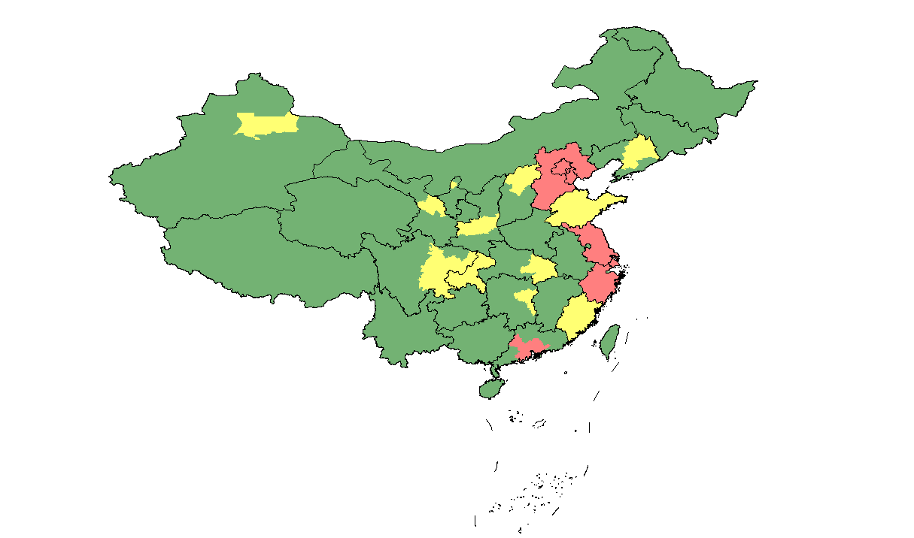
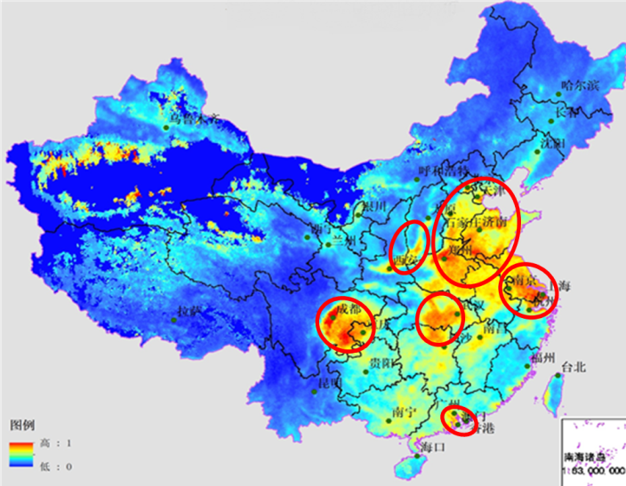
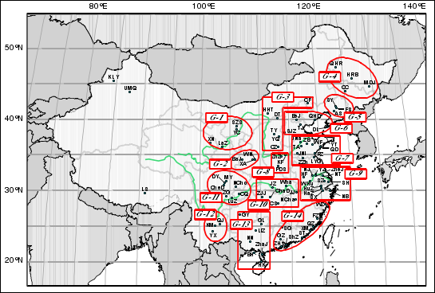
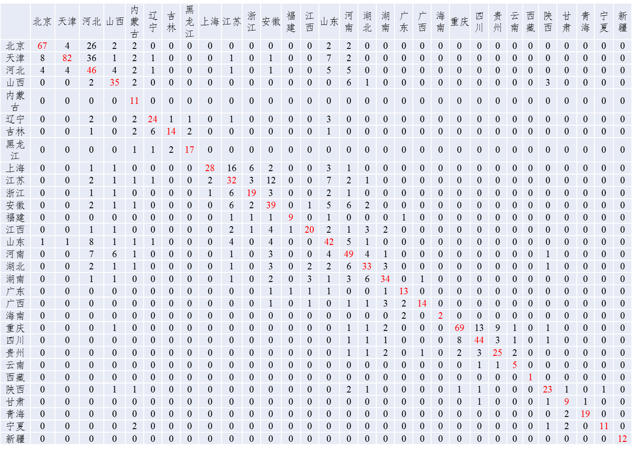
研究内容4）区域大气污染防治协调机制与政策研究
4) Task 4: Coordination Mechanism and Policy Study for Regional Air Pollution Prevention and Control
传统分区：行政、经济、人口、污染物排放
Traditional management zone: Territorial, Economic, Population, Emission
基于卫星遥感的分区：大气污染特征相似性 Satellite management zone: Similarity of air pollution
传统分区未考虑污染传输规律，缺乏对污染特征的系统分析，因此不够全面。
1) Conventional air pollution control and management in China lacks consideration of air pollution transport and a systematic analysis of air pollution.
2) In the future, regions should be scientifically grouped based on quantitative research based on satellites, ambient monitors and air quality models to enhance air quality management.
基于地面监测的分区：大气污染累积过程的
同步性 Monitoring date management zone: synchronization of cumulative process of urban air pollution
基于模型模拟的分区：地区间大气污染传输
规律 Modeling management zone: regional air pollution transfer menchanism
Notes:
19

Slide 20
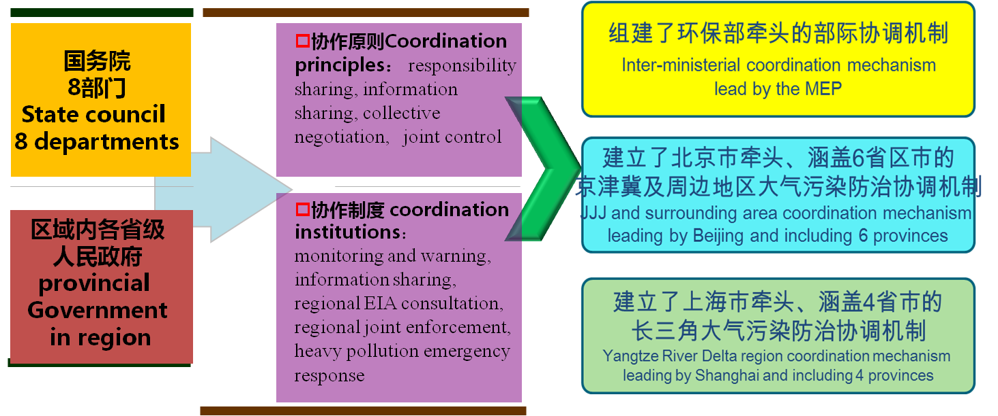
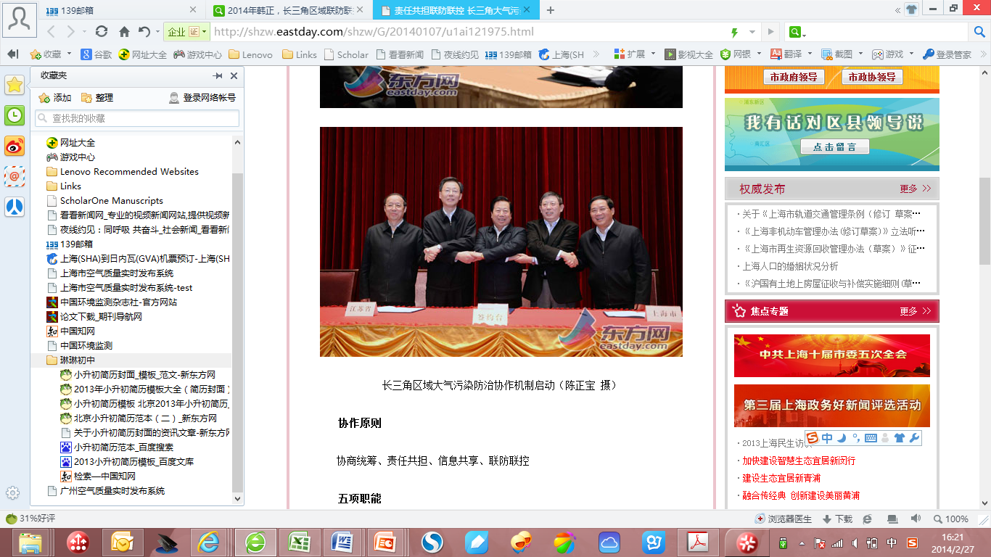
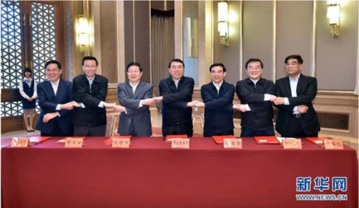
研究内容4）区域大气污染防治协调机制与政策研究
4) Task 4: Coordination Mechanism and Policy Study for Regional Air Pollution Prevention and Control
对全国、京津冀及周边地区、长三角区域大气污染防治协调机制进行了系统评估
Assess the coordination mechanism in national, and Jing-Jin-Ji/Yangtze River Delta regions.
The 2th coordinated meeting in JJJ and surrounding area
The 1st coordinated meeting in YRD region
Notes:
20

Slide 21
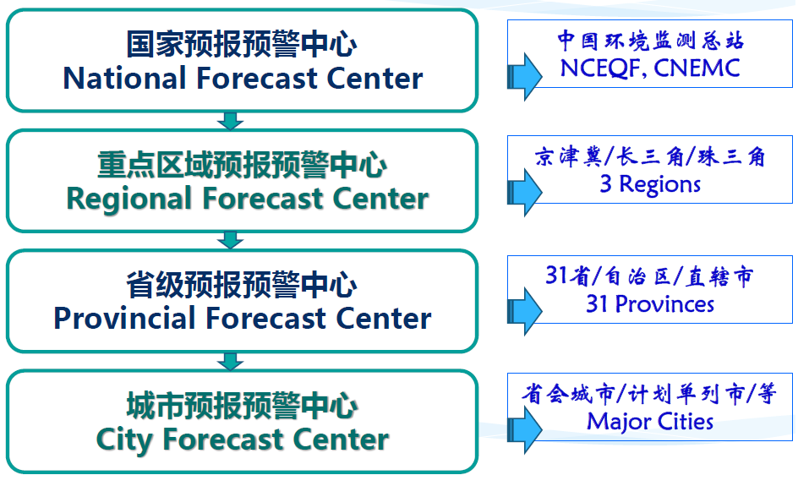
研究内容4）区域大气污染防治协调机制与政策研究
4) Task 4: Coordination Mechanism and Policy Study for Regional Air Pollution Prevention and Control
现有区域协作偏重于重污染天气的预警与应急联动，而在规划、控制目标和要求、常态化监督管理和联合执法机制的统一建设方面相对缺乏，环境信息共享覆盖面和深度远不能满足区域大气污染防治的要求。
1) The regional coordination mechanism is limited, focused primarily on heavy pollution weather alerts and joint emergency responses.
2) The regions lack unified plans, objectives, control requirements, supervision and administration. As to environmental information sharing, significant progress is needed to meet the requirements for regional air pollution prevention and control.
National Air Quality Forecasting and Warning System
Notes:
21

Slide 22
主要研究结论 Major Research Conclusions (1)
一、全国大气污染形势严峻，亟需建立完善的控制绩效评估体系
A Thorough Appraisal System is Needed for Air Pollution Plans
1) 以细颗粒物（PM2.5）为主要特征污染物的区域性大气环境问题日益突出。
Regional atmospheric problems, including PM2.5, which is becoming increasingly prominent.
2) 在《大气污染防治行动计划》指导下，亟需建立完善的控制绩效评估体系来科学评估各项措施实施带来的环境、社会和经济效益。
It is imperative to also establish a thorough performance appraisal system for scientific evaluation of the environmental, social and economic benefits generated by the pollution prevention and control measures.
3) 实施“大气十条”后京津冀地区PM2.5浓度降幅显著，但天津市和河北省仍存在达不到2017年浓度降低25%的风险，后续需进一步强化多源多污染物的协同控制力度。
According to the pre-implementation analysis of the Beijing-Tianjin-Hebei Region action plan, PM2.5 concentrations are expected to drop significantly. However, Tianjin and Hebei may not reach the 25% PM2.5 concentration reduction target by the year 2017. Resources and capacity for comprehensive implementation of the policy measures must be enhanced.
Notes:
22

Slide 23
主要研究结论 Major Research Conclusions (2)
二、未来中国实现空气质量达标的多污染物协同减排压力巨大
China Faces Great Challenges to Reduce Emissions and Meet the Air Quality Standard
1) 以实现2030年重点城市空气质量达标为目标的减排压力巨大：以2012年为基准，2030年全国SO₂、NO_{X}、PM_{2.5}和VOC排放量应分别至少削减52%、65%、57%和39%，NH₃排放量略有下降。对于污染严重的重点区域，还应采取更严格的控制力度。
Air quality in key cities should achieve the ambient air quality standard for PM_{2.5} by 2030. On the basis of 2012 emissions, SO₂, NO_{X}, PM_{2.5} and VOC emissions nationwide should be reduced by at least 52%, 65%, 57%, and 39%, respectively, by 2030, and NH₃ should decrease slightly. We should intensify emission control in heavily polluted areas.
2) 亟需开展多污染物、多污染源和多区域的协同控制，采用调整能源结构、提高能源效率、加强末端治理等全过程的控制措施。
China should carry out coordinated control efforts for multiple pollutants and emission sources in different regions, adopting control measures that can complement the process of adjusting the energy structure, improving energy efficiency and enhancing end-of-pipe pollution control, etc.
China’s Air Pollution Problem Will Require Years to Solve！
Notes:
23

Slide 24
主要研究结论 Major Research Conclusions (3)
三、国际经验可为我国区域大气污染防治协调机制提供重要的参考
International Experience is an Important Reference for Regional Air Pollution Control and Coordination
1) 欧洲和美国要求地方和州/国家有关当局在规定的时间框架内达到环境空气质量标准，并提供减少排放和降低污染的综合策略，同时建立综合和信息公开的空气质量监测网。
Europe and the US demand that the relevant local and state/national authorities achieve air quality standards within specified time frames.
The European Air Quality Plans and the American State Implementation Plans outline comprehensive strategies for emission reductions and air quality improvements.
Comprehensive air quality monitoring networks are used to evaluate progress toward meeting ambient air quality standards, and ensure transparency of relevant environment monitoring information.
2) 为协调区域大气污染防治，欧洲和美国均建立了完善的区域空气质量管理机制。
Both Europe and the US have established integrated management mechanisms for regional air quality to coordinate regional air pollution prevention across states/nations (e.g., CLRTAP, RPO).
Notes:
24

Slide 25
主要研究结论 Major Research Conclusions (4)
四、中国区域协调机制较为松散，统一的规划、目标和管理较缺乏
China Lacks Strong Regional Coordination Institutions and Unified Plans, Objectives and Management
1) 传统的大气污染控制管理分区对大气污染传输规律考虑不够，缺乏对大气污染特征的系统分析。
Conventional air pollution control and management lacks consideration of air pollution transport and a systematic analysis of air pollution.
2) 以主要污染物总量减排为主的考核方式导致地方政府在一定程度上忽视了辖区空气质量改善，区域和城市缺乏统一的空气质量目标。
Because the performance appraisal focuses on total emission control of SO₂ and NO_{X}, local governments have, to some extent, not focused on air quality improvements. A lack of unified air quality objectives and lack of coordination among cities and provinces have hindered regional air quality improvements.
3) 现有区域协调机制较为松散，区域协作多停留在重污染天气的预警与应急联动
The regional coordination mechanism is limited, focused primarily on heavy pollution weather alerts and joint emergency responses.
The regions lack unified plans, objectives, control requirements, supervision and administration, as well as environmental information sharing.
Notes:
25

Slide 26
主要政策建议 Major Policy Recommendations (1)
一、建立基于质量改善的大气污染控制管理模式
Building an Air-Quality-Oriented Air Pollution Management System
提高空气质量达标的法律地位：应在《大气污染防治法》中明确规定实施以空气质量达标为核心的大气环境保护目标责任制和考核评价制度。
Improve the Legal Status of Standard Air Quality: The Atmospheric Pollution Prevention Law should explicitly state that provincial and local governments must implement and enforce atmospheric protection programs based on air quality objectives.
2) 在以质量改善为核心的环境管理模式下，大气环境管理应打破行政边界的限制，进行科学大气环境管理分区：将我国东部污染较重且传输活跃的省份统一纳入一个分区。
The atmospheric management regions should not be based purely on political boundaries, but should be based on scientific assessments that consider spatial and temporal distribution of emissions, meteorology, terrain and pollution transport.
The eastern provinces with heavy air pollution should be grouped into one region.
Notes:
26

Slide 27
主要政策建议 Major Policy Recommendations (2)
二、深化区域大气污染联防联控机制
Deepen Joint Prevention and Control for Regional Air Pollution
1) 针对污染严重的大气环境管理分区，如我国从京津冀到长江中下游的东部区域，从国家层面以区域空气质量整体达标为目标，制定东部区域空气质量达标规划，推进区域大气污染协同控制。
Based on the target of regional air quality compliance in key regions, such as eastern provinces, the schedule for achieving air quality standards in different cities should be considered at the national level, aiming to improve air quality while providing a reasonable and feasible pathway.
Policies should promote coordinated control of regional air pollution, rigorously control the total emission amount and reduce pollution transport.
2) 建立明确、统一、完整的区域大气污染防治管理机制。
Establish a clear-cut, unified and integrated regional air pollution control and management mechanism.
3) 整合国家科技力量建立区域决策支持和规划机构。
Establish regional decision support and planning agency to provide national and local scientific and technological resources.
Notes:
27

Slide 28
主要政策建议 Major Policy Recommendations (3)
三、在现有措施的基础上进一步强化大气污染治理
Enhance Air Pollution Control Based on the Existing Measures
煤炭清洁高效可持续利用：优先用于控制水平较好的电厂等大型燃烧设备。燃煤电厂的平均热效率由2010年的36%提高到2030年的42%，2030年工业锅炉、水泥生产和炼焦炉单位产品的能耗分别比2010年降低24%、16%和44%
Clean, efficient and sustainable use of coal: Preferable to use coal in large-scale facilities with high-efficiency control technologies. The average energy efficiency of coal power increased to 42% in 2030 and the energy intensity per unit of production of industrial boilers, cement production and coke ovens should be 24%, 16%, and 44% lower, from 2010 to 2030.
2) 加速能源结构调整，提升清洁能源比例：实施煤炭总量控制，2030年煤炭占总能源消费不超过50%，清洁能源利用（天然气、核能、可再生能源等）占比应达到25%
Accelerate adjustment of the energy structure and increase clean energy: Coal share of total energy consumption should be less than 50% by 2030 and the use of natural gas, nuclear energy and renewable energy up to 25%.
3) 强化多源、多污染物的协同控制：为实现分阶段的大气环境质量目标和主要大气污染物排放控制目标，需坚持“协同”、“综合”、“联动”的战略思路。
Enhance coordinated control over various sources of pollution and contaminants.
Notes:
28

Slide 29
主要政策建议 Major Policy Recommendations (4)
四、建立科学的评估制度
Establish Scientific Appraisal System
1) 建立预评估和年度评估制度，结合评估调整措施，保障达到预期目标。
Pre-implementation and annual appraisal systems should be established so that local governments can assess progress and adjust measures as necessary to meet the goals.
The pre-implementation indicators include projected reductions of PM_{2.5} concentrations and frequency of heavy pollution days.
The annual appraisal indicators should include the actual monitored PM_{2.5} concentration, emission reductions and progress on control measures such as improving energy efficiency and adjusting the energy structure.
2) 建立终期评估制度，为空气质量持续改善提供技术基础。
A final appraisal system should be established to provide a technological basis for the sustained improvement of air quality. The appraisal indicators should include PM_{2.5} concentrations (multi-year moving average); number of heavy pollution days; economic, industrial and energy structures; and benefits to human health attributable to improved air quality.
Notes:
29

Slide 30
Thank You !

