Slide 1
Institutional Innovation of
Eco-Environmental Redlining
生态保护红线制度创新研究

Slide 2
汇报提纲 Contents
1
项目背景 Background
2
研究分析 Analysis
3
政策建议 Policy Recommendations
4
实施建议 Implementation Priorities

Slide 3
I. 项目背景 Background — The Ecology Problem
对于保障国家生态安全具有重要战略意义
Ecology Strategically important for national security
气候变化、人为干扰
生态功能受损
生态问题突出
Global climate change
Irrational human activities
Eco-functions impaired
A series of eco-problems
Ecological Degradation
1.Land reclamation
2.Deforestation
3.Overgrazing
4.Disordered mining
5.Predatory fishing
6.Improper irrigation
…………
1.Biodiversity
2.Water conservation
3.Conserving water and
soil resources
4.Wind prevention
and sand fixation
5.Flood water regulation
…………
1.Sharp decline in
biodiversity
2.Water and soil
erosion
3.Grassland
deterioration
4.Desertification
5.Frequency of
droughts and floods
…………
Ecological Support
生态退化
生态支撑
生态退化总体趋势尚未扭转，国家生态安全形势严峻
The ecological degradation trend hasn’t been reversed and national ecological condition is grim.

Slide 4
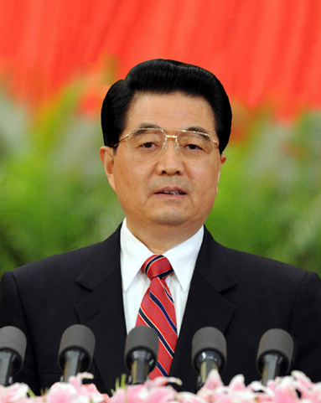
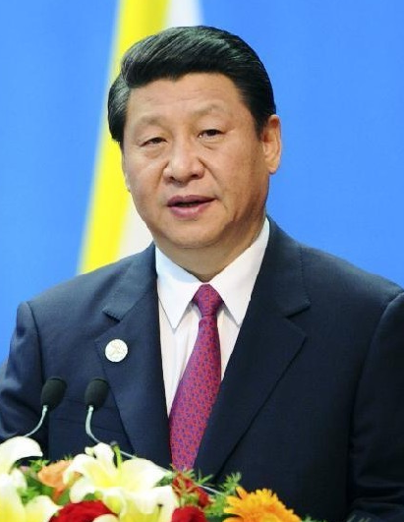
I. 项目背景 Background—Government Direction
八、Vigorously advancing ecological civilization
construction
Strive to build a beautiful China and achieve sustainable development of Chinese nation.
improve land development program
Promote the intensiveness and efficiency of production space, the livability of living space and gracefulness of eco-space
Build a scientific and reasonable urbanization pattern, agriculture development pattern and ecological safety pattern.
优化国土空间开发格局，构建生态安全格局
2012.11.8
Hu Jintao’s report at 18th Party
Congress
2013.5.24
Important
Address
draw and observe the ecological red line and whoever transgress the bounds would be punished.
划定并严守生态红线，不越雷池一步。
2013.11.9
Third Plenary
Session
We should draw ecological red line, implement the paid use of resources and ecological compensation system and reform management system of ecological environment protection.
划定生态保护红线，改革生态环境保护管理体制
Planning the ecological red line is the basis and premise of optimizing land development program, building ecological security program and a beautiful China. （美丽中国）

Slide 5
I. 项目背景 Background
六个产出 Six Required SPS Products
确定定义与特征
提出新的制度体系
提出制度构成
确定基本原则
提出生态补偿的主要途径
提出生态保护红线路线图
Define Ecological Protection Redline (EPRL), outcomes and characteristics
Propose new Institutional regime
Propose Institutional components
Identify foundational principles
Outline essential parts of approach to eco-compensation
Identify a Roadmap

Slide 6
II. 研究分析 Analysis
面临挑战 What are the Present Challenges
红线多、机构多、缺乏协调
缺乏划定标准
概念、内涵与实践认识不统一
缺乏协调机制
缺乏实施方案
知识储备不足
Many Lines & agencies, No Agreement, No coordination
No management standards & enforcement
No Agreement on EPRL concept, characteristics or practical application
No coordination mechanism
No agreed implementation approaches
Knowledge is insufficient

Slide 7
II. 研究分析 Analysis
国内外经验 National & International Experience
国内:
部分地区开展很好实践，如：深圳
国际:
通过土地利用规划明确保护地
国家公园有法律、预算和系统规划
有效的部门协调机制
透明管理和社会参与
明确的管理办法、监测与执行体系
China:
Good but isolated initiatives. e.g. Shenzen
International Best Practice:
Integrated land use planning to identify conservation lands
Parks have laws, budgets & systematic plans
Effective Coordination between ministries
Transparent Administration & Society Engaged
Clear Rules, Monitoring & Enforcement

Slide 8
II. 研究分析 Analysis
主要结论 Conclusions
生态退化对生态文明建设带来严重威胁
生态文明建设为生态保护提供了良好机遇
迫切需要明确责任主体、改革体制和制度
生态保护红线制度是生态文明建设的重要内容。
Ecological damage Threatens path to an Ecological Civilization
The Reform Process is an Opportunity
Need to Clarify Responsibilities and Reform Institutions
Ecological Protection Redlining Confirmed as Critical Components of an Ecological Civilization

Slide 9
II. 研究分析 Analysis
生态保护红线需求 EPRL: What needs to be done
明确定义
制定规则
澄清土地利用问题
明晰制度目标
处理好保护地问题
社区参与
停止保护区域开发活动
提供激励机制
Agree to one Definition
Deal with Lack of Rules
Address Land Use Issue
Resolve the lack of Institutional Focus
Deal with the Protected Areas Problems
Enable communities
Freeze development in key areas to protect options
Provide Incentives

Slide 10
III. 政策建议 Policy Recommendations
完善和明确生态保护红线的内涵与体系构成
完善空间规划体系，明确划定生态保护红线
建立自然生态保护协调机制
完善自然保护地体系，将生态保护红线与保护地体系整合，建立生态保护红线分部门、分类、分级管理机制
生态保护红线为基础，完善生态补偿制度和激励机制
Set definition and characteristics of ecological protection red lines in law
Reform spatial, land-use planning and marine-use planning systems to include EPRLs
Establish new national coordinating mechanisms for ecological conservation and for monitoring and compliance
Renew and expand a national Protected Areas system
Design and implement a national program of payment for performance in EPRL

Slide 11
1 完善和明确生态保护红线的内涵与体系构成
1 Definition and characteristics of ecological protection red lines
明确界定生态保护红线的内涵。生态保护红线是指为维护国家和区域生态安全及经济社会可持续发展，提升生态功能、保障生态系统服务持续供给必须严格保护的最小空间范围。生态系统服务包括水源涵养、土壤保持、防风固沙、洪水调蓄以及灾害防护功能等。
生态保护红线构成。生态系统服务保障线、人居环境安全保障线和生物多样性保护线。
An ecological protection red line (EPRL) defines the minimum spatial area within which strict development controls ensure sustainable provision of ecosystem services vital for national and regional development. EPRL includes natural and constructed ecosystems, terrestrial, freshwater and marine, and degraded areas with potential for ecological restoration to valuable health. The ecosystems may be located in rural or urban settings.
Ecological protection redlines include three components: Ecosystem Services Protection line, Living Environment Security Protection line and Biological Diversity Protection line.

Slide 12
1 完善和明确生态保护红线的内涵与体系构成
1 Definition and characteristics of ecological protection red lines
确定生态保护红线国家目标。建议将国土面积的35%的区域确定为国家生态保护红线，保护生态系统服务重要区域与生态高敏感区，保障国家生态安全。
尽快制定《生态保护红线管理办法》。
Establish a national target of 35% of China’s land area to be within an EPRL on the basis of ecological problems, ecological sensitivity and important spatial characteristics of ecosystem services in China.
State Council to issue Management measures as regulations to ensure full implementation.

Slide 13
2 完善空间规划体系，明确划定生态保护红线
2 Reform spatial planning systems to include EPRLs
土地利用规划体系中增设生态用地类型。在现有的土地利用规划体系中，增设生态用地类型，形成包括农业用地、建设用地、生态用地与未利用地四个类型的新的土地利用规划分类体系。
Establish a new terrestrial land-use category to protect as “Ecological Lands” those lands that have the dominant function of providing ecosystem services.
Form a new integrated land use planning and spatial planning system and new categories of land designations.

Slide 14
2 完善空间规划体系，明确划定生态保护红线
2 Reform spatial planning systems to include EPRLs
将生态保护红线纳入各类空间规划。建议在国土规划、土地利用规划、城乡规划等空间规划中，明确划定生态保护红线。
海洋空间规划中划定海洋生态保护红线。通过海洋生态功能区划和海洋其他空间规划，确定海洋生态保护红线，维护海洋生态健康和生态安全。
Once ecological lands have been identified, it will be important to ensure that they are appropriately managed. In many, but not all, instances, it may be appropriate to incorporate these ecological lands into China’s protected area system.
Establish a similar approach to national marine spatial planning undertaken through China’s ocean zoning, or by dedicated EPRL initiatives.

Slide 15
3 建立自然生态保护协调机制
3 Establish new national coordinating mechanisms
制定国家生态保护战略与政策。从保护目标、空间架构、保护措施、保护政策等方面制定国家生态保护战略与政策。
实施统一协调与管理国家自然保护地。统一对我国自然保护区、国家公园、生态功能保护区等主要类型自然保护地进行管理。
State ecological conservation policy: develop a single integrated national ecology strategy and policies.
EPRL oversight, coordination and facilitation.
Oversee and coordinate the work to develop a single integrated national Protected Areas system plan and management approach.

Slide 16
3 建立自然生态保护协调机制
3 Establish new national coordinating mechanisms
生态保护红线监督与报告。对生态保护红线区域生态保护状况进行定期监测与评估,定期报告生态保护红线区域生态环境状况、变化与问题。
规划、组织区域重大生态建设与恢复工程。统一实施区域重大生态建设与恢复工程，保障生态保护红线区域生态系统服务的持续供给。
实施生态补偿和奖励机制。依据生态保护红线区域范围、保护机会成本和保护投入在生态保护红线区域实施生态补偿机制。
规划和开展生态保护红线划定、监管能力建设。
Implement unified EPRL monitoring, reporting and enforcement.
Plan and organize regional major ecological construction and restoration projects to protect and restore ecosystem services in EPRL lands.
Plan and Implement the new payment for performance and eco-compensation approach.
Plan and implement a national capacity development and engagement program.

Slide 17
4 完善自然保护地体系
4 Renew and expand a national Protected Areas system
完善自然保护地体系。建立生态功能保护区。我国自然保护区体系可以由自然保护区、国家公园、风景名胜区、农业种质资源保护区、生态功能保护区等类型构成。
整合生态保护红线与自然保护地体系。针对自然保护地体系中的生态保护红线区域实施统一协调和分类分级、分部门管理，实现生态保护红线区域的有效保护。
Develop a single integrated national PA system plan that includes consolidation of PA categories and management approach as well as integration with the EPRL system.
Further examine the need and requirement for a National Park Agency and administration.
Develop a Protected Areas law to strengthen Protected Area management by improving public engagement, management plans and dedicated financing.

Slide 18
5 完善生态补偿制度和激励机制
5 Design and implement payment for performance in EPRL
以生态保护红线区为载体，建立生态补偿长效机制。将生态补偿直接支付到生态保护红线区的土地所有者或经营者。
以生态保护红线区为重点布局重大生态建设工程。
依据生态保护红线区面积及保护成效，完善生态转移支付政策。实现生态转移支付强度与生态保护红线区域面积和保护成效挂钩。
New payment for Performance eco-compensation program to provide incentives to local governments and to those impacted by the designation of red lines.
Payment directly to the impacted individuals, cooperatives or local governments.
Requires monitoring to ensure improvement and protection of ecological services, or other ecological and environmental benefits.

Slide 19
IV. 实施建议 Implementation Priorities
当前实施的工作。成立“生态保护红线协调办公室”；完善生态保护红线体系；制定规则和管理条例。
一年内实施的工作。协调机构完善土地利用规划体系、生态保护红线划定、监测、评估、管理、报告制度和公众参与机制、生态补偿机制。
5-10年内实施的工作。重点是生态保护红线监督和报告，生态保护红线制度的完善。
Immediate Tasks. Establish national coordination office for EPRLs; Refine the EPRL system; Develop the rules and regulations, development freeze.
Year 1 Tasks. Renew institutions for land use planning system, draw proposed EPRLs, New monitoring, evaluation, reporting, stakeholder engagement, and new ecological compensation.
Years 5- 10 Tasks. EPRL monitoring and reporting procedures routine; EPRL institution improvement.

Slide 20
谢 谢！
Thank You !

