Slide 1
中国绿色转型进程评估与展望
Evaluation and Prospects for a Green Transition Process in China
主要研究结论和政策建议
Key Research Findings and Major Policy Recommendations
2014.12.1-3

Slide 2
主要研究结论
Key Research Findings

Slide 3
过去10年中国采取了一系列政策措施
Numerous Policy Initiatives in Past 10 Years
战略与政策 | 出台期间 | 具体内容
一般目标
“十一五”规划能源强度目标 | 2006-2010 | 首次明确提出了单位GDP能耗降低20%左右的目标
“十二五”规划能源强度目标 | 2011-2015 | 到2015年，非化石能源占一次能源消费比重达到11.4%，单位国内生产总值能源消耗比2010年降低16%，单位国内生产总值二氧化碳排放比2010年降低17%
可持续发展 | 1992 | 将可持续发展正式作为国家发展战略，陆续组织实施了“三河、三湖”污染防治、退耕还林还草、天然林资源保护等环境保护和生态建设重大工程
科学发展观 | 2003 | 坚持以人为本，树立全面、协调、可持续的发展观，促进经济社会和人的全面发展，按照统筹城乡发展、统筹区域发展、统筹经济社会发展、统筹人与自然和谐发展、统筹国内发展和对外开放的要求，推进改革和发展

Slide 4
绿色转型取得了很大进展
Green transition has achieved progress
（CO2 intensity of GDP)

Slide 5
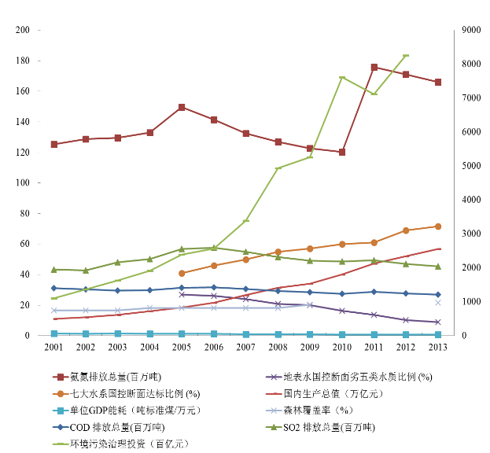
其他污染物指标
Some other indicators

Slide 6
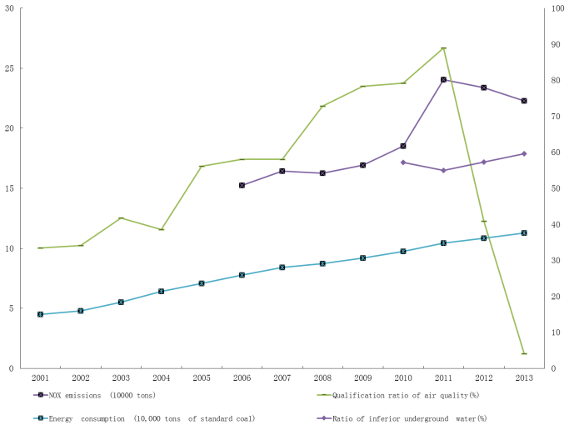
仍面临巨大挑战
But challenges are huge

Slide 7
主要存在的问题
Main Problems

Slide 8
1. 经济结构失衡
The structure of economic growth
过去10年来投资消费结构失衡是加剧空气污染的主要原因之一，导致过度能源消耗。
Imbalance in investment-consumption structure in the past 10 years is one of the major causes of worsening air pollution, leading to excessive and wasteful energy consumption.
过度投资及由此带来的产能过剩，也导致环境恶化。
Over-investment, then over-capacity, played important roles in environment worsening in particular in past two periods of over-heated growth.
绿色转型主要是转变经济发展方式，而不是低速增长。
The green transition to great extent is the transition of economic growth pattern, not just slowdown of growth.

Slide 9
2. 较少运用市场化经济政策和措施
Too little market-based economic policies
环境法律法规执行不力，监督与实施成本太高。
Lack of effective enforcement of environmental laws and regulations, with high costs on supervision and enforcement.
政府主要依赖行政手段来解决环境污染问题，较少运用市场化措施。
The government relied too much on administrative controls and too little on economic policy measures which affect behavior via the market.
价格体系扭曲，不能反映资源与环境的社会成本，不能提供足够的激励与约束使企业和个人采取有利于环境保护的行动。
The price system has been distorted without reflecting the difference between social costs and private costs, and cannot provide strong incentives and constraints on companies and individuals to take right actions for environment protection.

Slide 10
3. 缺乏有效的需求方政策
Lack of “demand side policies”
发展清洁能源和可再生能源政策主要采用了供给方政策，而忽略了市场需求和加速利用新能源。
Policies for clean and renewable energy development focused on supply-side, overlooking the need to expand market and accelerate the uses of these energies.
中国已成为可再生能源设备和材料的最大生产国，却是使用清洁能源最少的国家之一。
China has become the largest producer of renewable energy equipment and materials, but is one of smallest users of clean energy, measured by its share in total energy consumption.

Slide 11
4. 能源使用效率低下
Low energy efficiency
国有企业和地方政府对提高能源效率的经济刺激措施不敏感。
State companies and local governments are not quite sensitive to economic incentives for the energy efficiency improvement.
缺乏能源交易机制和鼓励节能的有关规定。
Lack of “cap and trade” mechanism and other regulations for encouraging energy saving.

Slide 12
5. 缺少多方面的参与和协作
Lack of participation of many relevant players
政府各部门缺乏协调，许多重要的部门无视生态环境的发展目标。
Environmental goals often lost in division of labor among government departments, although economic ministries are highly relevant with the pollution.
金融业在配置资源方面起着重要作用，因此要为防止环境污染承担起责任 。
Some sectors, such as financial sector, which do not directly pollute but actually play critical roles in reallocating resources, should take the responsibility in preventing pollution.
公众对环境的责任意识仍很缺乏。
Still lack of consciousness of environmental responsibilities among all individual industries, companies and consumers.

Slide 13
实现绿色转型的机遇
Historical Opportunity for Green Transition
尽管存在问题与挑战，但中国在今后发展阶段面临着绿色转型的重大历史机遇。
Despite all problems and challenges, China is facing good opportunities to achieve great steps forward in green transition in next stage of development.
  污染的持续恶化大大提高了公众对污染严重性的认识。
  Recent worsening in air pollution greatly raised the public awareness about the seriousness of the problems and the need for changes.
  城市中产阶层不断壮大，更期望拥有美好环境。
  With further growth of urban middle class, the demand for better environment is rising.

Slide 14
实现绿色转型的机遇
Historical Opportunity for Green Transition
  中国还可以借鉴其它国家的转型经验。
  There are great deal of experiences and lessons China can learn from other countries, developed or developing.
  中国政府提出了进一步推动体制改革的各项举措，将会对改善环境有积极的影响。
  The Leadership has promised to push forward a new around institutional reforms, many of which can have positive impacts on the environment and ecological balance.

Slide 15
--如果政府采取正确的结构调整和绿色发展措施，中国在未来10年以至更长的发展中仍可保持7%左右的增长，并使环境状况得到明显改善。
If the government could incorporate right policies aiming at structural changes and green development, China could be able to continue its 7% GDP growth in the next years with significant improvement in environmental conditions.
--数量较小但效率较高的投资，能产生同样的增长；环保技术和环保基础设施的投资本身即对经济增长作出贡献，又促进绿色转型。
Smaller share of investment in GDP may even produce stronger GDP growth if the remaining investment is directed to green technology and infrastructure, and if consumption is oriented towards environmentally friendly goods and services.

Slide 16
主要政策建议
Main Policy Recommendations

Slide 17
主要政策建议
Main Policy Recommendations
1. 改善经济结构，避免过度投资
Improve economic structure with less and better targeted investment
本课题组强烈建议政府通过政策调整和改革推动消费-投资结构和产业结构的再平衡，从而抑制过度投资和产能过剩及由此产生的过度能源消费和大气污染。
Within China’s reform program, government should prioritize institutional reforms and policy adjustments to rebalance China’s economic structure, and focuses on reducing tendency to over-invest to reduce excessive energy consumption and air pollution.
实现结构再平衡需要一系列改革和政策调整，包括财政和金融部门改革、改善收入分配和社会保障体系等。在财政和行政体制改革方面，我们建议推进政府职能转变，减少政府投资，增加公共服务和社会保障支出，以促进投资-消费结构再平衡。
Policy adjustments are needed in structural rebalance: fiscal and financial reforms, improvement in income distribution and social safety net. A transformation in government functions is required to reform financial and administrative systems: reducing government investment, and increasing public service and social security spending.

Slide 18
主要政策建议
Main Policy Recommendations
2. 更多地动用税收、价格等市场经济政策
Promote a shift in resource use via green taxation and market-based instruments
对煤炭和石油等化石能源产品应征收较高的资源税，并使电价调整到市场价格水平，同时在那些空气污染严重的城市对电力和汽车消费征收环境税。
A higher resource tax should be imposed on fossil fuels, including coal, as well as environmental taxes on electricity and automobile consumption in cities which face severe air pollution.
3. 更多地采取“需求方政策”，鼓励利用新能源
Stimulate demand for clean tech via targeted policies
需要强有力的需求方政策鼓励使用清洁能源和可再生能源。目前的政策重点只在供给方，而可再生能源的发展因受到市场制约而面临产能过剩。拓展需求方的政策调整，包括变补贴生产者为补贴消费者，并解决新能源入网问题，可使化石燃料消耗总量在2030年进一步减少5％。
Government should maintain and reinforce demand-side policies to support renewable energy industry. Clearer demand-side policies should be applied more broadly, to expand all green technology markets and help address overcapacity in green industries.

Slide 19
主要政策建议
Main Policy Recommendations
4. 在城市化进程中推进绿色建筑和绿色城市标准
Green urbanization policies
建设高效城市和绿色建筑对控制未来能源消费和减少污染至关重要。课题组情景分析显示，如全面实行强制性节能建筑标准，并在大城市加速发展城市和城际轨道交通，减少私家车使用，有可能在2030年前后使能源消费降低约5％-12％。
Efficient cities and green buildings are critical to manage energy consumption and reduce pollution. Scenarios by TF suggest, fully enforcing compulsory building standards for energy efficiency and expanding inter-city and urban rail transport could lower energy consumption by about 5-12% around 2030.
5. 推进绿色金融
Financial sector reforms to catalyze Green Transition
建议推行绿色金融政策，实行更广泛的改革，使金融体系积极推动绿色转型。鼓励金融机构将环境因素纳入利润计算，有助于将更多的金融资源配置到“绿色产业”而不是污染行业。
Financial institutions should incorporate environmental factors in profit calculations, and allocation of financial resources should avoid polluting activities and creating opportunities for green growth.

Slide 20
主要政策建议
Main Policy Recommendations
6. 对化石能源实行总量控制
Stringent caps on fossil fuel consumption
建议对化石能源消费在强度控制的基础上，实行“全国总量目标控制”, 并实行区域配额。
In addition to intensity control, adopt “National Quantity Target Control” on energy consumption, with “quota allocation” for regions and main industries/companies.
如能全面实现本报告提出的各项转型政策和改革措施，到2030年前后，化石能源、二氧化碳和主要污染物的排放量将有效得到控制。
If we can implement all policies suggested above, China may achieve significant progress in Green Transition by 2030 and onward.

Slide 21
主要政策建议
Main Policy Recommendations
初步估计，以上政策措施如果都能实现，我们有可能实现以下绿色转型“三步走”目标：一，2020年前后可再生能源增速快于其他各能源品种；二，2025年前后非化石能源增量高于化石能源；三，在2030-2040年间化石能源消耗达到峰值，然后实现绝对量降低 （2020年之前强污染能源即煤和石油的消费达到峰值）。
Combining all the policy efforts we suggested above, it is possible we achieve the goals as following “three-steps”: 1) Renewable energy should grow faster than other energy sources by 2020; 2) non-fossil energy could grow faster than fossil fuels by 2025; 3) Fossil energy consumption could peak around 2030-2040s and then decline in absolute terms (the “dirty fossil energy consumption peaks before 2020, but afterward, natural gas continues to increase until 2040).

Slide 22
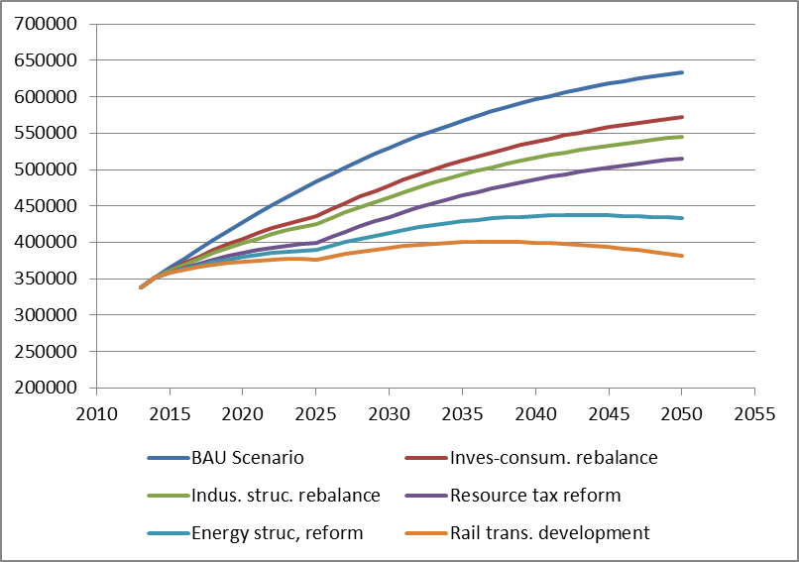
绿色转型政策对化石能源消费的迭加效应（万吨标准煤）
Combined effect of Green Transition Policies on fossil energy demand (10000 SCE)

Slide 23
绿色转型政策对二氧化碳排放的迭加效应（万吨）
Combined effect of Green Transition Policies on CO2 Emissions (10000 tons)

Slide 24
谢谢！
Thank You !

