Slide 1
应对气候变化与大气污染治理协同控制 政策研究
—聚焦短寿命气候污染物和非道路移动源
Coordinated Actions for Addressing Climate Change and Air Pollution
—With a Focus on Short-Lived Climate Pollutants and Non-Road Mobile Sources
郝吉明 Jiming Hao, 清华大学 Tsinghua University
Lars-Erik Liljelund, 斯德哥尔摩环境研究所 Stockholm Environment Institute
Michael P. Walsh, 国际清洁交通委员会 International Council on Clean Transportation
2015年11月9-11日, 北京 Nov 9-11, 2015, Beijing

Slide 2
汇报内容 Outline
项目背景和主要实施过程
Project Storyline and Implementation Process
短寿命气候污染物防控现状、国际经验和多部门协调机制
Current Status, International Experience on Short-Lived Climate Pollutants and their Inter-agencies Coordination Mechanism
非道路移动源防控现状、国际经验和多部门协调机制
Current Status, International Experience on Non-Road Mobile Sources and their Inter-agencies Coordination Mechanism
主要研究结论与政策建议
Major Research Conclusions and Policy Recommendations
Notes:
2

Slide 3
项目背景
The rationale: Why this Special Policy Study?
1) 短寿命气候污染物（SLCPs）主要是指黑碳（BC）、甲烷（CH₄）、对流层臭氧（O₃）和部分氢氟碳化物（HFCs）。减少短寿命气候污染物(特别是甲烷和黑碳)的排放能够在减少空气污染的同时减缓短期气候变暖。实施短寿命气候污染物减排战略会带来多重收益，如改善公众生活质量、避免粮食产量损失及应对短期气候变化等。
Short-Lived Climate Pollutants (SLCPs) include black carbon (BC), methane (CH₄), ozone in the troposphere, and some hydrofluorocarbons (HFCs). Of particular interest, is the fact that strategies to reduce BC and CH₄ will reduce both air pollution and near-term warming. Thus, implementing strategies to address SLCPs will improve quality of life for humans and crop yields and also contribute to addressing climate change, especially in the near term.
2) 短寿命气候污染物减排与非道路源污染物控制关联紧密，但目前的相关政策框架中往往将其忽略。通过短寿命气候污染物和非道路移动源污染物的协同控制，可以协同治理空气污染和应对气候变化
There are many linkages between SLCPs reduction strategies and action to prevent emissions from non-road mobile sources (NRMS), which is an area neglected by current policy. Coordinated actions in this report address air pollution and climate change, with a focus on SLCPs and NRMS.

Slide 4
项目背景
The rationale: Why this Special Policy Study?
1、中国面临协同治理空气污染和应对气候变化的机遇和挑战
China faces opportunity and challenge for accelerating coordinated actions addressing air pollution and climate change.
中国面临气候变化适应和减缓、空气质量改善等多重目标的挑战 China faces challenges for the achievement of climate change adaptation and mitigation targets and air quality improvements ;
中国新修订的《大气污染防治法》给短寿命气候污染物和非道路移动源的减排带来新的机遇，也明确将治理空气污染和应对气候变化有机地联系起来 The new Air Law will open up new opportunities to address SLCPs and NRMS. The new Air Law explicitly links air pollution and climate change.
2、短寿命气候污染物战略对未来几十年减缓温升和其他气候变化的影响有一定作用
An SLCP strategy is helpful for mitigating near-term warming and other climate change over the next few decades.
3、空气污染影响能够通过短寿命气候污染物战略得到一定程度减缓
Air pollution impacts can be mitigated to certain extent with an SLCP strategy:
-- The development of the SLCP approach.
-- Complementing existing policy approaches.

Slide 5
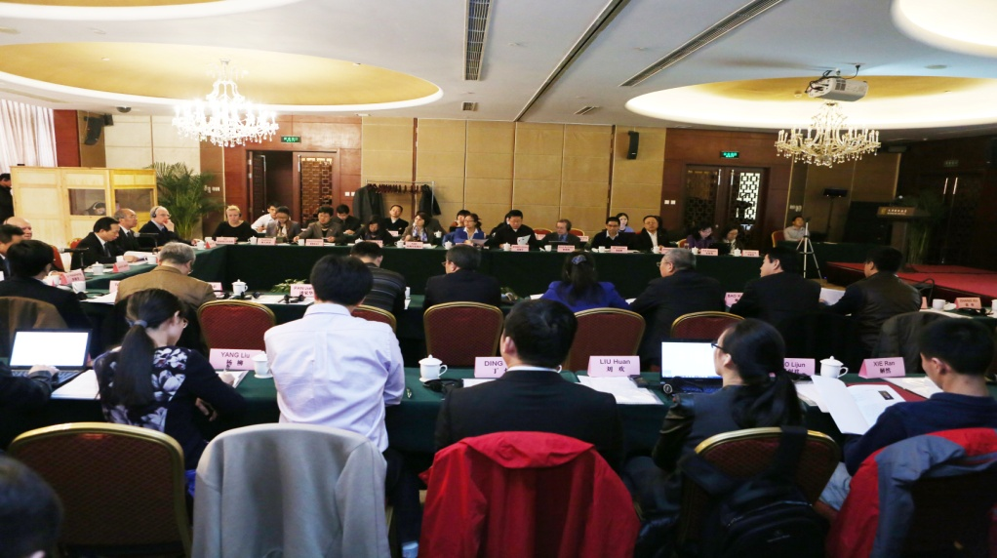
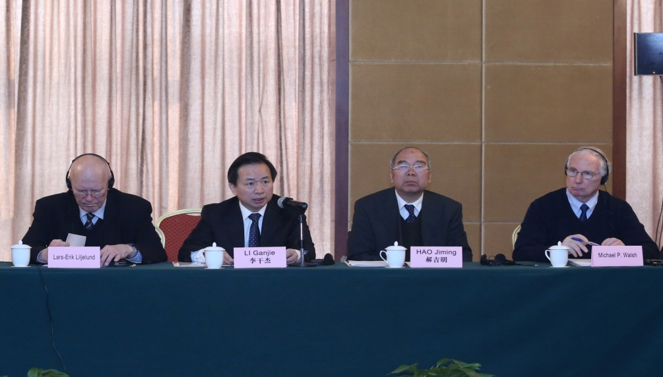
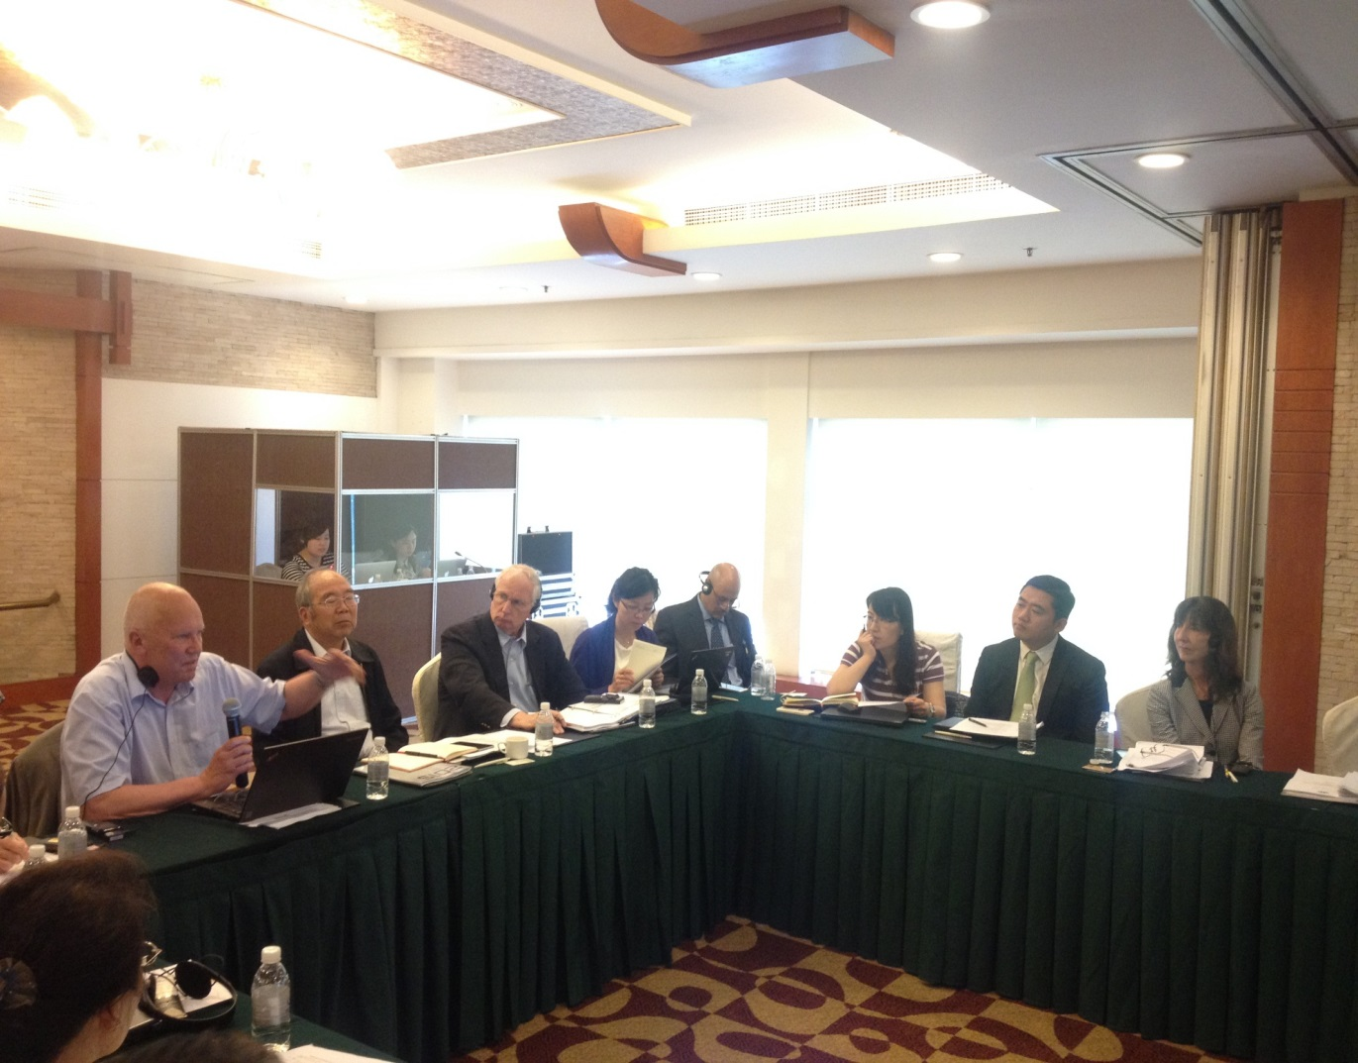
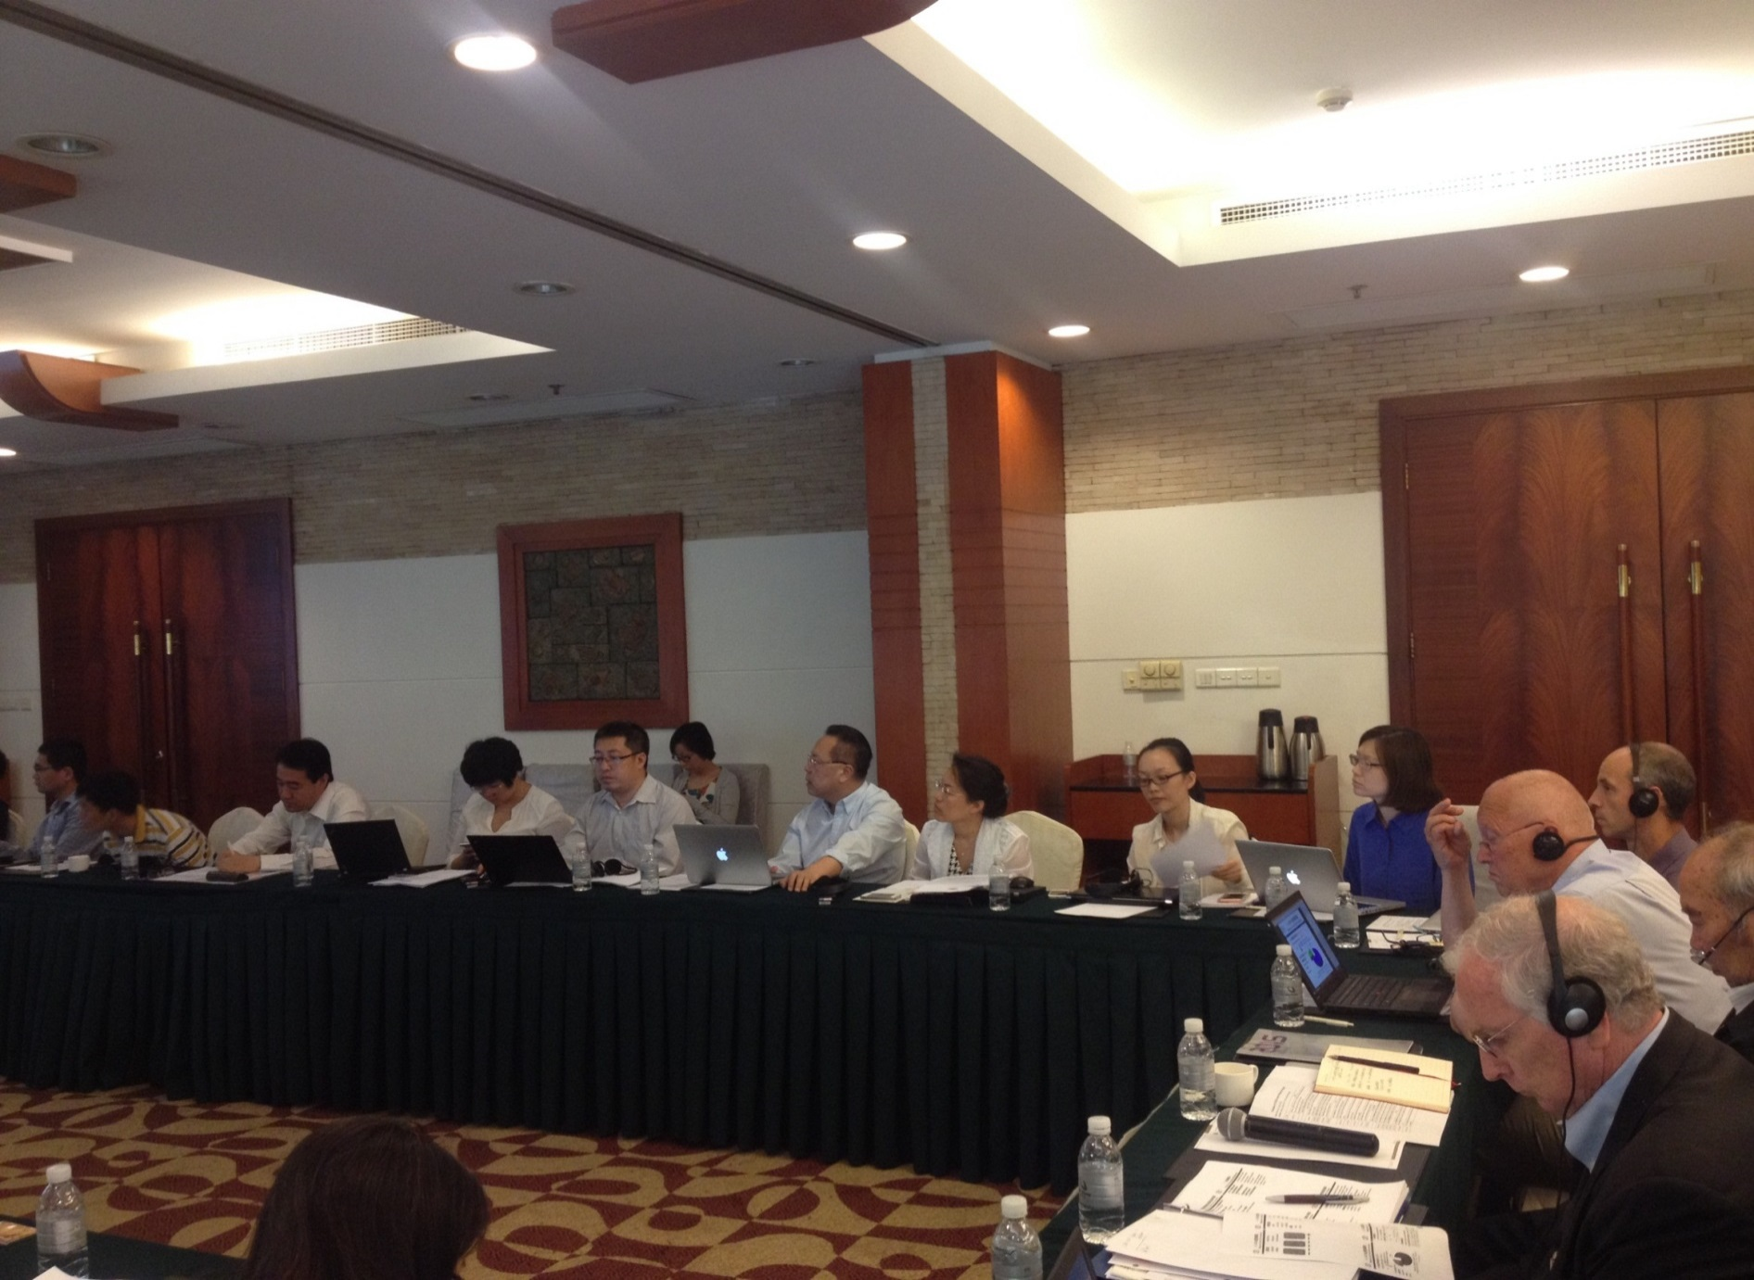
项目主要实施进程 Progress of the Project
1) 3月项目启动会暨第一次工作会议 March, the kick-off/first working meeting in Beijing
2) 6月项目第二次工作会议 June, the second working meeting in Shanghai
3) 9月项目第三次工作会议 September, the third working meeting in Beijing
4) 期间多次内部技术专家讨论会 Several internal project meetings in Beijing

Slide 6
汇报内容 Outline
项目背景和主要实施过程
Project Storyline and Implementation Process
短寿命气候污染物防控现状、国际经验和多部门协调机制
Current Status, International Experience on Short-Lived Climate Pollutants and their Inter-agencies Coordination Mechanism
非道路移动源防控现状、国际经验和多部门协调机制
Current Status, International Experience on Non-Road Mobile Sources and their Inter-agencies Coordination Mechanism
主要研究结论与政策建议
Major Research Conclusions and Policy Recommendations
Notes:
6

Slide 7
短寿命气候污染物的研究进展及政策行动
Research Progress and Policy Initiatives on SLCPs
国际上的代表性研究是UNEP/WMO2011年的研究报告，识别了SLCPs对气候变化、大气质量、人体健康、农作物产量、生态环境等方面的影响，并梳理了16项经济有效的减排措施
Internationally, the most influential report is led by UNEP and WMO (2011), in which scientists identified the impacts of SLCPs on climate change , air quality, human health, crop production, ecosystems, and concluded with 16 cost effective mitigation measures.
中国国内研究目前尚未将短寿命气候污染物作为一大类污染物进行整体研究，关于排放、源解析、影响、减排技术、管理规范等相关研究已经有些进展，但SLCPs减排相关的社会经济分析还比较少
In China, holistic research on SLCPs has not taken place. Considering air pollutants, research has progressed with regard to emissions, source apportionment, impact, abatement technologies and management practices. Further research findings about emissions and source apportionment will be needed to support some of the decisions on integrated control and focus action in the most cost-effective manner.

Slide 8
短寿命气候污染物的研究进展及政策行动
Research Progress and Policy Initiatives on SLCPs
近些年，国际上涌现了很多行动倡议旨在减少SLCPs，其中，2012年2月成立的气候与清洁空气联盟（CCAC）是全球第一个专门针对减排SLCPs的行动倡议。此外，美国、欧盟等国也纷纷开展了减排SLCPs的行动
In recent years, new international initiatives to promote taking action to reduce emissions of SLCPs have emerged. In February 2012, the Climate and Clean Air Coalition to reduce Short Lived Climate Pollutants (CCAC) was launched as a first global effort to address SLCPs. US, EU, Canada, Mexico, etc., also started to respond to reduce SLCPs in their own country.
中国在大气污染防治和温室气体减排领域出台了诸多相关法律法规、政策和行动计划等，特别是《大气污染防治行动计划》和《大气污染防治法》。这些行动措施在减少大气污染物的同时能够达到协同减排SLCPs的效果，但中国目前尚无专门针对SLCPs的政策行动
Chinese government has released many laws, regulations and policies on air pollution prevention and GHG mitigation (e.g., the Air Pollution Prevention and Control Action Plan, and the new Air Law). These actions greatly reduce the air pollution and achieve co-benefits in the reduction of SLCPs emissions. However, China has no dedicated policy actions to address SLCPs.

Slide 9
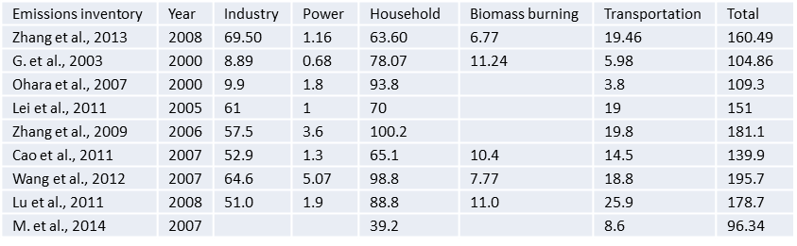
中国短寿命气候污染物排放现状及行业特征
The status quo and industrial characteristics of SLCPs in China
中国BC主要来源于煤炭燃烧、生物质燃烧和机动车排放，特别是广大农村地区采暖、炊事等燃煤及燃烧生物质等生活保障行为。国内外估算的中国地区（不含港澳台）2000-2008年各年份BC排放量约96-181万吨。In China, BC mainly comes from coal combustion, biomass burning, vehicles, and particularly heating and cooking activities in the rural areas. It is estimated that China’s BC each year from 2000 to 2008 were 0.96-1.81 million t.
源于居民生活的黑碳 (BC)具有较高的排放因子和排放量，约占总估算排放量的40-85%。The residential sector presents a high BC emission factor and is responsible for 40%-85% of the estimated BC emissions.
BC排放清单的不确定性普遍在100%以上。Emission inventory uncertainty of BC is generally above 100%.
BC emissions in different studies (10,000 tons)
黑碳
Black Carbon

Slide 10
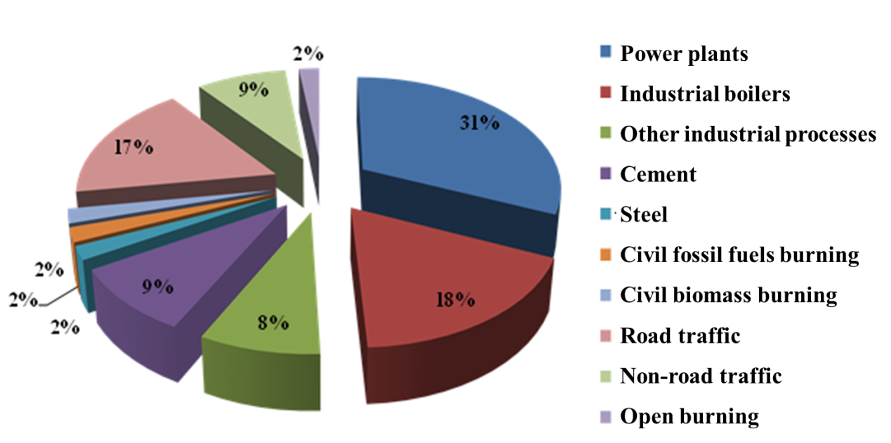
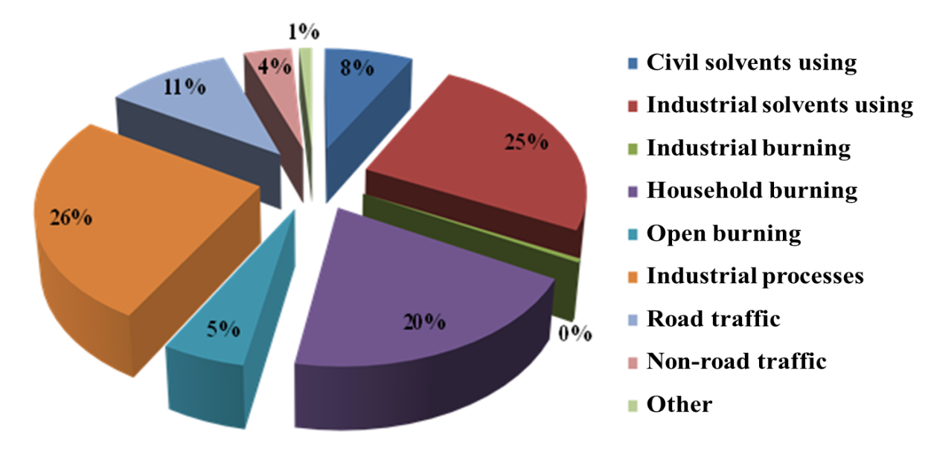
中国短寿命气候污染物排放现状及行业特征
The status quo and industrial characteristics of SLCPs in China
与黑碳同时排放的NO_{X},VOCs和CO同时也是O₃的前体物，对O₃的形成、分布也有重要的影响。
NO_{x}, VOCs and CO co-emitted with BC are precursor gases with an important influence on O₃ formation and distribution.
对流层臭氧
Tropospheric
Ozone
China’s NO_{x} emissions sources and distribution in 2010
China’s VOCs emissions sources and distribution in 2010

Slide 11
中国短寿命气候污染物排放现状及行业特征
The status quo and industrial characteristics of SLCPs in China
2005年中国甲烷(CH₄)排放总量约为930 MtCO₂ e。In 2005 CH₄ emissions amounted to 930 MtCO₂e in China.
在煤炭生产领域排放的甲烷中，瓦斯抽采过程的排放是一大来源，煤炭领域的减排潜力巨大。One of the CH₄ emission sources during coal production comes from the CMM drainage process, with great mitigation potentials.
2014年，全国煤矿瓦斯抽采量133亿 m³，利用量45.3亿 m³，相比2005年分别增长503%及466%。2014 the total CMM drainage volume in China was 13.3 billion m³ with the utilization volume of 4.5 billion m³, respectively increased by 503% and 466% compared with 2005.
China’s CMM drainage and utilization volume, 2005-2014
甲烷
Methane

Slide 12
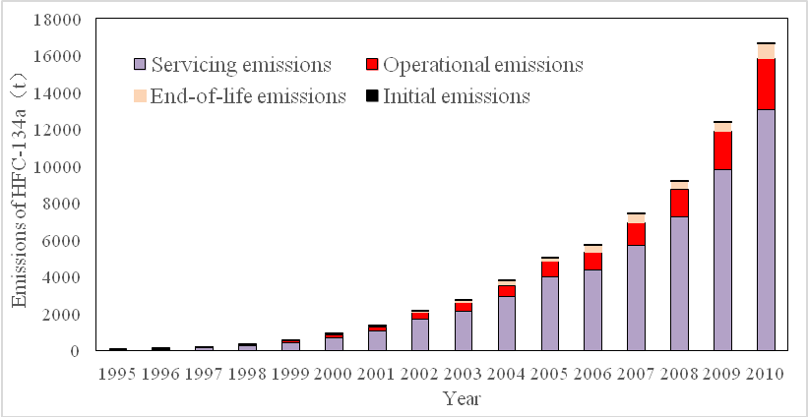
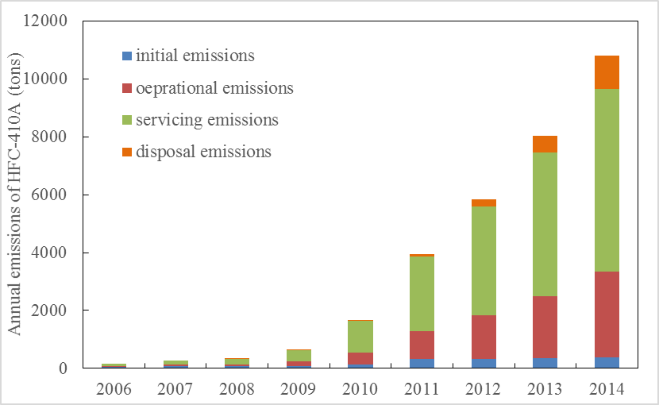
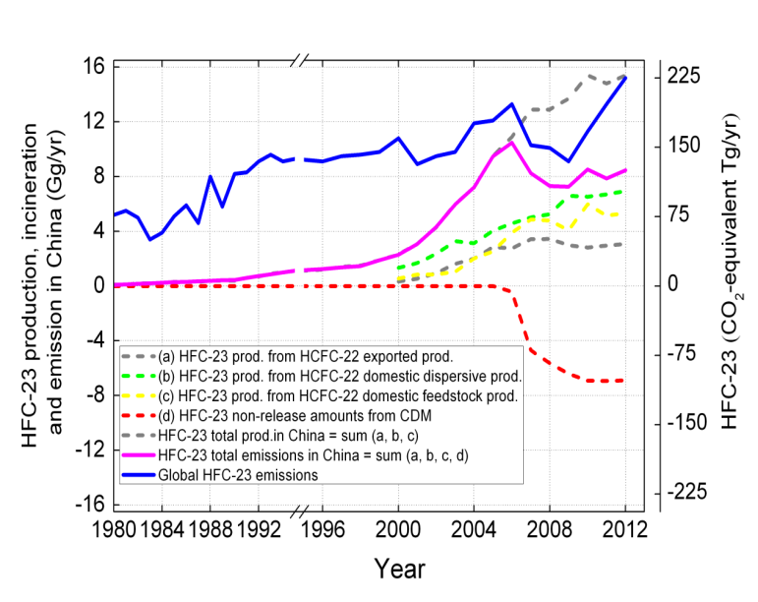
中国短寿命气候污染物排放现状及行业特征
The status quo and industrial characteristics of SLCPs in China
本报告提到的中国HFCs的排放主要包括：1）汽车空调行业 HFC-134a；2）房间空调行业 HFC-410A；3）HFC-23。
HFCs in China mentioned herein include: 1) HFC-134a in the automobile air conditioning industry; 2) HFC-410A from room air conditioning systems; 3) HFC-23 .
部分氢氟碳化物
Some HFCs
HFC-23 production, reduction and emission in China, 1980–2012
HFC-134a emissions in the lifecycle of automobile air conditioners, 1995-2010
HFC-410A emissions in the life cycle of room air conditioning systems, 1995-2010 (tons)

Slide 13
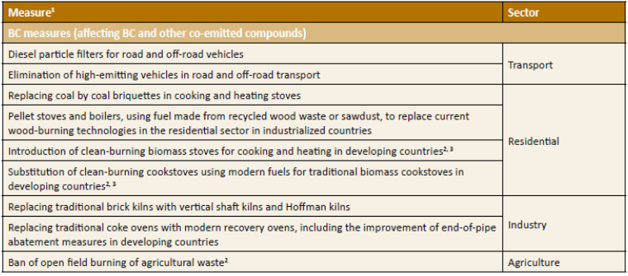
短寿命气候污染物排放控制技术和减排潜力分析
Analysis of SLCPs Control Technologies & Emission Reduction Potential
黑碳排放措施可划分为两类：一类是致力于减少化石能源使用和提高化石/生物质能源使用效率，另一类则属于末端黑碳减排技术的应用措施。所有这些措施都能够通过减排黑碳提高空气质量。
Fossil energy consumption reduction, and fossil/biomass energy efficiency increment, and after-treatment control technologies are major reduction methods for BC. All of these measures are capable of improving air quality.
黑碳
Black Carbon
UNEP推荐的9项黑碳减排措施
民用部门的黑碳减排技术措施归纳为：炉具改进、煤型优化、尽量避免使用中等成熟度烟煤、在郊区和农村推广采取集中供暖、使用清洁能源替代农村散煤燃烧等。
BC emission reduction technologies in the residential sector are identified as follows: stove improvement，improve coal type，avoid the use of bituminous coal with medium maturity & higher ash content，facilitate community central heating system in the suburbs and rural areas， substitute lump coal in the rural areas with clean energy, etc.
来源：UNEP/WMO，2011

Slide 14
短寿命气候污染物排放控制技术和减排潜力分析
Analysis of SLCPs Control Technologies & Emission Reduction Potential
中国煤矿瓦斯主要减排技术
China’s major technologies of reducing coal mine methane (CMM) emissions
能源开发和利用过程中的甲烷减排技术较为成熟，减排潜力较大。Methane emissions reductions in fuel exploiting and production is relatively ready for the market, while the rate of application of which is with great potentials.
技术名称 | 技术描述 | 技术经济参数 | 应用情况
民用燃料 | 民用燃料技术是指将矿井中抽采浓度高于40%的煤矿瓦斯气收集存储、铺设管道系统、调压输送到城镇居民区，为居民生活提供燃气，用于烧水、做饭、烧锅炉、取暖等。 |  | 在安徽、贵州、山西等许多地区有应用。
工业化工 | 工业利用包括替代燃煤锅炉和生产炭黑、甲醇和甲醛等化工产品，其中浓度为40%-90%的煤矿瓦斯均可用做生产炭黑，且浓度越高，炭黑的产率越高；煤矿瓦斯生产甲醛的方式包括直接氧化成甲醛，或先将瓦斯制成甲醇，然后氧化成甲醛。 |  | 目前由煤矿瓦斯直接生产甲醇划入国家禁止类项目。
煤矿瓦斯发电技术 | 不同浓度的煤矿瓦斯可以通过燃气内燃机、燃气汽轮机等进行发电。其原理是将甲烷与空气混合至爆炸极限(5%-15%)，在防爆气缸内爆燃做功，推动活塞运动，从而带动同步发电机发电。 | 投资一般为3000-4000元/kWh | 高浓度瓦斯（浓度>30%）及低浓度瓦斯（浓度<30%）发电已成为煤矿瓦斯利用的主要方式。
煤矿瓦斯提纯压缩技术 | 高浓度及低浓度煤矿瓦斯经过提纯、压缩可制成压缩天然气(CNG)产品，这样扩大了煤矿瓦斯应用范围。目前煤矿瓦斯加工提纯方法主要有吸附与解析分离、渗透分离和低温分离。 | 对于2000万m³纯瓦斯的压缩气厂，投资成本约为2200万元。
煤矿瓦斯提纯液化技术 | 煤矿瓦斯一般采用吸附与解析分离、渗透分离和低温分离等技术加工分离后进行液化及LNG产品生产，LNG大大降低了运输成本，且可随气源和用户不同需求改变运输路线，甚至可用现有的天然气管道作调峰资源使用。 | 对于年产量为2万吨的液化煤矿瓦斯厂，大约年消耗3200万m³纯瓦斯，大约投资9000万元。
风排瓦斯利用技术 | 甲烷浓度小于1%的风排瓦斯目前采取的措施以排空为主，现有可利用技术主要有热氧化、催化氧化和作为辅助燃料三种利用方式。其中热氧化技术较为成熟且已实现工业化运行。 |  | 中国胜利动力机械集团公司、美国Megtec公司、英国Harworth公司等设备厂商的风排瓦斯热氧化技术均已成功建设示范项目。
甲烷
Methane

Slide 15
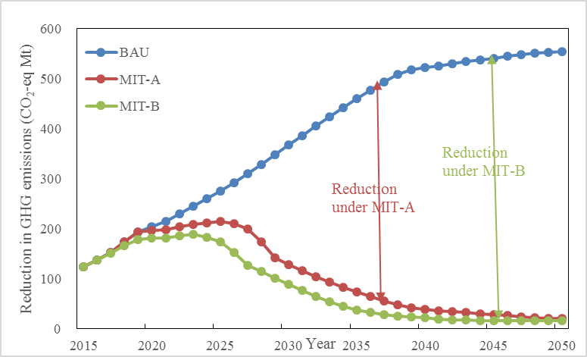
短寿命气候污染物排放控制技术和减排潜力分析
Analysis of SLCPs Control Technologies & Emission Reduction Potential
目前HFC-134a和HFC-410a的减排技术路径较为清晰。
The technical mitigation roadmaps of HFC-134a and HFC-410a are relatively clear now.
HFC-23的减排技术主要包括高温分解和转化利用两大类。高温分解法已经有成熟的技术和实际应用，而转化利用方法尚在探索阶段。
HFC-23 emission reduction technology is divided into high-temperature decomposition and trans-utilization. Regarding high-temperature decomposition, mature technology and practical application have been realized. Trans-utilization remains in the exploratory stage.
HFC-134a emission reduction potential for
automotive air conditioning in China, 2016-2050
HFCs emission reduction potential for
room air conditioners in China, 2016-2050
部分氢氟碳化物
Some HFCs

Slide 16
短寿命气候污染物减排的多部门协调机制
Inter-agencies coordination mechanism for SLCPs
针对不同的污染物，根据其主要来源确定主要监管部门和协作部门。
Regulatory departments and supporting departments are identified according to the SLCP sources.
1）对于黑碳，进一步明确能源、环保、农业、交通、城建等部门的职责，重点减少煤炭的终端使用和生物质露天焚烧、减少柴油发动机的排放等。To address BC, a coordination group comprised of energy, environment, agriculture, transportation, and construction departments should be identified, reducing end use of coal and biomass open burning, and reducing diesel engines emissions should be major focus.
2）对于甲烷，进一步完善现有体制机制，充分发挥各相关部门的作用，着重从减少能源开采过程和废物处置过程中的甲烷释放量入手进行控制。To reduce CH4 emissions in fuel extraction, storage and transmission and in waste disposal, a working group to coordinate coal, petrochemical, municipal, and environmental departments is needed.
3）对于氢氟碳化物，在现有的联合履约机制下开展工作，加强其排放管理，加快氢氟碳化物销毁和替代，推动有关企业全面开展HFC-23控排行动。HFCs should be aggressively controlled under the current joint compliance mechanism with increased efforts to reduce HFCs in industrial and commercial air conditioning and refrigeration to augment ongoing progress in residential and mobile air conditioning, strengthen HFCs emission management, accelerate HFCs destruction and replacement, and promote the enterprises to carry out comprehensive control actions of HFC-23 abatement.

Slide 17
汇报内容 Outline
项目背景和主要实施过程
Project Storyline and Implementation Process
短寿命气候污染物防控现状、国际经验和多部门协调机制
Current Status, International Experience on Short-Lived Climate Pollutants and their Inter-agencies Coordination Mechanism
非道路移动源防控现状、国际经验和多部门协调机制
Current Status, International Experience on Non-Road Mobile Sources and their Inter-agencies Coordination Mechanism
主要研究结论与政策建议
Major Research Conclusions and Policy Recommendations
Notes:
17

Slide 18
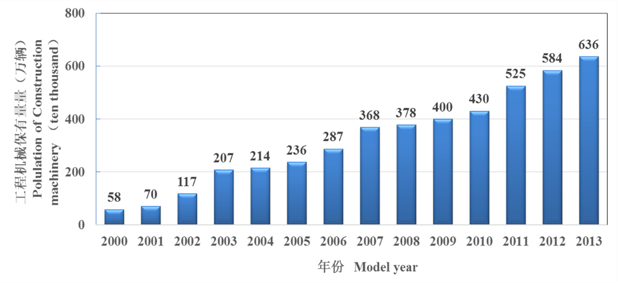
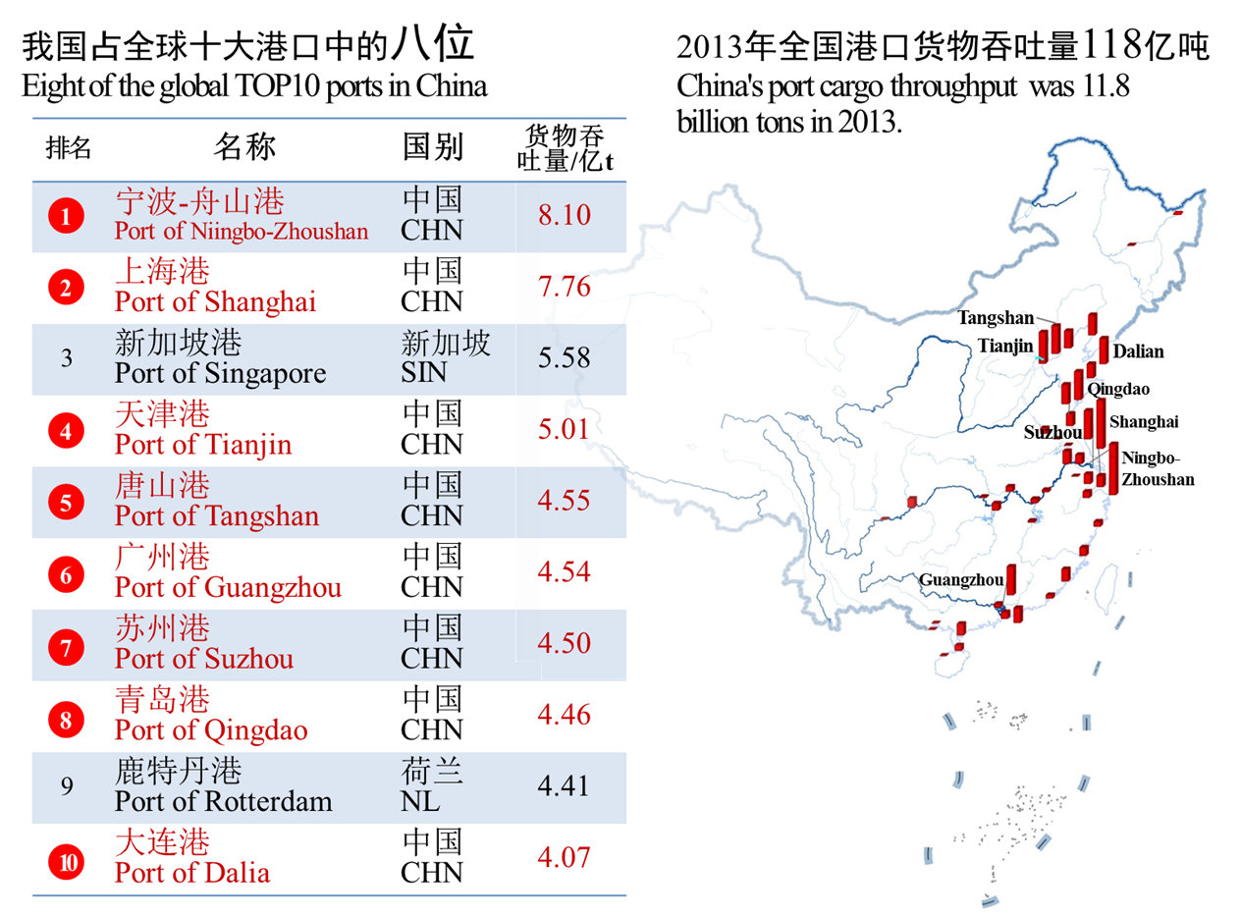
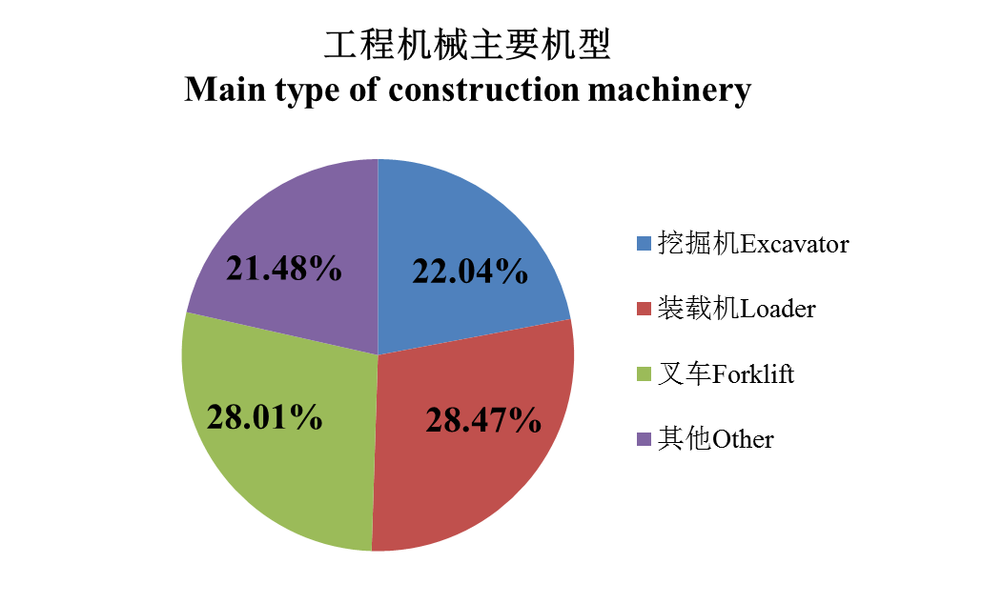
非道路移动源种类众多，数量巨大，但是防控薄弱
Non-road transport market increases fast but lack of control
非道路移动源：包括建筑工程机械、农业机械、船舶等
Non-road mobile sources (NRMS) include construction machinery, agriculture machinery, vessels and aviation.

Slide 19
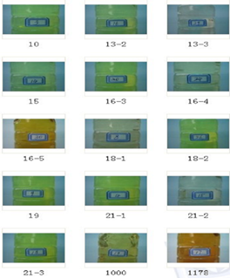
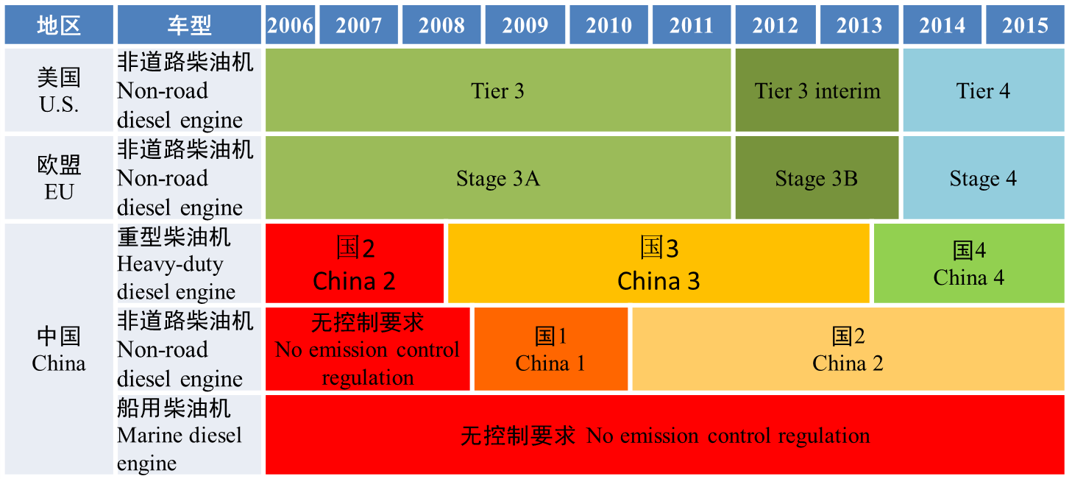
非道路移动源排放控制水平较低
Emission control of non-road mobile sources is poor in China
相对于道路机动车，非道路移动源排放管理相对滞后，长期以来缺乏有效监管。Compared with on-road motor vehicles, emissions management for NRMS is lagging behind and has long been lack of supervision.
排放标准严重滞后。Far lag behind with emission standards.
非道路油品质量很差。In reality sulfur was >400 ppm for majority of the construction machinery; and even worse, international vessels use as high as 3.5% sulfur content fuel in China.
非道路排放标准 NRMS emission standards
实际非道路油品 Real-world fuels for NRMS

Slide 20
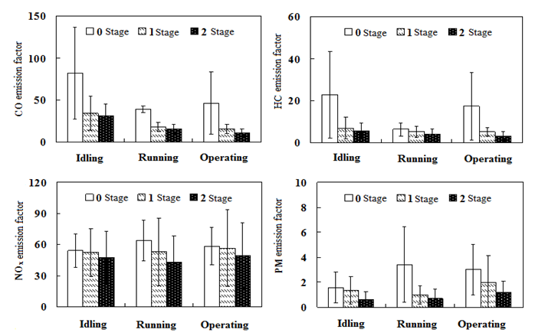
初步开展了非道路移动源排放测试，总体排放水平偏高
NRMS emission measurements started in China, and preliminary results show relatively higher emissions than those from international studies
工程机械 Construction machinery

Slide 21
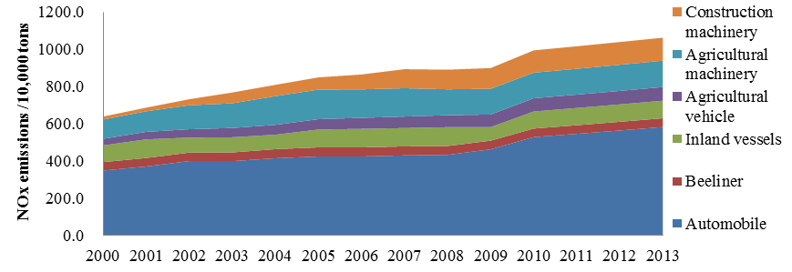
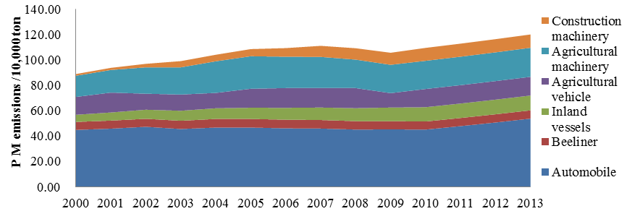
初步估计中国非道路机械污染物排放总量巨大
Results show that NRMS contributes large emissions in China
1)道路和非道路移动源NOx的分担比例已达6:4；而非道路移动源排放的一次PM_{2.5}甚至超过了道路移动源。
On-road and non-road mobile sources account for 60% and 40% of NOx emissions, while the latter has a larger role in the primary PM2.5 emissions.
2)在非道路移动源中，工程机械、农业机械和船舶是三类最重要的排放源
Construction machinery, agricultural machinery and ships are among the three major contributors in China.
历年道路和非道路移动源NOx排放量
NOx emission from vehicles and NRMS
历年道路和非道路移动源PM_{2.5}排放量
PM_{2.5} emission from vehicles and NRMS

Slide 22
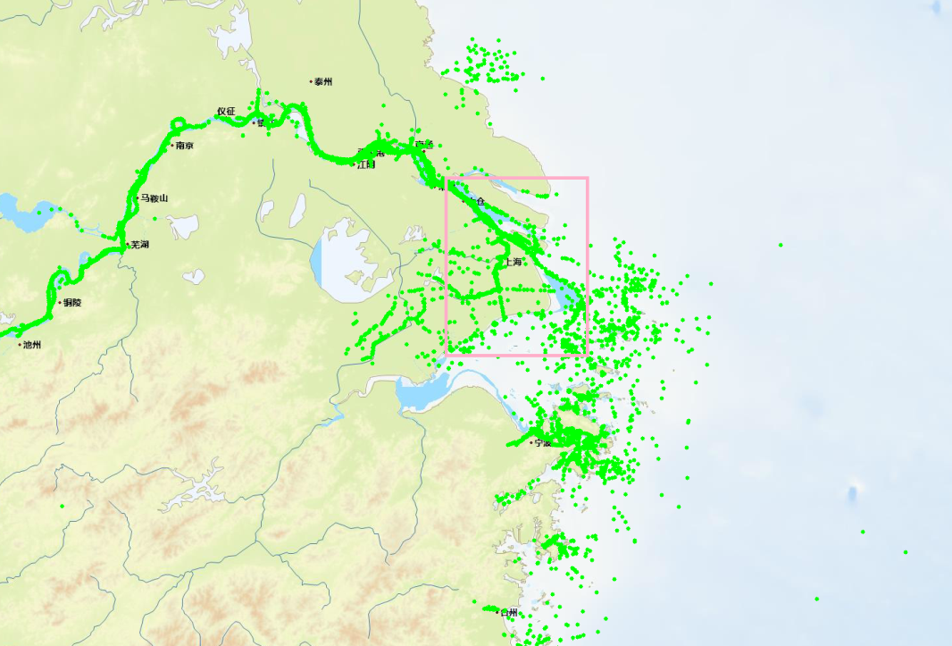
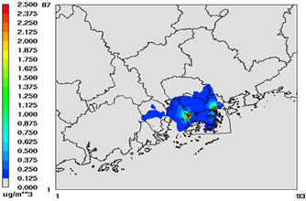
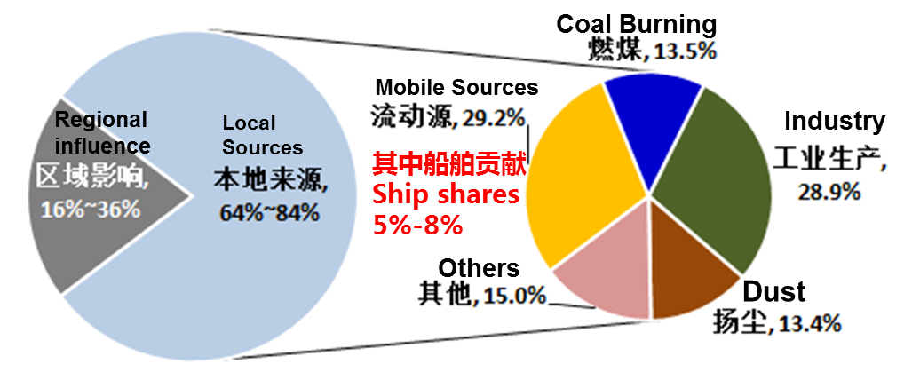
船舶成为上海/深圳等城市PM2.5污染的重要贡献源
Ship becomes a major contributor to PM2.5 pollution in Shanghai/Shenzhen
上海的PM2.5源解析结果
PM2.5 source apportionment in Shanghai
深圳的PM2.5源解析结果
PM2.5 source apportionment in Shenzhen
据深圳PM2.5源解析结果，全年船舶平均贡献约占PM2.5浓度的13%（5 µg/m³）。
According to PM2.5 source apportionment results, ships contributes 13% (5 μg/m³) of PM2.5 concentrations in Shenzhen.

Slide 23
非道路移动源的国际经验分析
Key lessons learned from the international experience
非道路移动源是空气污染物和温室气体（尤其是黑碳）的重要贡献源，且趋势在增加 Non Road vehicles and engines are an increasingly important contributor to air pollution and GHGs, especially BC.
当前已有的技术储备已具备很好的排放削减潜力 Technologies currently exist which can substantially reduce the emissions which contribute to these problems.
油品质量的逐步提升为上述技术的大规模推广扫清了障碍 Cleaner low sulfur fuels for this sector are gradually being phased in around the world, removing the major impediment to the use of advanced technologies.
欧美的在用符合性监管能力显著提升 Tools to help assure in use compliance have improved significantly, especially in Europe.
在用车改造技术在欧美有成功的经验，但是其有效推广需要严格的认证和监管相匹配 Retrofit technologies which can dramatically reduce PM and BC from the existing fleet are widely used, especially in California and Switzerland, but their use depends on a strong verification program.

Slide 24
非道路移动源的国际经验分析（续）
Key lessons learned from the international experience (cont’d)
控制船舶等非道路移动源需要准确测量和评估其空气污染和健康影响的关系，并推动公众支持 It is essential to measure and communicate the air pollution and health impacts from shipping and port-related activities to create public support for controlling shipping and port emissions.
强制和经济激励等手段需要综合应用以更好的推动船舶排放控制技术和措施的实施 A wide range of mitigation options exist to reduce SLCPs and air pollution from ships, but mandatory and incentive programs are needed to spur the deployment of such measures.
区域的联防联控是最佳的控制途径 Regional emission control efforts are best for addressing concerns over competitiveness.
标准和法规的有效实施需要依靠强有力的监管 Robust enforcement is a key to success for any regulatory program.
内河和远洋船舶可以考虑同步并行控制以达到最佳控制效果 Pollution from domestic vessels and OGVs can be targeted in parallel to achieve maximum emissions reductions.

Slide 25
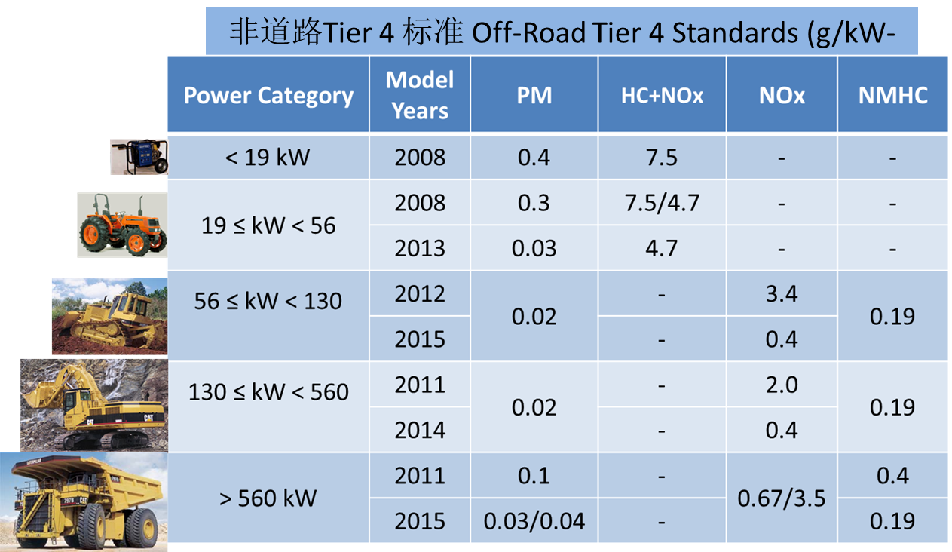

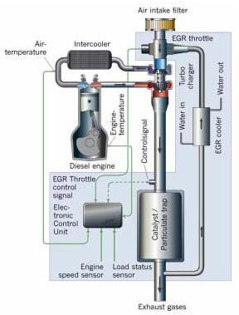
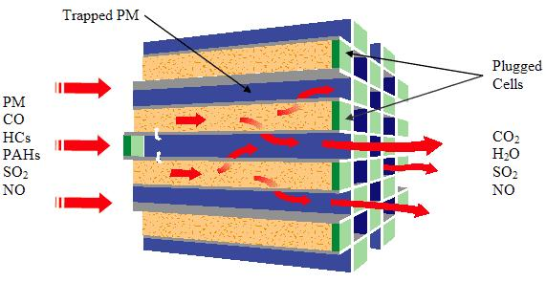
非道路移动源排放控制技术评估和应用
Advanced technologies and measures for non-road sector
全球范围内有效控制非道路排放源的技术广泛存在，中国可以有效借鉴 Affordable and feasible technologies exist for the effective control of off-road emissions and China can easily leapfrog in its pollution control policy development for NRMS.
广泛应用在道路移动源上的SCR/DPF等先进技术，可移植到非道路移动源上 The learnings from controlling pollution from trucks are readily applicable to the off-road sector. These include advanced engine design optimization, SCR and DPF, respectively.
相比无控情况，国际先进的非道路机械排放污染物减排幅度可达到50-90% Today’s most advanced off-road engines emit 50 – 90% less pollution than early uncontrolled engines.
x
x

Slide 26
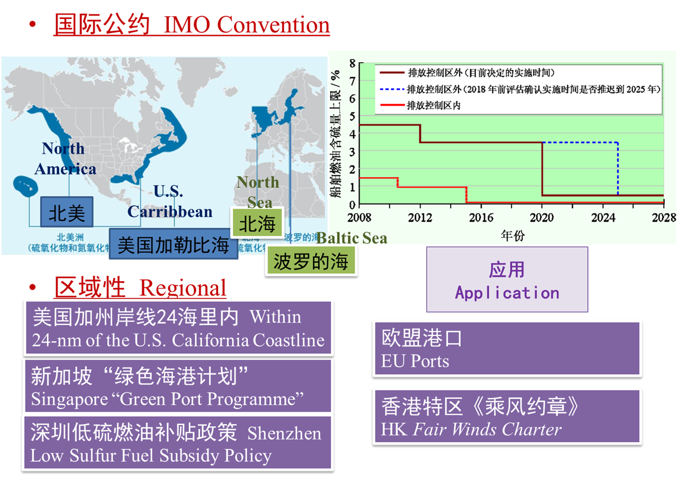
非道路移动源排放控制技术评估和应用（续）
Advanced technologies and measures for non-road sector (cont’d)
低硫燃油
Low Sulfur Fuel
岸电技术 Shore Power at Berth
控制
措施
Emission
Control
Technologies
清洁能源动力船舶（LNG动力船）
Alternative Fuels (LNG fueled ship)
船速控制
Vessel Speed Control
污染物末端处理
Exhaust Gas Treatment
油气回收
Oil & Gas Recovery

Slide 27
非道路移动源减排的多部门协调机制
Inter-agencies coordination mechanism for non-road sector
1）“新大气法”明确规定了非道路移动机械和船舶污染防治相关的部门责任和职责分工，并强化了环境保护主管部门对非道路移动源的环保监管职能，进一步明确生产企业应承担移动源大气污染控制的主体责任。
The new Air Law has specified the departments responsible for addressing NRMS pollution and specified their responsibilities. The environmental protection authorities under the State Council now have the authority to strengthen NRMS regulation and enterprises must bear the main responsibility for the control of mobile source air pollution.
2）交通部与环保部应进一步加强合作，在国家和地方层面加强沟通，联合制定计划，有效执行更严格的船用燃料和发动机标准。交通部加快研究和推进排放控制区域，当船舶在中国水域运行时，需使用含硫量更低(如0.1% S)的油品。
MOT, in collaboration with MEP and the transport and environmental agencies at the national and local levels, should jointly develop plans for adopting and effectively enforcing stricter standards for marine fuel and engines. MOT is encouraged to set strong ECAs that require use of lower-sulphur fuel oil (e.g., lower to 0.1% S) when vessels operate in Chinese waters.

Slide 28
汇报内容 Outline
项目背景和主要实施过程
Project Storyline and Implementation Process
短寿命气候污染物防控现状、国际经验和多部门协调机制
Current Status, International Experience on Short-Lived Climate Pollutants and their Inter-agencies Coordination Mechanism
非道路移动源防控现状、国际经验和多部门协调机制
Current Status, International Experience on Non-Road Mobile Sources and their Inter-agencies Coordination Mechanism
主要研究结论与政策建议
Major Research Conclusions and Policy Recommendations
Notes:
28

Slide 29
主要研究结论 Major Research Conclusions (1)
一、在大气污染防治工作中对短寿命气候污染物和非道路移动源关注程度不够
Current policies regarding air pollution prevention and control have not adequately taken SLCPs and NRMS emissions into account.
1) 随着复合型大气污染日益突出，中国的管理资源和研究资源都大幅向常规大气污染防治倾斜，但导致对短寿命气候污染物的关注远低于对常规大气污染物的关注。
As composite air pollution worsened in recent years, more management and research resources have been delivered to air pollution prevention and control while SLCPs attracted less attention compared with conventional air pollutants.
2) 当前，道路和非道路移动源NOX 排放的分担比例已经达到了6：4，而非道路移动源排放的一次PM2.5 甚至超过了道路移动源。
On-road and NRMS account for 60% and 40% of NOx emissions respectively, while the latter has a larger role in the primary PM2.5 emissions.
3) 目前进入我国的远洋船舶仍以重油为主要燃料，重油中的硫含量一般在1%~3.5%，较高的硫含量使得船舶的SO2 和PM2.5 排放量均十分巨大。
Currently, the ocean-going vessels entering the country mainly rely on heavy oil which has sulfur content as high as 3.5%. This results in huge SO2 and PM2.5 emissions from marine vessels.
Notes:
29

Slide 30
主要研究结论 Major Research Conclusions (2)
二、当前短寿命气候污染物和非道路移动源的管理系统不足以确保非道路部分短寿命气候污染物的有效控制，“新大气法”为改善此系统提供了机会
The current management systems for SLCPs and NRMS are insufficient to ensure effective control of SLCPs from the non-road sector; the new Clean Air Law offers an opportunity to improve such systems.
1) 在控制非道路移动源空气排放方面，中国现有的管理系统还缺乏统一的监控和监管要求，较难确定非道路机械排放的实际水平。在燃料质量管理方面，非道路移动源所使用的燃料质量普遍很差。
On controlling air emissions from NRMS, the ongoing management system lacks unified monitoring and regulatory requirements, making it impossible to identify the actual level of emissions. In terms of fuel quality management, the quality of fuel used by NRMS is poor.
2) “新大气法”为环保等部门在国家和地方水平控制来自非道路机械和船舶的大气污染以及燃料质量的改善方面提供了法律基础，为在国家水平和大气污染严重的关键区域改善现有短寿命气候污染物和非道路移动源的管理体系提供了机会。
The new Clean Air Law provides the legal foundation for the environmental agencies at the national and local levels to control air pollution from NRMS, and mandates improvements in fuel quality. This also offers an opportunity for improving the existing management system for SLCPs and NRMS.
Notes:
30

Slide 31
主要研究结论 Major Research Conclusions (3)
三、短寿命气候污染物和非道路移动源的排放法规标准及政策相对滞后，“新大气法”为监管体系的完善提供了可能
Emission standards and policies for SLCPs and NRMS emissions lag behind international best practices, and the new Air Law present an opportunity for improving the regulatory system.
1) 在大气污染物排放标准中，除了《煤层气（煤矿瓦斯）排放标准（暂行）》等极个别标准提出了对甲烷排放控制外，对油气开采和农业等领域的甲烷排放均没有控制要求；对黑碳和氢氟碳化物排放的主要污染源也未提出控制要求。
In China, only very few (e.g., Coal-Bed CH4 Emissions Standards) set requirements for CH4 emissions control; but there is no standard towards BC and HFCs control, and CH4 control from other sources (e.g., oil/gas extraction).
2) 我国尚未对非道路移动源排放进行有效管理。“新大气法”规定所有国内船舶使用的新发动机必须符合国家排放标准，同时在关键区域设立排放控制区域；针对非道路移动源的排放标准正在制定，燃油质量也正在进一步提升；这些新立法和监管的发展为非道路部门的加强控制提供了一个难得的机会。
China has not effectively regulated control for NRMS emissions. The new Air Law stipulates that new engines for use on domestic vessels must meet national emission standards and ECAs be established in key regions. Also, standards for NRMS and non-road fuels are being developed. These new legislative developments present a unique opportunity for strengthening control of NRMS.
Notes:
31

Slide 32
主要研究结论 Major Research Conclusions (4)
四、短寿命气候污染物和非道路移动源的某些先进控制技术已在世界范围内应用，这为加快其在中国的应用提供了重要的国际经验
Some of the advanced technologies to control SLCPs and NRMS emissions are available and used around the world; international experience offers opportunities for rapidly enhancing their application in China.
1) 在非道路机械方面，国际上先进的减排技术主要包括选择性催化还原技术（SCR）、颗粒物捕集器技术（DPF）等。这些技术可有效地降低NOX 和PM2.5 的排放，但受到燃油品质、工程机械尿素存储能力等因素限制，尚未应用于国内的非道路机械上。
Advanced technologies to reduce emission from non-road machinery include SCR and DPF. They can effectively reduce NOX and PM2.5 emissions, but have not yet been used on non-road machinery, due to poor fuel quality and a lack of urea storage capacity.
2) 在船舶方面，先进的减排技术包括靠港船舶使用岸电技术、发动机换低硫燃油等。目前岸电技术在上海港、深圳港等港口开始开展试点研究。
Advanced technologies for the control of shipping emissions include using shore power at berth and switching to low-sulfur marine fuel. Now, shore power has not yet been widely used, except for pilots in a few ports, such as Shanghai and Shenzhen.
Notes:
32

Slide 33
主要研究结论 Major Research Conclusions (5)
五、进一步系统研究和更全面的数据将提高对短寿命气候污染物和非道路移动源有效控制的能力
Further research and more comprehensive data will improve the ability to target action on SLCPs and NRMS.
1) 在短寿命气候污染物方面，中国现有的统计体系并未把其纳入污染物排放量的统计范围。仅在《气候变化国家信息通报》等极个别政府文件中，报告了甲烷和少部分HFC的排放量，对于其他短寿命气候污染物，甚至没有国家层面的排放量报告。
SLCPs are not covered as pollutants specified in existing statistical reporting system. Only emissions of CH4 and some HFCs are reported in National Communications on Climate Change and relevant government documents. As to other SLCPs, there are no emission reports at the national level.
2) 在非道路移动源方面，由于缺乏系统全面的统计数据及排放基础数据，我国尚未建立非道路移动源国家排放清单。
There has not yet been a comprehensive emission inventory on NRMS and the research findings to date provide only test results about certain kinds of machinery. The basic data about emission factors and activity data are limited.
Notes:
33

Slide 34
主要政策建议 Major Policy Recommendations (1)
一、制定并完善相关的排放法规标准及政策
Accelerating sound emission regulations, standards, and policies
完善排放标准体系，并基于减排的最佳实用技术规定短寿命气候污染物的排放限值。 SLCPs standards and caps based on the best available technology (BAT).
黑碳，加快能源使用政策转换速度；柴油车、炼焦炉等应达到最佳实用技术要求。energy use policies accelerate the transition away from solid fuels. Regulations for on-road diesel vehicles, coke ovens achieve BAT for reducing BC emissions.
煤矿瓦斯，提高财政补贴标准，完善税收优惠等政策。The CH4 emission standards for coal mine gas allowances and subsidies, as well as tax incentives.
2) 尽快制定针对新的和在用的工程机械、农业机械和海洋船舶排放削减的法规，以力争2020年达到国际最佳实践水平的目标。Regulations for NRMS accelerated with the goal of achieving international best practice norms during the 13th Five Year Plan.
对非道路机械，考虑在“十三五”期间跨越到欧IV阶段非道路排放标准。Leapfrog to Euro IV non-road machinery standards.
对于内河、沿海船舶，中国应考虑跨越到美标Tier 4或同等标准。Leapfrog to US Tier 4 or equivalent standards for inland waterway and coastal vessels.
建立严格的船用燃油标准，尽早将燃料硫含量限值降低到0.1%。Require the use of lower-sulfur fuel, striving to achieve 0.1% limits ASAP.
Notes:
34

Slide 35
主要政策建议 Major Policy Recommendations (2)
二、建立短寿命气候污染物和非道路移动源污染减排管理体系
Building a management system that reduces SLCPs and NRMS emissions
1) 明确监管主体和各部门分工: 针对不同的污染物和重点排放源，分别确定主要监管部门和协作部门。
Regulatory bodies and responsibilities need to be carefully identified.
2) 建立国家-地方分工明确的非道路移动机械环保管理模式: 环保部应建立国家新生产非道路移动机械环保达标管理体系，包括企业信息公开、生产一致性、在用符合性、环保标志等管理制度；地方环保部门应建立在用非道路移动机械环境管理体系。
Establishing an NRMS environmental management mechanism that clarifies the responsibilities of state and local departments: MEP should establish a national compliance system of new NRMS products, covering conformity of production, in-use compliance, environmental labeling, etc.. Local environmental departments establish an environmental management system of in-use NRMS products.
3) 强化排放标准达标管理，创新标准实施机制: 加强能力建设，建立针对短寿命气候污染物主要源和重要非道路移动源的排放监测与监管网络；加强制度创新，开展绿色领跑者计划、排污交易、环境税费等政策研究，提高标准实施的灵活性和有效性。
Enhancing compliance management and introducing innovative implementation mechanisms: enhancing monitoring and supervision networks, institutional innovation such as Green Top Runner Programs, emission trading and environmental taxes.
Notes:
35

Slide 36
主要政策建议 Major Policy Recommendations (3)
三、尽快组织实施“国家清洁柴油机行动计划”
Launching the “National Clean Diesel Engine Campaign”
借鉴美国在非道路移动机械污染防治领域的成功经验，结合我国“一带一路”和“中国制造2025”国家战略，在“十三五”期间尽快组织实施“国家清洁柴油机行动计划”，由国务院牵头，环保部、交通部等部门参加，重点开展道路柴油车、工程机械、农业机械、船舶等关键柴油机领域的清洁化专项工程。Drawing on the U.S. successful practice in NRMS pollution control, China launch the National Clean Diesel Engine Campaign during the 13th FYP period, in line with "the Belt and Road" and "Made in China 2025"
在尽可能多的车辆和发动机上、尽可能快地安装DPF等先进技术，使细颗粒物、黑碳等污染物排放大幅削减。Require DPF on as many vehicles and engines ASAP.
进一步加快老旧柴油机淘汰进程，出台高排放柴油机限期强制淘汰制度，采取财政支持和市场扶持相结合的手段鼓励提前淘汰老旧柴油机，使用DPF等先进技术改善符合条件的在用柴油机排放水平，优化现有非道路移动源车队结构。Mandatory retirement combined with financial and market measures to encourage early elimination of old diesel engines and optimization of the fleet structure.
加快船舶岸电设施建设与使用力度，在港作船、公务船、短途固定航线船舶中推广天然气等清洁能源船舶应用。Shore power facilities intensified and natural gas and other clean energy options favored.
Notes:
36

Slide 37
主要政策建议 Major Policy Recommendations (4)
四、强化科研技术创新应用和行业减排国际合作
Strengthening technological innovation and application and international cooperation in the field of emission reduction
1) 持续加大投入，推动短寿命气候污染物和非道路移动源排放控制最佳实用技术的自主研发，例如非道路移动源的先进技术（SCR和DPF等）的开发、示范和产业化工作。
Expand investment on Best Available Control Technologies (BACTs) to control SLCPs and NRMS emissions, such as development, demonstration and commercialization of advanced technologies (e.g., SCR/DPF) applicable to NRMS.
2) 建立统一的数据核算体系，建立相关大数据监管和控制决策平台，完善相关科研和监管数据的公开和共享机制。
A statistical and accounting system consistent with the systems for other pollutants; and a platform for big data monitoring and control to better facilitate sound decisions and the mechanism for data disclosure and sharing should be established.
3) 中国在建立减排战略的过程中，应充分参考和利用现有的针对短寿命气候污染物治理的多边国际合作机制，包括全球甲烷行动计划（GMI）、气候与清洁空气联盟（CCAC）、全球清洁炉灶联盟，等等。
The emission reduction strategy should fully refer to and use the mechanisms of multilateral cooperation on SLCP governance, including the GMI, CCAC, Global Alliance for Clean Cookstoves, etc..
Notes:
37

Slide 38


致谢 Acknowledgements
Notes:
38

Slide 39
Thank You !

