Slide 1
土壤污染管理专题研究
Special Policy Study on Soil Pollution Management
王树义 Shuyi Wang

Slide 2
汇报提纲 Outline
一、中国土壤污染管理现状及现实需求 Current status of soil pollution management in China and need for legal regulation
二、土壤污染管理的国际经验 International experience and enlightenments on soil pollution management
三、土壤污染管理政策建议 Policy recommendations for soil pollution management in China

Slide 3
一、中国土壤污染管理状况及现实需求
Current status of soil pollution management and need for legal regulation
（一）中国土壤环境状况 Soil pollution in China
1.《全国土壤污染调查公报》（2014.4.17 环保部、国土资源部）
National Soil Pollution Survey Bulletin, April 17 2014, by MEP & Ministry of Land & Resources
注：调查范围：中国境内，未含香港、澳门特别行政区及台湾地区，630万平方公里
Note: The facto survey area is 6.3 m km², excluding Hong Kong SAR, Macao SAR, and Taiwan Province.
全国土壤总超标率为16.1%，污染以无机型为主，占超标点位的82.8% 16.1% of surveyed land exceeds general pollution limits, the main pollution sources are inorganic pollutions, which takes up a proportion of 82.8%
耕地土壤点位超标率为19.4% 19.4% of arable land fail to attain soil environment quality standards

Slide 4
一、中国土壤污染管理状况及现实需求
Current status of soil pollution management and need for legal regulation
部分地区土壤污染较重，耕地土壤环境质量堪忧，工矿业废弃地土壤环境问题突出 Some areas are suffering from bad soil pollution, the environmental quality of the arable land is worrying, and there are pressing environmental problems in industrial and mining deserted lands
南方土壤污染重于北方 The pollution in southern part is worse than the northern part
长三角、珠三角、东北老工业基地土壤污染严重 The pollution is particularly serious in areas of Yangtze River Delta, Pearl River Delta, and the historical industrial bases in northeast China
西南、中南地区土壤重金属超标范围较大 South-western and central regions of China have found wide range heavy metal pollution

Slide 5
一、中国土壤污染管理状况及现实需求
Current status of soil pollution management and need for legal regulation
2.《中国耕地地球化学调查报告》（2015.6, 国土部中国地质调查局） Geochemical Survey Report on Chinese Farmland, June 2015, China Geological survey under Ministry of Land and Resources
调查面积150.7万平方千米 Survey area: 1.5 m km²
调查耕地13.86亿亩（占耕地总面积20.31亿亩的68%） Survey farmland : 68% of total farmland in China
无污染耕地12.7亿亩，占调查耕地面积的92％(污染8%) 8% of total investigated arable land has been contaminated

Slide 6
一、中国土壤污染管理状况及现实需求
Current status of soil pollution management and need for legal regulation
3.《土壤生产力与食品安全调查》（地球化学探索杂志，2014） Soil’s ability to sustain food production and food safety, Journal of Geochemical Exploration, 2014
60%的土壤 ——清洁 60% classified as clean
29.5%的土壤 ——次清洁 29.5% classified as less clean
2.6%的土壤 ——污染 2.6% classified as polluted

Slide 7
一、中国土壤污染管理状况及现实需求
Current status of soil pollution management and need for legal regulation
环保部李干杰副部长指出： From Mr. Li Ganjie, Deputy Minister of MEP
“前述各种调查显示的信息表明，中国的土壤污染已经到了较为危险的程度，如果再不加强土壤污染管理，恐怕会出大问题。若放任不管，一些地方吃饭将成问题”。 “As showed by the various surveys and investigations, the soil pollution in China has arrived very serious degree. If the soil pollution is left untreated, even the food supply will be a problem in some areas.”
“如不采取有力措施，今后一段时间内中国土壤污染加重的趋势将难以扭转，土壤污染将成为影响公众健康与社会稳定的重要因素”。 “If no powerful measures would be made, the soil pollution in China will be irreversible, and soil pollution will be an important problem that will harm the public health and social order.”

Slide 8
一、中国土壤污染管理状况及现实需求
Current status of soil pollution management and need for legal regulation
小 结 Conclusion
中国正面临日趋严重的土壤污染 Soil pollution in China is increasingly serious
全国土壤环境状况总体不容乐观 General condition of China’s soil environment is not optimistic
人为活动系土壤污染的主要原因 Human activity is the main cause of soil pollution

Slide 9
一、中国土壤污染管理状况及现实需求
Current status of soil pollution management and need for legal regulation
（二）中国土壤污染管理现状及问题 Current status of soil governance and management
中国真正意义上的土壤污染管理始于2005年：
A major milestone in Chinese soil pollution management in 2005:
现状
Current status
《关于落实科学发展观 加强环境保护的决定》（2005.12） Decision on Implementing scientific outlook and strengthening environment protection (December 2005)

Slide 10
一、中国土壤污染管理状况及现实需求
Current status of soil pollution management and need for legal regulation
《决定》指出：
Highlights of the Decision
“以防治土壤污染为重点，加强农村环境保护” Soil pollution prevention is a focal point in order to strengthen the environmental protection in rural areas
“开展全国土壤污染状况调查和超标耕地综合治理” Undertake a a national soil pollution survey and a comprehensive management of contaminated arable soil
“污染严重且难以修复的耕地应依法调整” Severely contaminated soil that requires complicated remediation should be regulated by law

Slide 11
一、中国土壤污染管理状况及现实需求
Current status of soil pollution management and need for legal regulation
2005年12月环保部会同国土资源部启动“全国土壤污染状况调查” Nationwide soil survey initiated in December 2005 jointly by MEP and Ministry of Land & Resources
2008年6月环保部发布《关于加强土壤污染防治工作的意见》 “Opinion on strengthening soil pollution prevention” released in June 2008 by MEP
2011年1月《国家环境保护“十二五”规划》专门规定“加强土壤环境保护”The 12th Five-year Plan on National Environment Protection stated that soil environment protection should be strengthened

Slide 12
一、中国土壤污染管理状况及现实需求
Current status of soil pollution management and need for legal regulation
2013年1月国务院印发《近期土壤环境保护和综合治理工作安排的通知》 The “Notice on recent work arrangement of soil environment protection and comprehensive management” issued in January 2013 by the State Council
2013年环保部着手起草《土壤污染防治行动计划》 MEP has been working on the development of an “Action Plan on Soil Pollution Prevention” since the year of 2013

Slide 13
一、中国土壤污染管理状况及现实需求
Current status of soil pollution management and need for legal regulation
国家林业局
State Forestry Administration
环境保护部
MEP
住建部
Ministry of Housing & Rural-Urban Development
国土资源部
Ministry of Land & Resources
土壤污染管理主要部门
Main government departments
水利部
Ministry of Water Resources
卫计委
National Health & Family Planning Commission
农业部
Ministry of Agriculture
其他
Others

Slide 14
一、中国土壤污染管理状况及现实需求
Current status of soil pollution management and need for legal regulation
土壤污染管理主要法律法规依据
Major legislations
环境保护法 Law of Environment Protection
土地管理法 Land Administrative Law
水土保持法 Law of Soil & Water Conservation
固体废物污染环境防治法 Law on the Prevention and Control of Environment Pollution Caused by Solid Wastes
农业法 Law of Agriculture
农产品质量安全法 Law on Quality and Safe Agricultural Products
森林法 Law of Forestry
城乡规划法 Law for Rural Urban Planning
土地复垦条例 Regulation on Land Reclamation

Slide 15
一、中国土壤污染管理状况及现实需求
Current status of soil pollution management and need for legal regulation
土壤污染管理基本法律依据缺失
China lacks acts and regulations on soil pollution management
土壤环境标准体系不健全
An improved soil environment standard system is lacking
问 题
Challenges
土壤污染管理机构不健全，监管能力薄弱 There is a lack of soil management institutions and weak capacity for surveillance on soil environment
保护或治理缺乏稳定资金保障
There is the issue of lacking a financial guarantee for soil remediation, which potentially requires large funds

Slide 16
一、中国土壤污染管理状况及现实需求
Current status of soil pollution management and need for legal regulation
（三）中国土壤污染管理的需求 Need for regulation
土壤环境保护或污染管理的基本法律依据 A system of acts and regulations on soil pollution management
健全的土壤污染管理体制 An improved soil environment regime
明确的土壤污染管理思路 A framework on soil pollution management
科学的土壤环境标准体系 A scientific system on soil environment standard
稳定的土壤环境保护或污染土壤治理的资金保障 A financial guarantee for soil remediation, which potentially requires large funds

Slide 17
二、土壤污染管理的国际经验
International experience and enlightenments on soil pollution management
制定专门法律，完善配套规定，规范土壤污染管理活动 Formulating Legal Frameworks for Comprehensive, Integrated Systems of Soil Environment Protection
制定全面的土壤污染治理计划 Establishing a Comprehensive Soil Management System and Remediation Action Plan
建立健全基于环境风险控制、保障人体健康和生态安全的土壤环境标准体系 Establishing Appropriate Risk Based and Health Based Standards

Slide 18
二、土壤污染管理的国际经验
International experience and enlightenments on soil pollution management
以土壤环境法律颁布实施为分界线，严格规范利用土壤的活动，防止新的土壤污染的产生 The promulgation of new law can be a boundary and take stricter control measures to new polluting source and polluting equipment in order to prevent new pollutions and clarify the legal responsibility
建立专门的土壤污染治理的责任机制和资金保障机制 Establishing Adequate Responsibility Mechanisms and Financial Mechanisms
土壤污染治理与经济振兴相结合 Combining Environmental Protection with Economic Revitalization

Slide 19
三、土壤污染管理政策建议
Policy recommendations for soil management in China
（一）将土壤保护作为一项基本国策
Confer on Soil Protection Fundamental National Policy Status
土壤为万物之母，基础性资源，不可再生，不可替代 Soil is is an irreplaceable limited natural resource and the resource of life on the earth
土壤资源是食物的主要来源 Soil is the growing medium for food
中国是人口大国，粮食消费大国 China needs good soil to feed its people which represents one-sixth of the world population

Slide 20
三、土壤污染管理政策建议
Policy recommendations for soil management in China
（一）将土壤保护作为一项基本国策 Confer on Soil Protection Fundamental National Policy Status
中国约十分之一耕地土壤受到不同程度的污染 Nearly 10% of arable land in China has been polluted
中国的土壤污染日趋严重，未得到有效控制，总体还在加重 Soil pollution in China is increasingly serious and has not been effectively controlled
土壤的生产和生态服务功能不断下降 The function of production and ecological service of soil is continually decreasing
土壤的生态功能是生物多样性保存和生态系统支持的重要要素 Soil contains an essential component of biodiversity and support and/or influence all the country’s ecosystems

Slide 21
三、土壤污染管理政策建议
Policy recommendations for soil management in China
（一）将土壤保护作为一项基本国策 Confer on Soil Protection Fundamental National Policy Status
保护土壤就是保护中国经济社会可持续发展的支撑能力 The protection of soil will ensure China’s capacity for sustainable and social development
环境保护的国策地位被虚化，有名无实，不能使土壤环境得到有效保护 The Fundamental National Policy status of Environment Protection can not effectively protect the soil environment
仅仅将保护耕地作为国策不能满足现今土壤保护的客观需求 The Fundamental National Policy status of Arable Land Protection can not meet the needs for soil protection

Slide 22
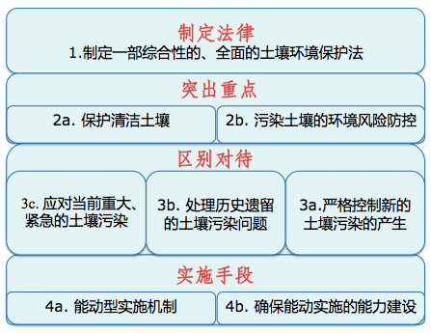
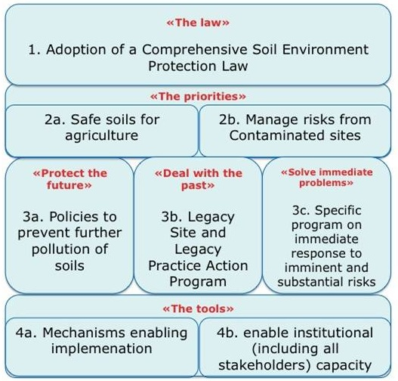
三、土壤污染管理政策建议
Policy recommendations for soil management in China
（二）理清土壤污染管理的基本思路
Identify effective management framework for soil pollution management

Slide 23
三、土壤污染管理政策建议
Policy recommendations for soil management in China
（二）理清土壤污染管理的基本思路
Identify effective management framework for soil pollution management
制定专门法律，将土壤污染管理纳入法治轨道，依法管理 Develop a special soil act in order to provide a legal basis for soil pollution management
保护清洁土壤（重点是清洁耕地土壤） Safe soil for agriculture
防控污染土壤的环境风险 Risk management
抓住两个重点 Two priorities

Slide 24
三、土壤污染管理政策建议
Policy recommendations for soil management in China
（二）理清土壤污染管理的基本思路
Identify effective management framework for soil pollution management
区别对待三个不同时期（过去、现在、将来）的土壤污染问题 Different measures should be taken in order to ensure the future of soil is protected, problems of the past are managed and have the flexibility to solve immediate problems
加强土壤污染管理和土壤法律实施的能力建设 Develop mechanisms enabling implementation; and enable institutional (including all stakeholders) capacity

Slide 25
三、土壤污染管理政策建议
Policy recommendations for soil management in China
（三）将制定《土壤污染防治法》修改为
制定《土壤环境保护法》
Develop a comprehensive Soil Environment Protection Act
转变立法理念，打破惯性思维 Change the traditional idea of legislation
保护 ≠ 防治 Protection ≠ Prevention
环境保护重在保护 The emphasis of environment protection is “protection”
治标与治本 Temporary relief and permanent cure
不单纯是名称问题 Not only a problem of title of the law

Slide 26
三、土壤污染管理政策建议
Policy recommendations for soil management in China
（三）将制定《土壤污染防治法》修改为制定《土壤环境保护法》
Develop a comprehensive Soil Environment Protection Act
由我国解决土壤问题的基本需求和立法的目的决定 China’s Soil Environment Protection Act must reflect China’s soil reality and the targets of soil legislation
由我现阶段解决土壤问题的实际能力决定（1:100） China’s Soil Environment Protection Act must fit with the country’s capacity to solve soil pollution problems
第二代土壤立法的趋势 The tendency of second generation of soil legislation

Slide 27
三、土壤污染管理政策建议
Policy recommendations for soil management in China
（三）将制定《土壤污染防治法》修改为制定《土壤环境保护法》
Develop a comprehensive Soil Environment Protection Act
土壤污染的预防主要应当通过修改、完善和严格执行其他污染防治方面的法律来实现 The prevention of soil pollution should mainly be achieved by revising and improving other relevant environmental laws
国外经验：多制定《土壤保护法》或《土壤环境保护法》 Most countries have used the name Soil Protection Law or Soil Environment Protection Law
《土壤环境保护法》更为全面，调整对象范围更宽 The Soil Environment Protection Act covers comprehensively a wider scope

Slide 28
三、土壤污染管理政策建议
Policy recommendations for soil management in China
（四）构建一个完整科学的土壤环境标准体系
Establish a scientific and integrated soil environment standard system
土壤环境标准是土壤污染管理和土壤环境执法的具体依据，土壤环境法律实施不可或缺的配套措施 The soil environment standard system is indispensable for the effective implementation of soil environment protection laws and regulations
我国缺失许多应有的土壤环境标准 China lacks many soil environment standards

Slide 29
三、土壤污染管理政策建议
Policy recommendations for soil management in China
（四）构建一个完整科学的土壤环境标准体系
Establish a scientific and integrated soil environment standard system
我国需要一个完整科学的土壤环境标准体系 A major task for China is to develop a scientific and integrated soil standard system
土壤环境标准可以分为国家标准和地方标准 The soil environment protection standard system should be consisted of national standards and local standards
可以制定分类、分区的土壤环境标准 The soil environment protection standard system should be consisted of classified and regional soil environment standards

Slide 30
三、土壤污染管理政策建议
Policy recommendations for soil management in China
（四）构建一个完整科学的土壤环境标准体系
Establish a scientific and integrated soil environment standard system
土壤环境标准的制定应遵循立足国情、满足管理需求；系统设计、科学制定；有限目标、持续改进的原则 Principles for developing soil environment standard system
土壤环境标准应在土壤法律中直接体现 The soil environment standard system should be incorporated into Soil Protection Act

Slide 31
三、土壤污染管理政策建议
Policy recommendations for soil management in China
（五）用特殊办法解决社会高度关注的 历史遗留土壤污染问题
Establish a fair and effective liability and financial mechanism to resolve legacy contamination
历史遗留土壤污染 是指现难以找到污染责任人或虽可以找到污染责任人，但其实际已不具备污染治理或修复能力的土壤污染 “Legacy contaminated sites” refers to sites that the person or entity responsible for the contamination can sometimes be difficult to find or identify given the elapsed time

Slide 32
三、土壤污染管理政策建议
Policy recommendations for soil management in China
（五）用特殊办法解决社会高度关注的历史遗留土壤污染问题
Establish a fair and effective liability and financial mechanism to resolve legacy contamination
历史遗留土壤污染具体是指历史遗留的污染场地或污染地块 The term “legacy contaminated sites” refers to sites that were polluted prior to a time specified in the law
现有的污染场地多为历史遗留 Most of the contaminated sites in China are legacy contaminated sites
历史遗留土壤污染受社会高度关注（毒土地、毒大米、血铅） The legacy contaminated sites are highly concerned by the public(contaminated land, poisonous rice, blood lead event)

Slide 33
三、土壤污染管理政策建议
Policy recommendations for soil management in China
（五）用特殊办法解决社会高度关注的历史遗留土壤污染问题
Establish a fair and effective liability and financial mechanism to resolve legacy contamination
解决历史遗留的土壤污染是各国的共性问题 This is a common problem in addressing legacy pollution in many developed countries worldwide
解决历史遗留的土壤污染问题，既可排除潜在的环境风险，又可使污染土壤得到再开发利用 Resolving the problem legacy contaminated sites can help avoiding environmental risks and redeveloping contaminated sites
用特殊办法解决历史遗留的土壤污染问题——许多国家的共同选择 It is a common choice for many countries to take special measures to address legacy contaminated sites

Slide 34
三、土壤污染管理政策建议
Policy recommendations for soil management in China
（五）用特殊办法解决社会高度关注的历史遗留土壤污染问题
Establish a fair and effective liability and financial mechanism to resolve legacy contamination
解决历史遗留土壤污染问题的特殊办法： Special mechanisms
建立一个清晰的责任机制，明确治理、修复责任主体 Establish a clear liability system
设立一个专门的基金，解决治理、修复资金问题 Create a fund dedicated to remediation
开展历史遗留污染场地的调查、分类、评估，做好准备工作 Carry out investigation, classification and assessment of legacy contaminated sites in order to be prepared for the remediation and reparation of polluted soil

Slide 35
三、土壤污染管理政策建议
Policy recommendations for soil management in China
（六）建立和完善土壤污染管理的激励机制和系列措施，充分调动各主体的积极性参与土壤污染管理
Establish an enabling mechanism which includes incentives and a series of measures for soil pollution management, to activate stakeholder participation
土壤污染管理应当摒弃单一的“命令＋控制”的管理模式 The traditional “command and control” model could no longer used in soil pollution management
土壤污染管理应当调动全社会的积极性，多方参与 Encourage and enable the participation of the governments, enterprises and citizens for soil environment protection and soil pollution prevention

Slide 36
三、土壤污染管理政策建议
Policy recommendations for soil management in China
土壤污染管理的激励机制和措施包括: Incentive mechanisms and a series of measures include
政府引导性的激励机制和措施
Government guided incentive mechanisms and measures
经济刺激机制和措施
Economic incentive mechanism and measures
鼓励公众参与的激励措施
Incentive measures for encouraging public participation

Slide 37
三、土壤污染管理政策建议
Policy recommendations for soil management in China
政府引导性的激励机制和措施
Government guided incentive mechanisms and measures
制定、公布污染场地再开发利用规划 The redevelopment plan for contaminated sites is an important part of national planning system
明确污染场地再开发利用的基本流程 A defined four step process that follows a plan, study, remediate and develop approach should be established
实行“谁投资谁受益”、“谁修复谁优先利用”原则 Implement the policies of “who invests in remediation takes the benefit” and “who remediates the land takes the privilege of redevelopment”
鼓励和支持建立“土壤银行” Set up a soil bank

Slide 38
三、土壤污染管理政策建议
Policy recommendations for soil management in China
经济刺激机制和措施
Economic incentive mechanism and measures
将土壤资源价值纳入自然资源核算体系 The economic value of soil should be integrated into the Natural Resource Accounting System
设立土壤保护基金 Encourage and support the establishment of soil protection fund
以资金补助方式刺激发展有机农业 A clear encouragement of organic agriculture through subsidy and technical assistance policy

Slide 39
三、土壤污染管理政策建议
Policy recommendations for soil management in China
鼓励公众参与激励措施
Incentive measures for encouraging public participation
公开土壤环境信息 Public access to and distribution of all relevant information
开通公众检举、投诉土壤污染行为的渠道 Open channels for complaints and reports from the public on soil pollution behaviors
建立沟通渠道，创新公众和企业合作共赢管理模式 more innovative cooperation between public and society

Slide 40
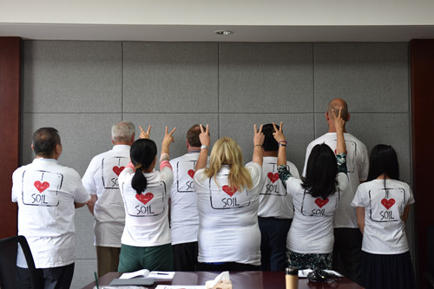
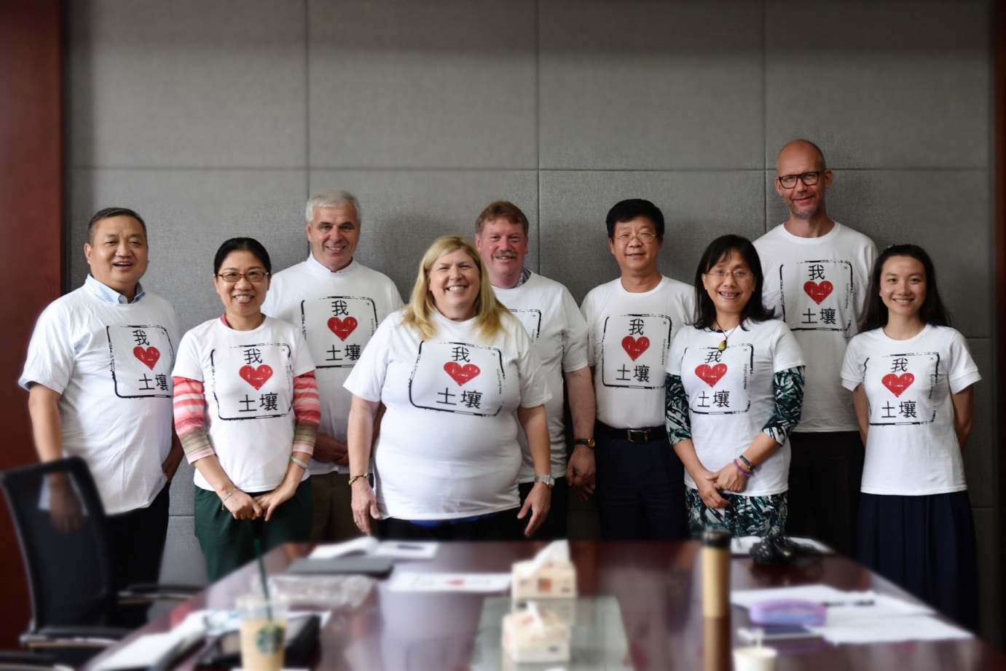
保护土壤环境，推进生态文明建设
谢谢!
Thank You !

Slide 41
Safeguarding Soils 保护土壤
VISION : Fundamental National Policy Status for Soil
愿景：把土壤保护列为基本国策
LEGISLATION : Comprehensive Soil Environment Protection Law
立法：综合性土壤环境保护法
Better protection for agricultural soils 更好地保护农业土壤
2. Protecting and enhancing stores of soil carbon 保护和改善土壤碳储存
3. Building resilience of soils to a changing climate 提高土壤气候变化适应能力
4. Preventing Soil Pollution 土壤污染防治
5. Soil protection during construction and development
建设开发中的土壤保护
6. Dealing with the legacy of contaminated land 解决历史遗留污染土壤问题
7. Future Research
研究未来
8. Working Together 合作与协调
National, Provincial, Municipal Level Policy, Project Integration 各级政府政策与项目的合作与协调
Cross Ministry Cooperation Initiatives 部门间合作
Responsibility/Accountability Assignments 责任划分与问责
Stakeholder Engagement – General Public, Private Sector including Banks, Insurance Companies 多方参与 - 公众、私营部门（包括银行、保险等金融机构）

Slide 42
Path Forward-CCICED led Summit Within First Half of 2016 前瞻 – 建议2016年上半年国合会主办土壤峰会
China Soil Summit- The Economic Bottom Line, Social Influence. Cultural Implication and Environmental Impact of Soil on China’s Future Development, Security and Prosperity. 中国土壤峰会 – 土壤的经济效益、社会影响、文化意蕴和环境影响与中国未来的发展、安全和繁荣
Government Responsibility, Accountability, Legislative Initiatives and Enforcement –”Who is Protecting the People/the Polluter?” 政府责任、立法与执法 – 保护人民还是庇护污染？
Cumulative Impacts and No Net Degradation “Fantasies and Realities” 积累影响与不再恶化 “梦想与现实”
Stakeholder Leadership - State Owned Enterprises, Multinational Companies, SME’s, Developers, Banks. Insurance Companies, Legal Services, Technical Service Providers (remediation firms, labs, universities) 政企合作、行业带头

Slide 43
The Path Forward-Comprehensive, Holistic and Integrated 前瞻 – 全面、整体与综合
Soil is Soil is Soil is Soil 土壤就是土壤
Agriculture Soil Protection 农业土壤保护
Protecting and Enhancing Stores of Carbon 保护和改善土壤碳储存
Resilience of Soils to Changing Climate 提高土壤气候变化适应能力
Protecting Soils During Construction and Development 建设开发中的土壤保护
Research Focus on Above 研究未来
Acknowledgements 致谢
CCICED/Team Members

