Slide 1
大气污染防治行动计划绩效评估与区域协调机制研究
Performance Evaluation on the Action Plan of Air Pollution Prevention and Control and Regional Coordination Mechanism
贺克斌 Kebin He
清华大学 Tsinghua University
2014年5月9日, 天津 May 9, 2014, Tianjin

Slide 2
汇报内容 Contents
1
项目背景 Background
2
研究目标、内容和组织方式
Objectives, Scope and Responsibilities
3
初步研究进展
Progress and Preliminary Results

Slide 3
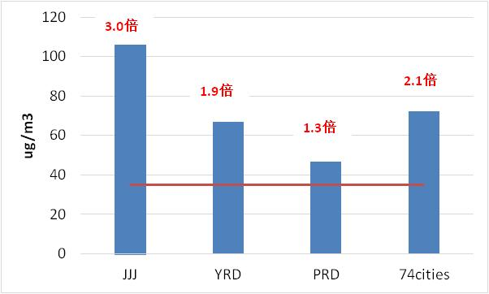
项目背景 Background
全国大气污染形势极为严峻: PM_{2.5}浓度距达标差距较大
A wide gap between PM_{2.5} concentration and the standard
首批开展PM_{2.5}监测的74个城市中，有71个不达标
71 cities out of 74 (started PM_{2.5} monitoring since 2013) fail to comply with the PM_{2.5} standard
京津冀区域PM_{2.5}平均浓度为二级标准的3倍
Beijing, Tianjin and Hebei : 3 times the level of Grade-II standard
长三角区域PM_{2.5}平均浓度为二级标准的1.9倍
Yangtze River Delta: 1.9 times the level of Grade-II standard
珠三角区域PM_{2.5}平均浓度为二级标准的1.3倍
Pearl River Delta: 1.3 times the level of Grade-II standard
74个城市PM_{2.5}平均浓度为二级标准的2.1倍 74 cities : 2.1 times the level of Grade-II standard
2013年PM_{2.5}浓度超标情况
PM_{2.5} concentration in 2013
数据来源于中国环境监测总站
Source: China National Environmental Monitoring Center

Slide 4
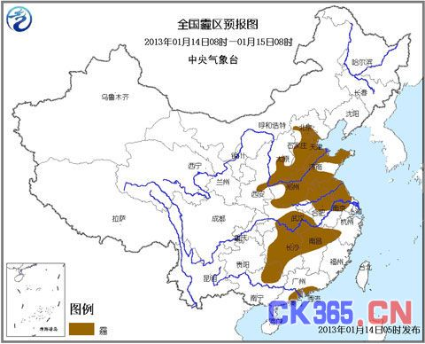
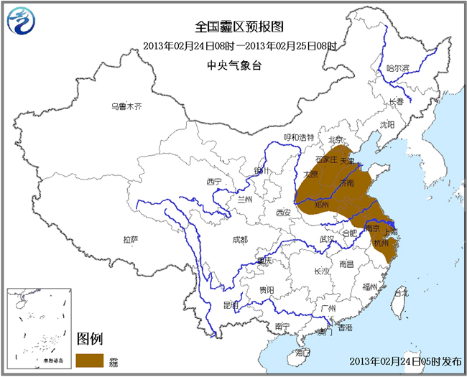
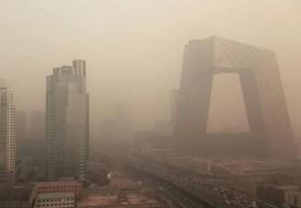
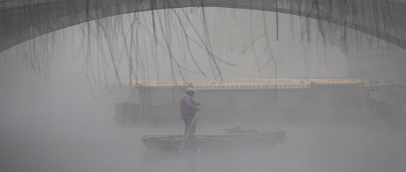
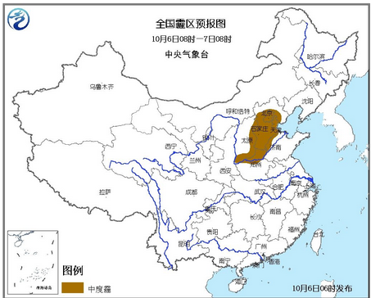
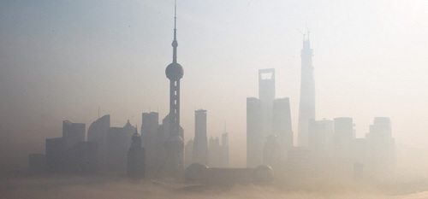
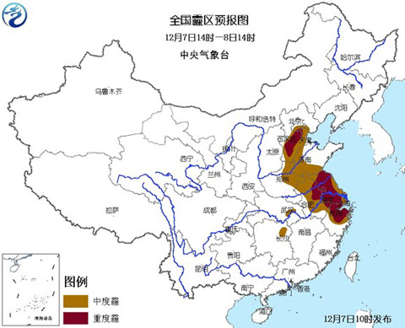
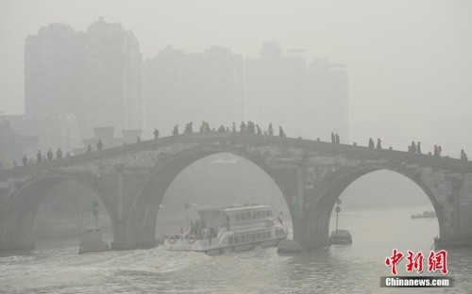
项目背景 Background
全国大气污染形势极为严峻: PM_{2.5}导致高强度的灰霾污染
Severe haze episodes led by PM_{2.5} pollution
Jan 14-15, 2013
Feb 24-25, 2013
Beijing
Jinan
Oct 06-07, 2013
Dec 07-08, 2013
Shanghai
Hangzhou

Slide 5
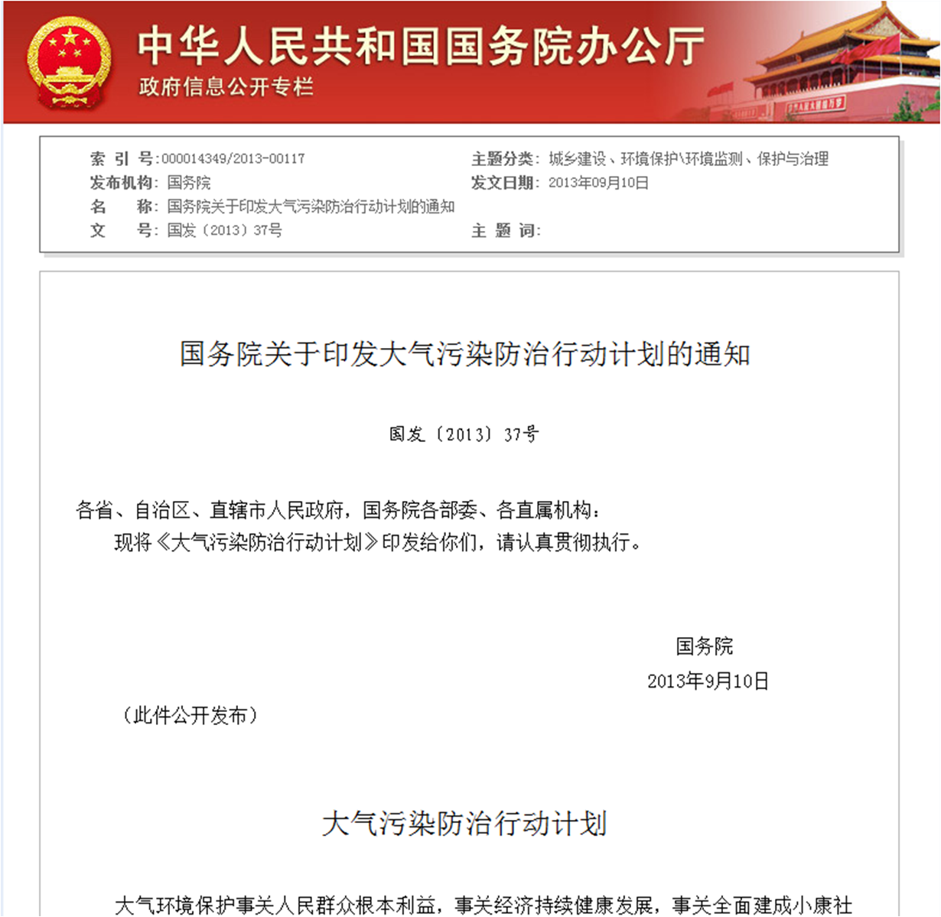
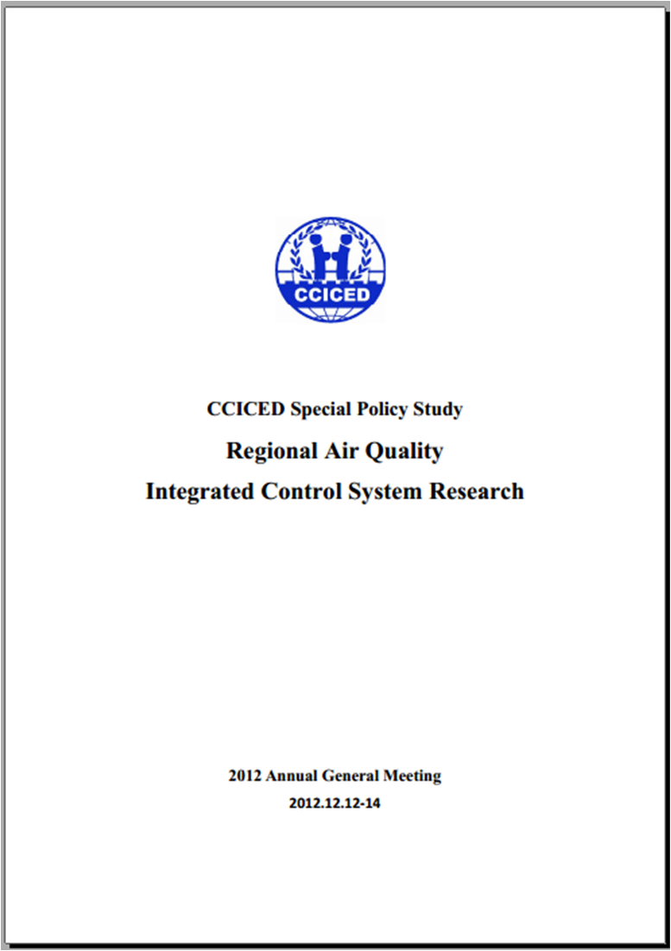
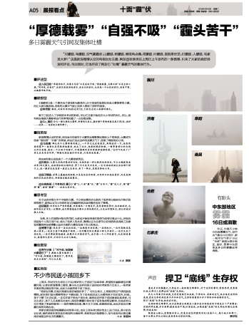
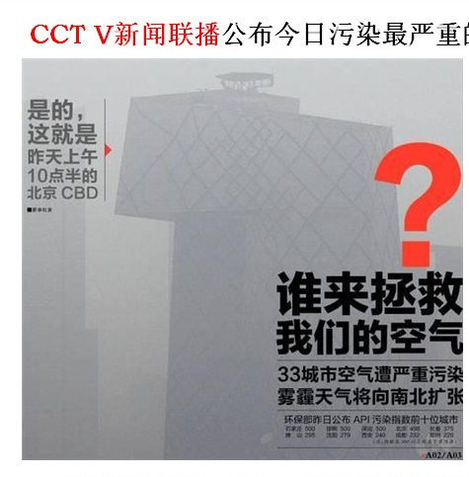
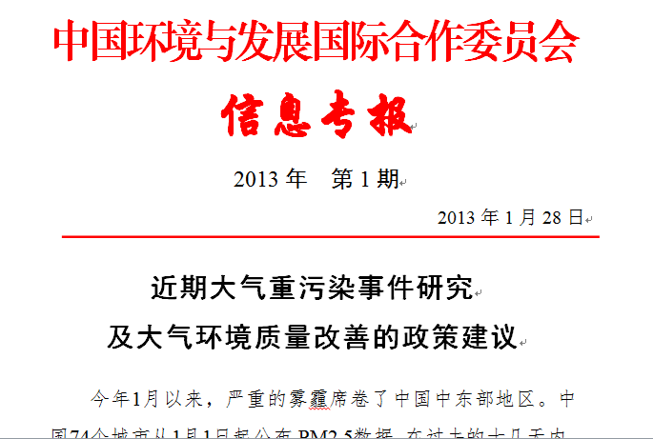
新一届政府制定行动计划，制定了最严格的措施
Action Plan and most stringent measures developed by the government
人民关注
Public concern
专家建议
Recommendations

Slide 6
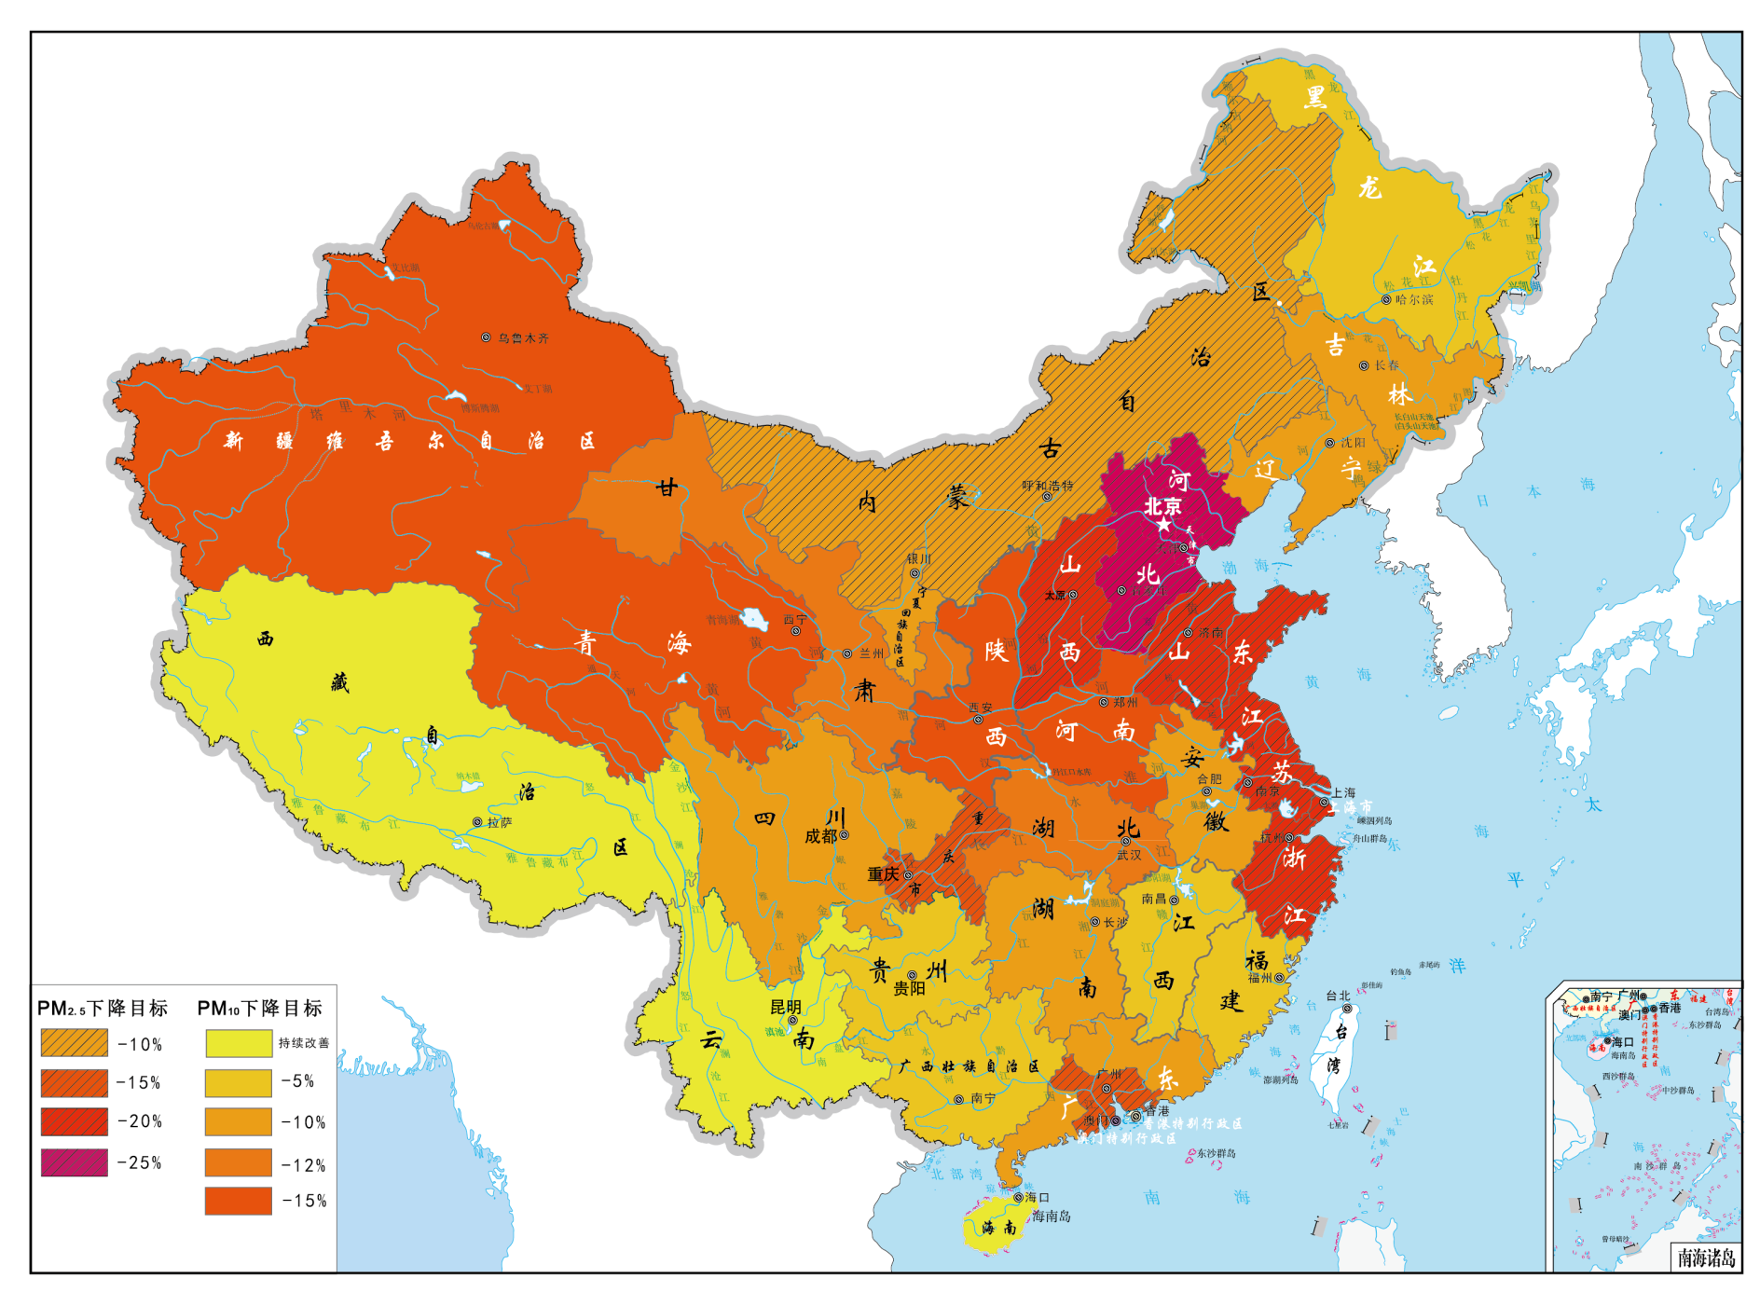
以签订目标责任书的形式确定了2017年31个省空气质量改善目标 Letter of target signed on AP targets for 31 provinces
目标分档原则
Principles for classification
各地社会经济发展现状
Current social and economic development
结合当地空气质量现状
Current air quality
目标分档类型
Types for classification
重点与非重点地区
Key areas and non-key areas
PM_{2.5}四档；PM₁₀五档
4 levels for PM_{2.5} and 5 levels for PM₁₀

Slide 7
汇报内容 Contents
1
项目背景 Background
2
研究目标、内容和组织方式
Objectives, Scope and Responsibilities
3
初步研究进展
Progress and Preliminary Results

Slide 8
项目目标 Objectives
《行动计划》实施绩效评估
Performance evaluation
区域协调机制建议Recommendations on regional coordination mechanism
中长期路线设计
Mid-to-long-term roadmap design
1
2
3
建立反映《行动计划》实施进展与效果的指标体系；Indicator system reflecting the progress & results of implementing Plan (the Action Plan);
研究《行动计划》绩效评估的方法，对各措施绩效进行预评估；Explore evaluation methods & Pre-evaluate the performance of Plan;
根据预评估提出《行动计划》各项措施动态调整的对策建议，提高《行动计划》的执行效果；Propose recommendations for dynamic adjustment to Plan based on pre-evaluation, optimize implementation
基于污染跨界输送规律划定实施联防联控的区域，设计区域大气污染防治协调机制，提出改善区域空气质量的政策建议；
Delineate the areas for joint prevention and control according to the law of transboundary pollution transmission, design the regional coordination mechanism, and propose policy recommendations for improving regional air quality
研究提出可纳入“十三五”的中期及至2030年的长期大气污染防治目标、路线图和战略措施。
Design the objective, roadmap and strategic measures for pollution prevention and control that can be incorporated into the 13th FYP and
long-term plan

Slide 9
项目内容 Project Contents
专题一：《行动计划》绩效评估指标与方法体系研究
SPS1: Study on Performance Evaluation Indicators and Methodology System for the Action Plan
专题二：“十三五”与2030年大气污染防治目标与路线图
SPS2: Air Pollution Prevention and Control Targets and Roadmap for the 13th FYP and 2030 Long-term Plan
专题三：区域大气污染防治协调机制国际经验研究
SPS3: Study on International Experiences of Coordination Mechanism for Regional Air Pollution Prevention and Control
专题四：区域大气污染防治协调机制与政策研究
SPS4: Coordination Mechanism and Policy Study for Regional Air Pollution Prevention and Control
政策建议 Policy Recommendations

Slide 10
项目组织方式 Responsibilities
中方主席 Chinese Co-chair：郝吉明 院士 Jiming Hao CAE Academician
外方主席 International Co-chair：Michael Walsh
中方核心组成员 Chinese team members：
贺克斌 (Kebin He)，杨金田(Jintian Yang)，鲍晓峰 (Xiaofeng Bao)
外方核心组成员 International team members：
Jeremy Schreifels, Markus Amann, Martin Lutz, Steinar Larssen
顾问 Consultant：周宏春 (Hongchun Zhou)，赵英明 (Yingming Zhao)，周大地 (Dadi Zhou)
支持专家 Supporting experts: 王书肖 (Shuxiao Wang)，吴烨 (Ye Wu)，雷宇 (Yu Lei)，宁淼 (Miao Ning)，张大伟 (Dawei Zhang)，伏晴艳 (Qingyan Fu)，胡京南 (Jingnan Hu)，刘欢 (Huan Liu)

Slide 11
汇报内容 Contents
1
项目背景 Background
2
研究目标、内容和组织方式
Objectives, Scope and Responsibilities
3
初步研究进展
Progress and Preliminary Results

Slide 12
1)《行动计划》绩效评估指标与方法体系研究
Study of performance evaluation index and method for ACTION PLAN
Ⅰ. 绩效评估的方法 Performance Evaluation Method
《行动计划》的预评估 Pre-evaluation
《行动计划》措施
Measures
减排效果评估
Emission reduction evaluation
基于模型模拟的空气质量改善效果评估
AQ improvement effect evaluation by model
控制措施加强/改进建议
Strengthen or improvement recommendation
《行动计划》实施进展的追踪评估 Dynamic/Track evaluation
空气质量改善绩效评估
AQ improvement evaluation
大气污染防治工作进展评估
Progress of air pollution control
空气质量改善是否达到预定目标?
AQ reaches target?
大气污染防治任务是否完成?
Implement the air pollution control task?
关于控制措施加强/改进的建议
Strengthen control measures
关于措施实施的建议
Recommendations on measures to implement
若未完成预定目标与任务，分析原因
If no, analysis reason
Notes:
12

Slide 13
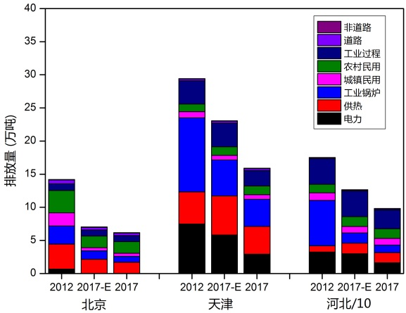
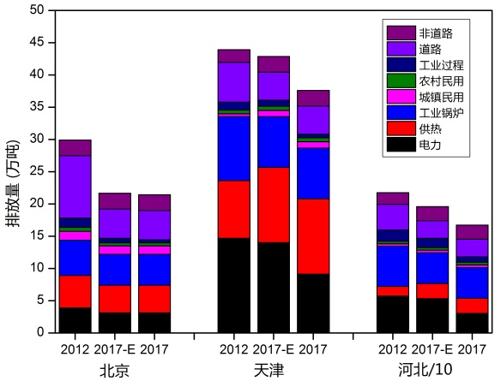
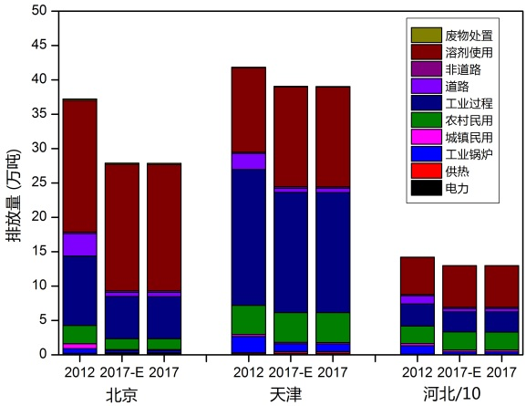
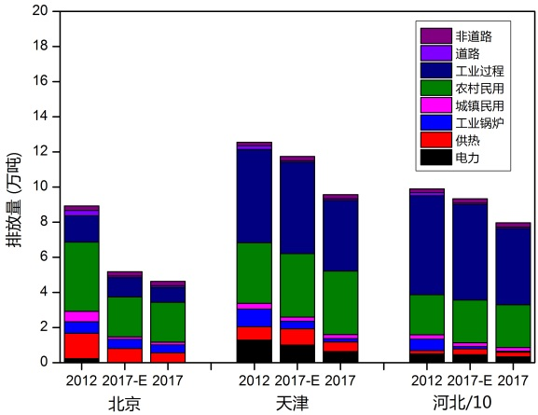
1)《行动计划》绩效评估指标与方法体系研究
Study of performance evaluation index and method for ACTION PLAN
Ⅱ《行动计划》实施绩效预评估（京津冀地区）
Pre-evaluation (Jing-Jin-Ji region)
京津冀地区2017年主要污染物SO₂、NO_{x}、PM_{2.5}、VOC的排放量相比2012年分别下降45%、22%、22%、11%。
SO2, NOx, PM2.5, VOC emissions in 2017 decreased by 45%, 22%, 22%, 11% compared to 2012
河北省贡献了京津冀地区SO₂、NO_{x}、PM_{2.5}、VOC减排量的78%、77%、73%、50%；
Hebei contributed SO2, NOx, PM2.5, VOC emission reductions of 78%, 77%, 73%, 50% for JJJ region.
北京市的减排幅度最大
Beijing with maximum reduction rate.
(a) SO₂ (b) NOx
(c) VOC (d) PM_{2.5}
京津冀地区主要污染物排放变化
Air pollutants emission trend in JJJ
Notes:
2017-E是只考虑能源结构调整的措施，2017是所有措施都包括的减排潜力。
13

Slide 14
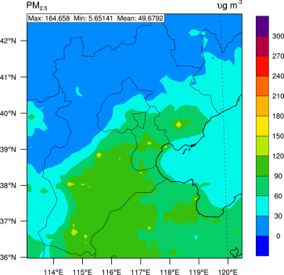
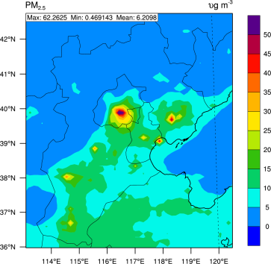
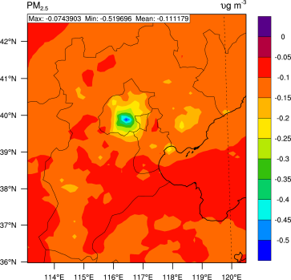
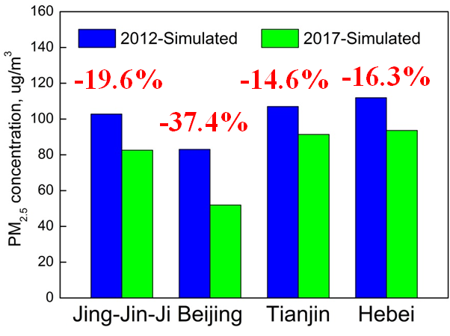
1)《行动计划》绩效评估指标与方法体系研究
Study of performance evaluation index and method for ACTION PLAN
Ⅱ《行动计划》实施绩效预评估（京津冀地区）
Pre-evaluation (Jing-Jin-Ji region)
初步模拟结果显示，现有能定量减排的政策措施落实后，北京PM_{2.5}浓度降幅明显，但天津市和河北省仍存在达不到2017年浓度降低25%的风险。
Initial simulation results based on existing policies and measures which could be quantitative show that the Beijing PM2.5 concentrations reduce significantly, but Tianjin and Hebei are at risk to reach the target.
而且现在的资源、能力建设等基础尚不能支持政策措施全面落实到位.
The resources, capacity building and other infrastructure is not yet fully to support measures implementation.
2017 2012 - 2017 (2017 - 2012) / 2012
Notes:
14

Slide 15
1)《行动计划》绩效评估指标与方法体系研究
Study of performance evaluation index and method for ACTION PLAN
Ⅲ 《行动计划》实施绩效的跟踪评估（京津冀地区第一季度）
Dynamic/Track evaluation (JJJ region the First Quarter )
Index | Content
AQ improvement | PM2.5 concentration
 | Heavy pollution day
Air pollutants mitigation | SO₂/NOx/PM₁₀/PM_{2.5}/VOCs
Air pollution control task progress | Optimize industrial structure | Reduce Excessive Production Capacity Phase out outdated production capacity Relocation of heavy pollution enterprise
 | Optimize energy structure | Total coal consumption control Optimize coal consumption structure Improve coal quality Improve energy use efficiency
 | Industry pollution control | Phase out small coal boilers Desulfurization, de-nitrogen and dust removal projects in key industries. VOCs control Oil and gas recovery
 | Dust control | Construction site road Storage
 | Vehicle pollution control | Phase out Yellow label Improve oil quality Strict vehicle standard
 | Heavy pollution day early warning | Timely warning information In strict accordance with the warning level to activate contingency plans
《行动计划》实施绩效应从三个方面进行系统评估
空气质量改善 AQ improvement
大气污染物减排 Air pollutants mitigation
大气综合整治工作进展 Air pollution control task progress

Slide 16
2) “十三五”与2030年大气污染防治目标与路线图
Air Pollution Prevention and Control Targets and Roadmap for the 13th FYP and 2030 Long-term Plan
情景设计 Scenario settings

Slide 17
2) “十三五”与2030年大气污染防治目标与路线图
Air Pollution Prevention and Control Targets and Roadmap for the 13th FYP and 2030 Long-term Plan
经济和行业发展预测
Forecasting of economic and sector development

Slide 18
2) “十三五”与2030年大气污染防治目标与路线图
Air Pollution Prevention and Control Targets and Roadmap for the 13th FYP and 2030 Long-term Plan
Air quality goals
空气质量目标设定
2020年：
50%以上城市空气质量达标(GB 3095-2012)
珠三角、长三角区域空气质量全面达标，京津冀区域PM_{2.5}年均浓度降至50 ug/m³以下
2020:
More than 50% cities meeting the NAAQS (GB 3095-2012)
The whole region of PRD and YRD meeting the NAAQS, and annual PM_{2.5} concentration in BTH region down to below 50 ug/m³
2030年：
80%以上城市空气质量达标
珠三角、长三角区域空气质量达到世卫组织指导值的第二阶段目标值，京津冀区域空气质量全面达标
2030:
More than 80% cities meeting the NAAQS
The whole region of PRD and YRD meeting the interim target-2 of WHO guidelines, and the whole BTH region meeting the NAAQS

Slide 19
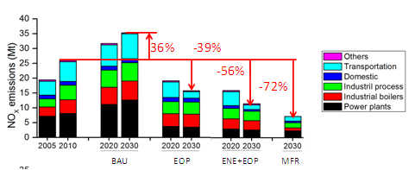
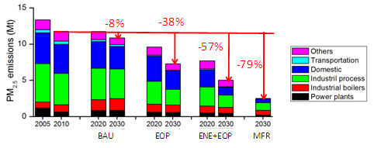
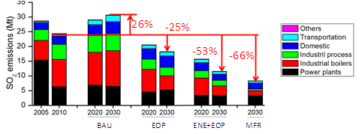
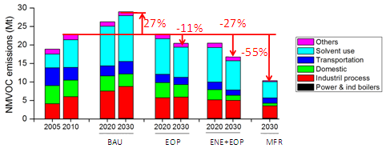
2) “十三五”与2030年大气污染防治目标与路线图
Air Pollution Prevention and Control Targets and Roadmap for the 13th FYP and 2030 Long-term Plan
中国NOx排放情景分析
NOx emission scenarios in China
中国PM_{2.5}排放情景分析
PM_{2.5} emission scenarios in China
中国SO₂排放情景分析
SO₂ emission scenarios in China
中国NMVOC排放情景分析
NMVOC emission scenarios in China

Slide 20
国际经验研究的重点 International Points of Focus
3) 区域大气污染防治协调机制国际经验研究
International Experiences of Coordination Mechanism for Regional Air Pollution Prevention and Control
系统梳理欧洲和美国区域空气污染控制的经验 Review and update experience in both Europe and the United States in addressing regional air pollution
最新的进展 Experience to date
当前面临的挑战 Current challenges
PM2.5空气质量监测的质量保证体系 QA/QC for PM2.5 air monitoring
国际应对重污染天气的经验 International experience with episodic events
达标挑战：以交通源控制为例 Compliance challenges – Transportation Example

Slide 21
3) 区域大气污染防治协调机制国际经验研究
International Experiences of Coordination Mechanism for Regional Air Pollution Prevention and Control
欧洲处理区域空气污染的经验 The European experience with regional air quality problems
Factors contributing to the past decline in SO₂, NOx and CO₂ emissions
Sectorial and spatial origin of ambient PM_{2.5} in European cities
The EU policy framework to respond to the different governance levels that are responsible for controlling emission sources
The National Emission Ceilings Directive: Efficiency versus equity
Types of AQ standards & their legal relevance
Consequences of non-compliance
美国处理区域空气污染的经验 US experience with regional air quality problems
Policy mechanisms and institutions for reducing regional emissions
Approach to developing state emission limits and schedules
Key policy mechanisms and institutions for controlling emissions from key sectors
当前欧洲空气质量标准实施的挑战 Current challenges for the implementation of EU air quality legislation:
In Use NOx emissions compliance for diesel vehicles
Small scale combustion and concentrated local pollution
Limited capacity to assess and manage air quality problems and impacts
Governance deficiencies preventing better coherence of air quality and other policies

Slide 22
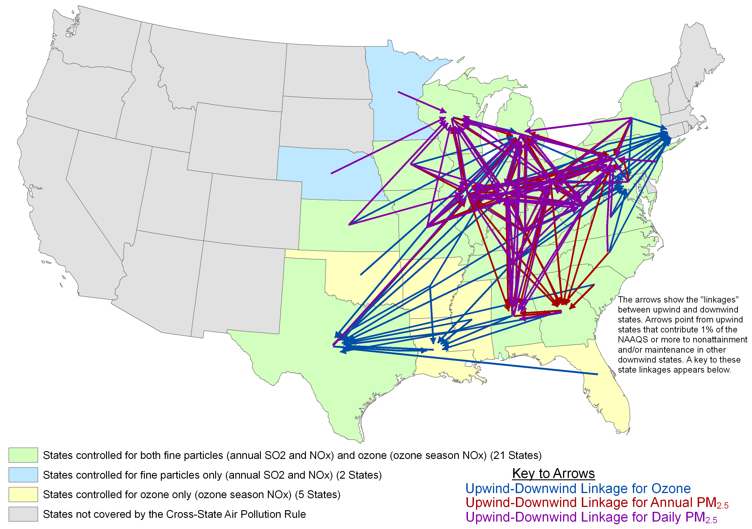
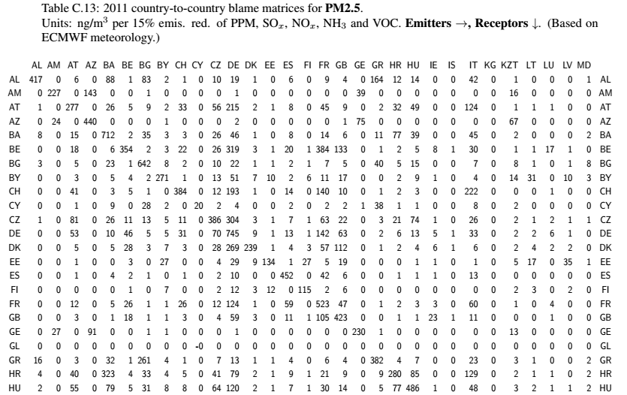
3) 区域大气污染防治协调机制国际经验研究
International Experiences of Coordination Mechanism for Regional Air Pollution Prevention and Control
联防联控区域划定 Area delineated
Source: USEPA
美国通过“跨州空气污染法案”，减少区域传输，降低PM2.5浓度
Clean Air Interstate Rule (CAIR) to reduce regional transport, reduce PM2.5 concentrations
Source: EMEP, 2013
欧洲1979年签署“长距离越境空气污染公约” ,减排政策的制定建立在定量化跨界输送分析基础之上。
LRTAP, emission reduction policy built on the basis of quantitative analysis of cross-border transport.
Quantitative analysis of cross-border transport for 31 provinces
Delineate area needing joint control
Notes:
22

Slide 23
4) 区域大气污染防治协调机制与政策
Regional air pollution prevention coordination mechanism and policy
组建了环保部牵头的部际协调机制
Inter-ministerial coordination mechanism
leading by the MEP
协调配合组建了北京市牵头的
京津冀大气污染防治协作机制
JJJ region coordination mechanism
leading by Beijing
Initially Established
Air Pollution
Prevention Coordination Mechanism
上海市牵头建立了长三角大气污染
防治协作机制
Yangtze River Delta region coordination
mechanism leading by Shanghai

Slide 24
4) 区域大气污染防治协调机制与政策
Regional air pollution prevention coordination mechanism and policy
区域产业结构调整与布局优化
Regional industrial structure adjustment and layout optimization
基于质量改善的区域主要大气污染物减排目标确定
Determined emission reduction targets based on regional AQ
基于PM_{2.5}跨界传输关系的大气污染物减排目标分解
Distribute mitigation tasks based on PM2.5 ross-border transmission
区域煤炭消费总量控制目标确定与分解
Setup and distribute regional total coal consumption target
实施区域协同
减排
Regional mitigation

Slide 25
4) 区域大气污染防治协调机制与政策
Regional air pollution prevention coordination mechanism and policy
构建区域环境信息共享机制 Information sharing
建立区域和部门协调制度，协商区域环境决策 Regional coordination system, negotiated regional environmental decision-making
建立常态化区域重污染天气监测预警平台 Establish normalized area heavily polluted weather monitoring and warning platform
进一步深化
区域协调机制
Further Speed up
Regional Coordination
Mechanism
建立重大项目环境影响评价会商机制 EIA consultation mechanism
统一区域环境执法标准和尺度 Unified regional environmental enforcement standards and scales
统一监测方法、监测内容 Unified monitor method and content
加强对区域空气质量的综合评估 Strengthen the comprehensive assessment of regional air quality
Notes:
建立区域和部门协调制度：关键在于构建区域内统一的环境管理信息共享与区域环境决策协商机制，形成协调区域行政主体之间利益的有效平台
建立常态化预警监控平台：通过科学研究和预测预警，在区域大气污染联防联控机制下，协调区域内的临时减排措施，减轻或避免极端不利气象条件下的大气重污染
建立环评监督和执法会商制度：对于新污染源的准入，需要建立重大项目环境影响评价会商机制。对于已有污染源的监督，需要在区域内统一环境执法监督的标准和尺度。
实施统一监测：对区域内的城市和背景点监测内容、监测方法进行统一要求；建立更加全面的评估方法，从目前对城市空气质量的评估拓展到对整个区域空气质量的综合评估
25

Slide 26
Thank You !

