Slide 1
International Practices & Innovation for Green Development 绿色发展的国际经验和创新
CCICED 2014 Roundtable
国合会2014年圆桌会议
Arthur Hanson

Slide 2
50 YEARS OF ENVIRONMENTAL CRISIS 50 年的环境危机
1963
1972
1987
1992
2002
2012
‘Silent Spring’
《寂静的春天》
EIA
环境影响评估
WCED
世界环发
委员会
IPCC 1st
Assess.
IPCC评估报告1
Poverty & Env.
贫困与环境
‘Future
We Want’
'我们想要的未来'
Stockholm Conf.
Human Environment
Rio Earth
Summit
WSSD
Jo’burg
Rio +20
Summit

Slide 3
Sustainable Development 可持续发展
Interlocked Relationships
连锁关系
SD可持续发展
ENVIRONMENT
环境
SOCIAL
社会
ECONOMY
经济
Jobs & Ecology
就业与生态
Citizen Protest
公民抗议
Health & Safety
健康与安全

Slide 4
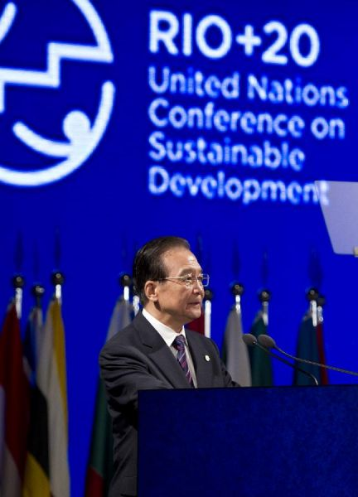
“A Green
and
Prosperous
World”
一个绿色
繁荣的世界

Slide 5
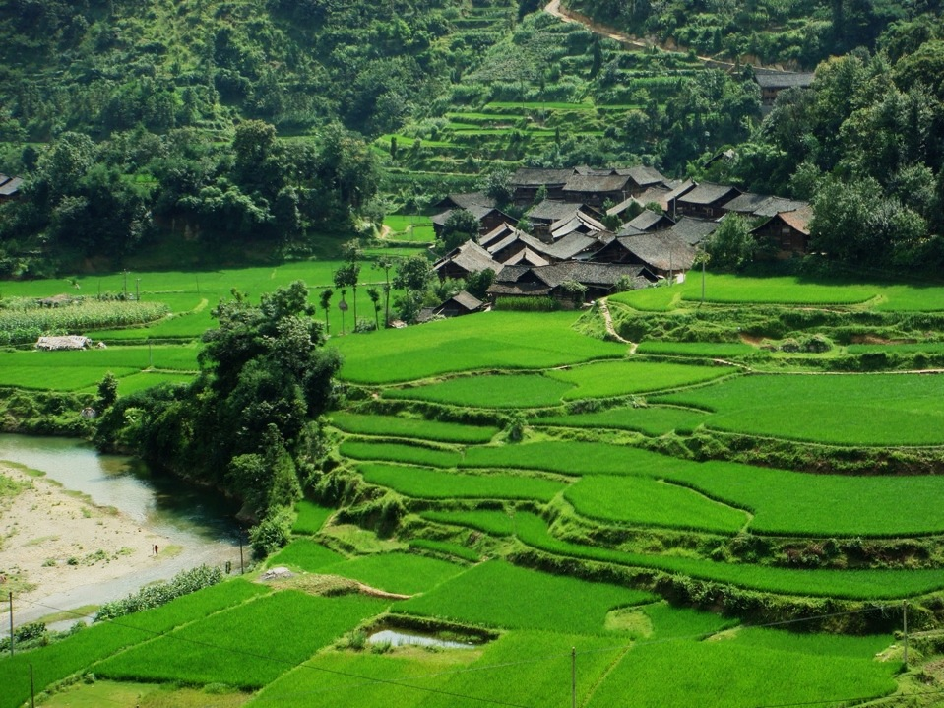
GREEN DEVELOPMENT 绿色发展
“People-centred, unified and harmonious development of economy & environment”
(Hu Angang)
以人为本，经济与环境统一而协调地发展（胡鞍钢）

Slide 6
Green Economy
Green
Development
Green Growth

Slide 7
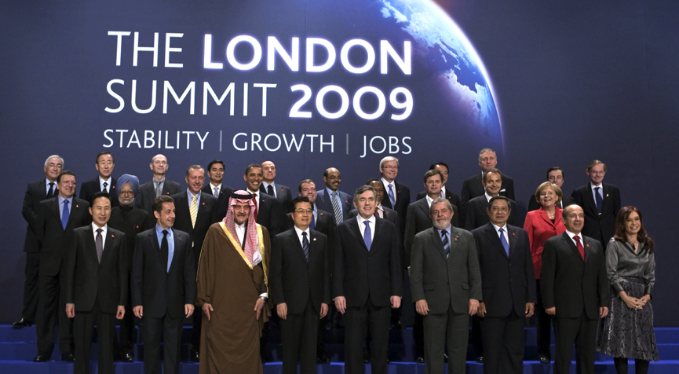
G20 & Financial Crisis - “Accelerate the transition to a green economy”
G20和金融危机－“加快向绿色经济的转型

Slide 8
Green Economy 绿色经济
“One that results in improved human well-being & social equity, while significantly reducing environmental risks & ecological scarcities…one which is low carbon, resource efficient & socially inclusive” (Rio+20/UNEP)
绿色经济旨在改善民生和社会公平，同时大幅度降低环境危害和生态稀缺…并且低碳、资源高效率、社会包容“(Rio+20/UNEP)

Slide 9
Ecosystem Services & Natural Capital
生态服务和自然资本
Green Economy
绿色经济
Optimized Development Benefits for People & Planet
为人类与地球优化发展的利益
=
₊
Healthy Ecosystems
健康的生态系统

Slide 10
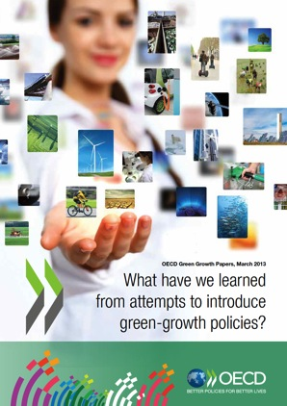
Green Growth – OECD 经合组织－绿色增长
“promoting economic growth while reducing pollution and greenhouse gas emissions, minimizing waste and inefficient use of natural resources, and maintaining biodiversity”
“促进经济增长，降低污染和温室气体排放，减少废物与低效利用自然资源，保持生物多样性”
“improving health prospects for populations and strengthening energy security through less dependence on imported fossil fuels”
“通过降低对进口化石燃料依赖性，提高人口健康前景，强化能源安全”
“making investment in the environment a driver for economic growth” with “a shift in both public and private investments”
用“公共与私人投资换位”来“使投资成为经济增长的驱动力”
http://www.oecd.org/greengrowth/oecdworkongreengrowth.htm
http://www.oecd.org/investment/green.htm

Slide 11
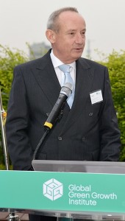
GGGI “Partners with countries to help them build economies that grow strongly and are more efficient and sustainable in the use of natural resources, less carbon intensive, and more resilient to climate change.”
全球绿色增长学院“与各国合作，帮其在强力经济增长同时，更有效、可持续地利用自然资源，更低碳密度，更能应对气候变化。”
Yvo de Boer – Director General of GGGI (and former CCICED Member)
GGGI总裁（前国合会委员）

Slide 12
Needed: 5 Green Growth ‘Revolutions’ 需要：五项绿色增长 ‘革命’
Clean Technology 清洁技术
Energy & Environment 能源与环境
Circular Economy 循环经济
Water & Sanitation 供水与卫生
Urban Green Development 城市绿色发展

Slide 13
GREEN DEVELOPMENT INNOVATION IS BOOMING! 绿色发展创新一片红火

Slide 14
Breakthroughs 突破
Disruptive Sustainability
颠覆性的可持续发展
Facilitative/Enabling 促进／促成
Business Profit Seeking 商业营利
Planning & Management 规划与管理
Consumer Choice 消费者选择
Indigenous/Local 本土／地方

Slide 15
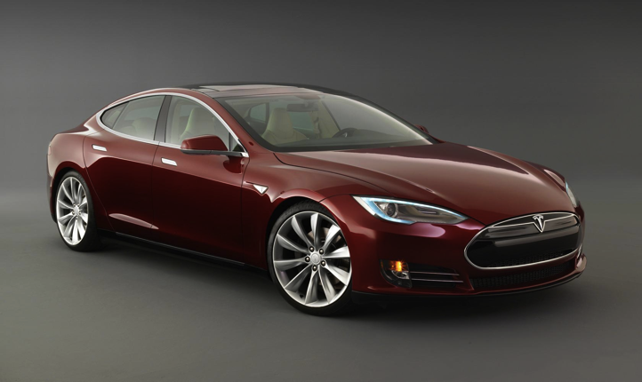
DISRUPTIVE SUSTAINABILITY 颠覆性的可持续发展
Combining Technologies with Design and Behaviour Shifts for Sustainability Solutions
设计与行为结合技术改写了可持续发展的答案
TESLA ‘S’
Nissan Tara
Electric Car
1947-50
http://www.nissan-global.com/EN/HERITAGE/tama_electric.html

Slide 16
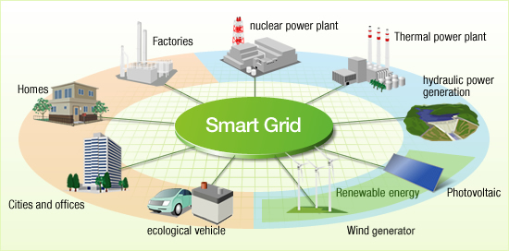
FACILITATIVE/ENABLING促进／促成
Smart Grids - power stability & efficiency 智能电网 － 电力稳定与高效
AJH
http://www.hitachi.com/environment/showcase/solution/energy/smartgrid.html

Slide 17
YET Green Development Is Still Trumped by Unsustainable Practices 绿色发展仍不敌不可持续的做法 WHY?

Slide 18
Weak Eco-Innovation Enablers 生态创新促成者
Partnerships合作伙伴
Green Tech 绿色技术
Enforceable Laws & Regulations
可执行的法律及法规
Business Model
商业模式
Eco-Innovation
生态创新
Financial Mechanisms
财务机制
Entrepreneurship
企业精神
Infrastructure
基础设施
Informed & Motivated Consumers
知情与积极的消费者
(Modified from OECD 2012 presentation Tomoo Machiba http://www.oecd.org/sti/inno/49521430.pdf)

Slide 19
Green Jobs 绿色就业
Investment for Green Economy 绿色经济投资
Green Innovation 绿色创新
Managing the Green Transition 管理绿色转型

Slide 20
Green Growth and Net Job Growth? 绿色增长与净就业增长？
Arguments against positive outcome: 对正面产出的反论：
Slow national transitions to green economy
国家绿色转型缓慢
Demand for green products & services limited
对绿色产品和服务需求有限
High cost of green job creation & limited training
创造绿色就业高成本及有限的培训
Developing countries face immediate challenges & must rely upon “tried and true” approaches
发展中国家面临眼前的挑战，须依赖“真正试过”的方法
Greater efficiency may translate into fewer jobs
提高效率可能意味减少就业

Slide 21
Green Jobs Potential - UNILO 绿色就业潜力
‘Environmentally sustainable & decent work’
‘环境可持续而且体面的工作’
Significance of informal economy
非正规经济的意义
New & additional employment
全新与增加的就业
Co-benefits of green jobs to environment & poverty reduction
绿色就业对环境与降低贫困的共生效益
http://www.uncsd2012.org/content/documents/230assessing%20green%20jobs%20potential%20ILO.pdf

Slide 22
Green Growth and Net Job Growth? 绿色增长与净就业增长？
REALITY – No clear picture at this early stage but millions of Green Jobs have been created as environmental protection takes hold
现实情况－在目前早期阶段还没有清晰的画面，但
随着环境保护逐渐扎根，已经创造了上百万绿色就
业机会

Slide 23
2015-2030 CRITICAL TIME for GREEN DEVELOPMENT 2015-2030年， 绿色发展的关键时期

Slide 24
POST-2015 PRIORITIES 2015年后的优先领域
New SD Goals (UN) 可持续发展新目标（联合国）
Climate Change & Biodiversity (all)
气候变化与生物多样性（全部）
Sustainable Consumption (OECD Countries & Emerging Economies)
可持续消费（经合组织国家及新型经济体）
Trade & Investment (Regional)
贸易与投资（区域性）
Green Development (Rural) 绿色发展（农村）
Poverty & Green Development 贫困与绿色发展

Slide 25
Difficult But Very Significant Topics 困难但有意义的题目
Climate Change & Green Development
气候变化与绿色发展
Planetary Eco-Boundaries – ‘Safe Operating Space’
地球生态边界－ ‘安全工作空间’
Conditions for Inclusive Green Growth Globally
包容性全球绿色增长条件
Trade & Investment Barriers to Green Tech Growth
绿色技术增长的贸易与投资壁垒

Slide 26
‘6th Wave’ of Tech Innovation (to 2030) 技术创新的 ‘第六次浪潮’（到2030年）
Sustainability Redesign – Smart Buildings
可持续性设计－智能建筑物
Radical Resource Productivity – ‘Factor 10’
激进的资源生产力－ ‘因素10’
Whole System Design – Urban Transportation, Circular Economy
完整系统设计－城市交通，循环经济
Green Chemistry 绿色化学
Industrial Ecology 工业生态
Green Nanotech, Biotech 绿色纳米技术、生物技术
Renewable Energy 可再生能源
Radical Communications Tech 激进的传播技术
(Modified from OECD 2012 presentation Tomoo Machiba http://www.oecd.org/sti/inno/49521430.pdf)

Slide 27
Some Conclusions Relevant to China 与中国相关的几个结论
China is best placed of any major country to address green development
中国处于解决绿色发展的最佳地位，
Huge opportunities for S-S cooperation
南南合作的巨大机会
Essential to expand green development responsibilities of enterprises
扩大企业绿色发展责任的关键

Slide 28
Investment, trade & environment relationships require significant strengthening in regional & bilateral relationships
投资、贸易及环境之间关系要求大力加强区
域和双边关系
Loss of ecological services now extends to regional & global levels - no country may now be considered ‘secure’
生态服务的丧失已经扩展到区域和全球层面
－没有哪个国家可被视为是 ‘安全’的

Slide 29
Failure to address climate change and biodiversity loss globally ultimately threatens success of green development nationally & locally
如果在全球范围内不能应对气候变化和生
物多样性的丧失，最终将在国家和地方层
面威胁绿色发展的成果

Slide 30
Alignment of China’s Green Development with International Green Economy Trends is Needed 中国的绿色发展需要向国际上的绿色经济发展趋势看齐

Slide 31
3 Levels of Transformative Change 三个转型性变化层面
‘Ecologically Respectful Conserver Society’
‘尊重生态的保护型社会’
Ecological Civilization 生态文明
‘Green Growth, ‘Green Economy’
‘绿色增长’、 ‘绿色经济’
Green Development 绿色发展
‘New Path for Environmental Protection’
‘环保新道路’
Environmental Protection 环境保护

