Slide 1
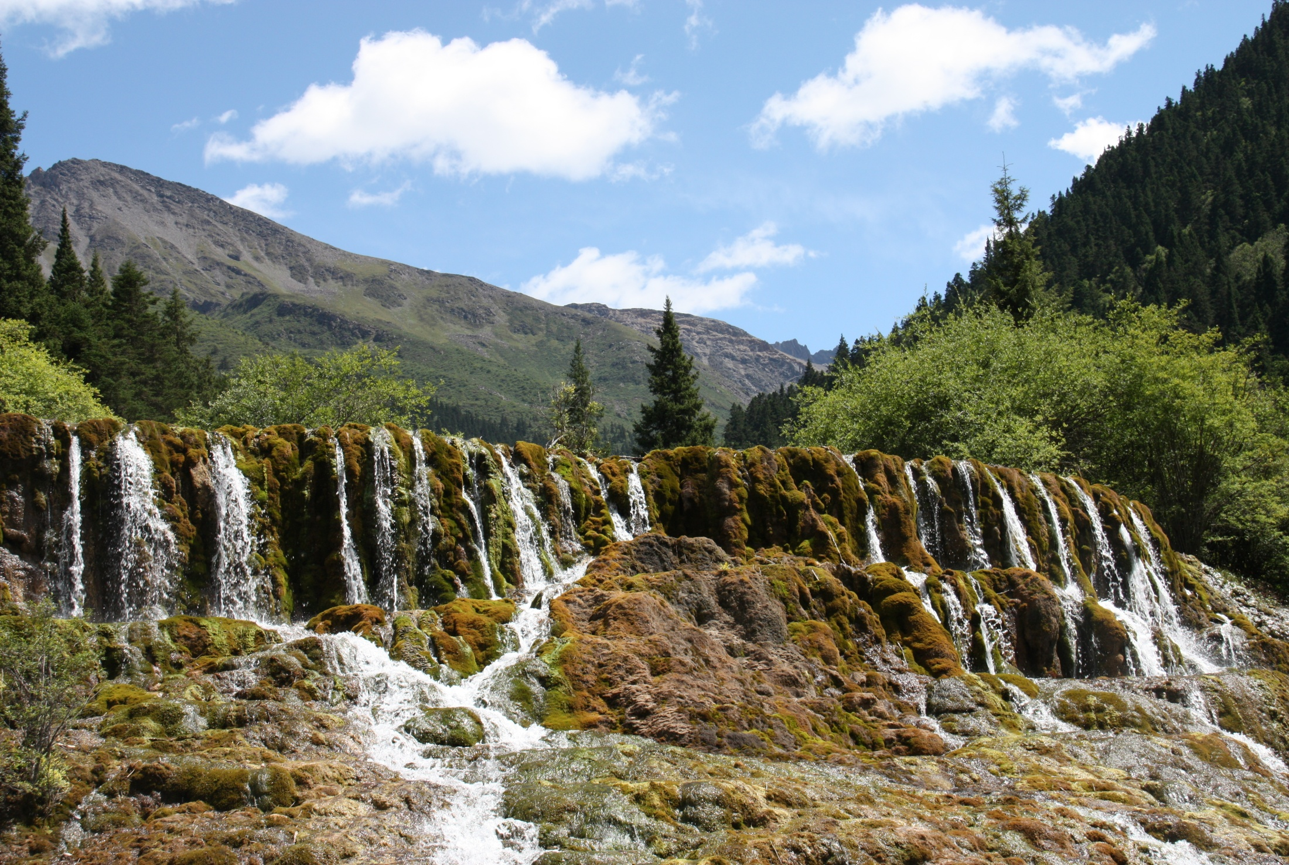
生态环境红线制度创新研究
Institutional Innovation of Eco-Environmental Redlining
Derek Thompson, 欧阳志云
生态环境红线制度创新研究课题组
Research Group on Institutional Innovation of Eco-Environmental Redlining

Slide 2
汇报提纲 Outline
背景/Background
研究意义/Reasons for this work
进展与挑战/Progress but Challenges
制度挑战/The Institutional Challenge
研究目标/Research Objectives
研究内容/Research Content
工作计划/Workplan
初步结果/Preliminary Conclusions

Slide 3
1 项目背景 Project background
简介 Introduction
  中共中央十八届三中全会通过的《关于全面深化改革若干重大问题的决定》中，将划定生态保护红线作为加快生态文明制度建设的重点内容。
  “The Decision on Several Significant Problems about Comprehensively Deepening the Reform adopted at the Third Plenary Session of the 18th Central Committee of the CPC” takes the drawing of ecological redlining as the key content of speeding up the construction of ecological civilization institution
国合会建议/CCICED Advice

Slide 4
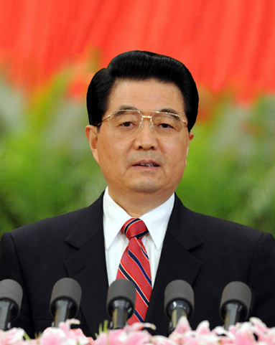
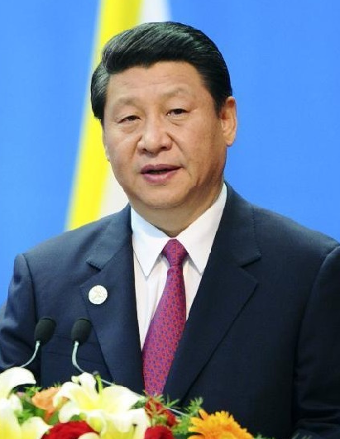
八、Vigorously advancing ecological civilization
construction
Strive to build a beautiful China and achieve sustainable development of Chinese nation.
（一）improve land development program
Promote the intensiveness and efficiency of production space, the livability of living space and gracefulness of eco-space
Build a scientific and reasonable urbanization pattern, agriculture development pattern and ecological safety pattern.
优化国土空间开发格局，构建生态安全格局
2012.11.8
Hu Jintao’s repot at 18th Party
Congress
2013.5.24
Important
Address
draw and observe the ecological red line and whoever transgress the bounds would be punished.
划定并严守生态红线，不越雷池一步。
2013.11.9
Third Plenay
Session
We should improve the property right system of natural resources application management system, draw ecological red line, implement the paid use of resources and ecological compensation system and reform management system of ecological environment protection.
划定生态保护红线，改革生态环境保护管理体制
planning the ecological red line is the basis and premise of optimizing land development program, building ecological security program and a beautiful China. （美丽中国）

Slide 5
六个产出：Six products
确定定义与特征/Define Outcomes and Characteristics
提出新的制度体系/Propose new Institutional regime
提出制度构成/Propose Institutional components
确定基本原则/Identify foundational principles
提出生态补偿的主要途径/Outline essential parts of approach to eco-compensation
提出生态保护红线路线图/Identify a Roadmap

Slide 6
2 研究意义 Reasons to Undertake this Work
划定生态红线对于保障生态环境、增强区域可持续发展能力具有重要意义。 /Drawing EER is key to Maintaining Ecology and to Define & Strengthen regional capacity for sustainable development
  维护国家生态安全/Maintaining ecological security
  增强区域可持续发展能力/Strengthen regional capacity for sustainable development

Slide 7
国家生态保护需求/National ecological protection requirements
对于保障国家生态安全具有重要战略意义
Strategically important for national ecological security
气候变化、人为干扰
生态功能受损
生态问题突出
Global climate change
Irrational human activities
Eco-functions impaired
A series of eco-problems
Ecological Degradation
1.Blind reclamation
2.Deforestation
3.Overgrazing
4.Disordered mining
5.Predatory fishing
6.Improper irrigation
…………
1.Biodiversity
2.Water conservation
3.Conserving water and
soil resources
4.Wind prevention
and sand fixation
5.Flood water storage
6.Climate regulation
…………
1.Sharp decline in
biodiversity
2.Water and soil
erosion
3.Grassland
deterioration
4.Desertification
5.Land salinization
6.Frequency of
droughts and floods
…………
Ecological Support
生态退化
生态支撑
生态退化总体趋势尚未扭转，国家生态安全形势严峻
The ecological degradation trend hasn’t been reversed and
national ecological condition is grim

Slide 8
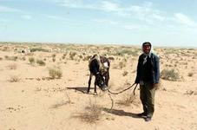
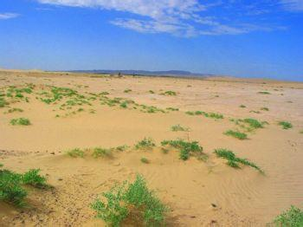
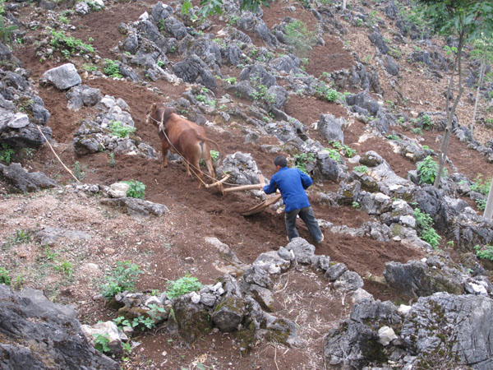
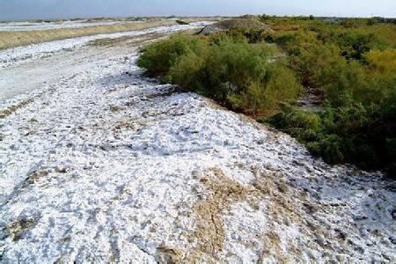
Ecological Degradation 生态退化
water and soil erosion
land desertification
stony desertification
salinization of soil

Slide 9
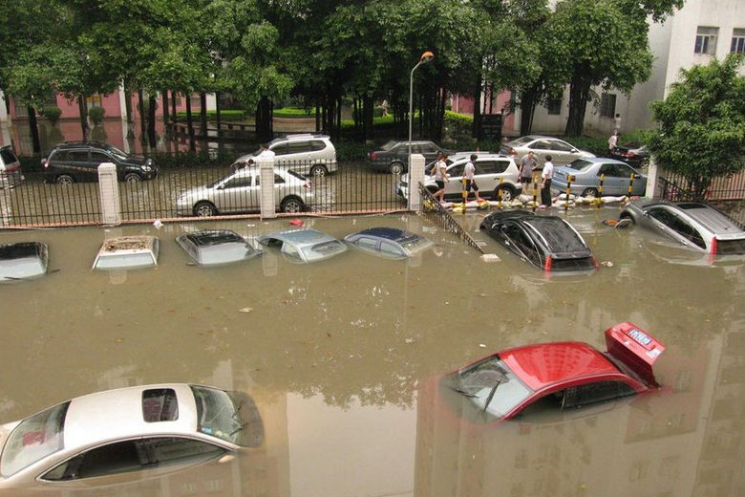
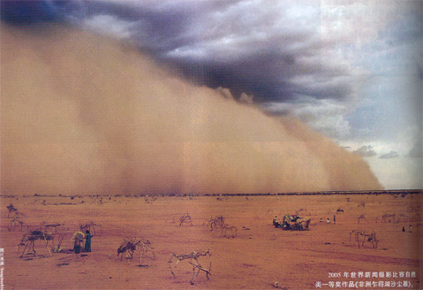
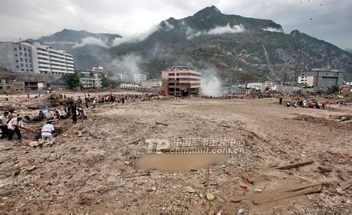
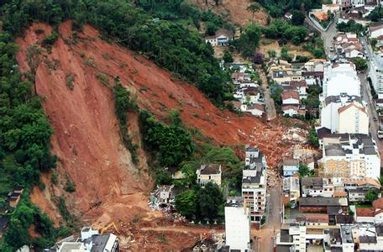
Ecological Disasters 生态灾害
flood
sand storm
mud-rock flow
landslide

Slide 10
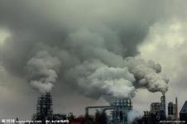
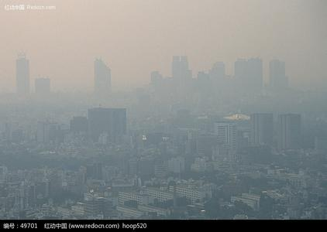
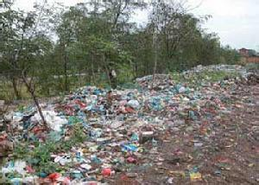
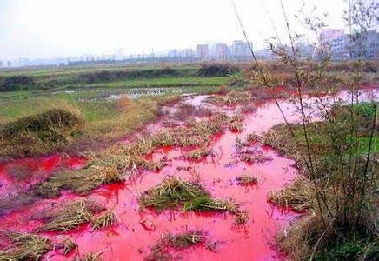
Environment Pollution 环境污染
air pollution
air pollution
soil pollution
water pollution

Slide 11
2 进展与挑战 Significant Progress but Challenges
许多部门开展生态红线划定工作/Many government agencies are working on E ER
  环境保护部/Ministry of Environmental Protection
  国土资源部/Ministry of Land and Resources
  水利部/Ministry of Water Resources
  国家海洋局/State Oceanic Administration
  国家林业局/State Forestry Administration
  江苏 /Jiangsu, 珠海/Zhuhai, 深圳/Shenzhen……

Slide 12
2 进展与挑战 Significant Progress but Challenges
1、Definition of “Red Line” given by each department
“Red Line” generally refers to unbridgeable boundary.
[红线]一般是指不可逾越的界限。
 | Name | Ministry | Feature
1 | red line of land， 用地红线 | Building Department | space bound area proportion
2 | red line of farm land，耕地红线 | Ministry of Land and Resources | quantity / total
3 | red line of water control，水资源红线 | Ministry of Water Resources | total \ limiting value
4 | law of water and soil conservation 水土保持法 | Ministry of Water Resources | spatial constraint
5 | red line of forest land 林地红线 | State Forestry Administration | quantity/quality
Strict control of its space boundary, quantity(proportion), limiting value……，，空间界线，数量（比例）、限值……

Slide 13
2 进展与挑战 Significant Progress but Challenges
概念、内涵与实践认识不统一/No Agreement on Red-line concept, characteristics or practical application
缺乏划定标准/No management standards
缺乏协调机制/No coordination mechanism
缺乏实施方案/No implementation approaches
知识储备不足/Knowledge is insufficient

Slide 14
部分观点：Some of the “Options/concepts” for definition of Eco-environmental Redlines
    观点一：指对维护国家和区域生态安全及经济社会可持续发展具有重要战略意义，必须实行严格保护的国土空间。包括重要生态服务保障线、人居环境安全保障线和生物多样性保护线。
    Concept 1：The ec-environmental redlining is the space that plays key roles in maintaining state and regional ecological security and economic and social sustainable development, and must be strictly protected. It includes safeguard line for critical ecosystem services, safeguard line for habitat environment security and conservation line for biodiversity.

Slide 15
部分观点：Some of the “Options/concepts” for definition of E Redlines
    观点二：生态保护红线包括空间上的保护红线、环境质量红线、资源消耗上线和污染物排放量最低限，包括生态功能保障基线、环境质量安全底线和自然资源利用上线。
    Concept 2: The eco-environmental redlining covers the regional geographical red line, environmental quality red line, upper limit of resource consumption and minimum of pollutant discharge amount, or covers the ecological function guarantee baseline, environmental quality and safety baseline and upper limit of natural resource utilization.
    观点三：生态保护红线就是重点生态功能区的范畴。
    Concept 3: The ec-environmental redlining is the category of important ecological function zones.

Slide 16
Preliminary conclusion on definition
生态保护红线指对维护国家和区域生态安全及经济社会可持续发展，在提升生态功能、保障生态产品与服务持续供给必须严格保护的最小空间范围，是落实“划定生产、生活、生态空间开发管制界限，落实用途管制”，“优化国土开发格局的基础”。
Eco-environmental protection redlines are the minimum space that must be protected to ensure the continuous supply of ecological and environmental products and services for maintaining the State and regional ecological safety and sustainable economic and social development.
For the purpose of “optimizing spatial pattern of land development “.

Slide 17


Preliminary conclusion on definition
2、What is ecological “Red Line”？
国家和区域生态安全的底线
Bottom line for national and regional ecological security
Supporting economic
Sustainable
development
Providing ecological
service
Ensuring living
condition
Alleviating &
controlling
ecological disasters
Sustainable
utilization
of bio-resources
Protection of
biodiversity
function
Protected area
Important ecological function area
Ecological sensitive area and fragile area
Important habitat of keystone species and ecosystems
重要生态
功能区
生态敏感区
脆弱区区
关键物种生境与生态系统

Slide 18
3 制度挑战 The Institutional Challenge
需要建立协调的机制/Establish a well coordinated mechanism to draw and manage the RLs.
需要与其他优先区协调/Alignment with other priorities (agriculture, development, urbanization)
需要多各部门及其政策实践的参与/Integrate all agencies and policies and practices (e.g., land use planning)
需要整合不同类型的保护地/Integrate different types of protected areas into EER system
需要强化执法管理/Monitor and ensure compliance and enforcement
需要建立生态补偿机制/Eco-compensation mechanism

Slide 19
Institutional Components for Redlining at National-Local levels:
生态环境红线的机构要素-国家和地方层面：
Information & Technical analysis
Integrated Government Policies
Setting targets, and limits
Coordinated Land Use Planning
Management of Compliance & Enforcement
Incentives & Compensation mechanisms
信息和技术分析
整合政府相关政策
确定目标、和约束条件
协调土地利用规划
遵从和执行的管控
激励和补偿机制

Slide 20
完善土地利用规划与保护体系/Land use planning system
土地利用规划
Land use planning
生态用地
Ecological land
生态保护红线
Ecological redline
保护地体系
PA systems
农用地/ agricultural land | 耕地/cropland
 | 园地/orchard
 | 林地/forestland
 | 牧草地/grassland
 | 其他未利用地/unused land
建设用地/ construction land | 城乡建设用地/ urban and rural construction land
 | 交通水利用地/transportation and water
 | 其他建设用地/ other c land
生态用地/ ecological land | 生物多样性保护/biodiversity protection
 | 自然遗迹/natural heritage
 | 水源涵养/water conserv
 | 土壤保持/soil conservation
 | 洪水调蓄/flooding regulation
 | 防风固沙/sandstorm control
 | ……
未利用地/ unused land | 水域/water
 | 滩涂沼泽/wetland
 | 自然保留地/natural reserve
生物多样性保护/ Wildlife habitat co
自然保护区/ Natural reserve
生物多样性保护/ Ecosystem conse
国家公园/ National park
自然遗迹/natural heritage
地质公园/
Geo- park
生态用地
Ecological land
森林公园/ Forest park
水源涵养/Water conservation
土壤保持/soil conservation
生态功能保护区/Eco-service reserve
防风固沙/sand storm control
湿地公园/ Wetland park
洪水调蓄/ Flooding regulation
生物多样性/生态功能格局
Pattern of ecosystem services and biodiversity

Slide 21
4 研究目标 Research Objectives
确定生态保护红线定义与特征/Define meaning, outcomes and characteristics of EER
提出新的制度/Propose new Institutional regime
提出制度构成/Propose Institutional components
确定基本原则/Identify foundational principles
提出生态补偿的主要途径/Outline essential parts of approach to eco-compensation
提出生态保护红线路线图/Identify a Roadmap

Slide 22
5 研究内容 Research content
总结生态红线实施进展及基本特征/Document current status, essential characteristics and international experience
发展创新制度的主要原则和实践/Develop principles and practices for an innovative Institution
提出线路图/Propose a Roadmap

Slide 23
项目组/Research Group
 | 中方团队/Chinese group | 外方团队/International group
组长/Chair | 欧阳志云(中国科学院生态环境)/Ouyang Zhiyun, Research Center for Eco-Environmental Sciences, Chinese Academy of Sciences | Derek Thompson/加拿大不列颠哥伦比亚省环境、土地与公园部前副部长/former Deputy Minister of Environment, Lands & Park, British Columbia, Canada
成员/Member | 高吉喜(环保部南京环境科学研究)/Gao Jixi Nanjing Institute of Environmental sciences, MEP | Tundi Agardy/海洋生态系统服务项目主任/Director, Marine Ecosystem Service Program
 | 林坚(北京大学)/Li Jian Peking University | John MacKinnon/中欧生物多样性保护东盟区域中心前主任/Former Director, EU-China Biodiversity Programme
 | 张丽君(国土资源部信息中心)/Zhang Lijun Information Center, Ministry of Land and Resource
 |  | Scott Perkin/世界自然保护联盟/Regional Biodiversity Conservation Programme, Asia, IUCN Asia Regional Office in Bangkok
 | 张惠远(中国环境科学研究院 )/Chinese Research Academy of Environmental Sciences
协调员/Coordinator | 郑华(中国科学院生态环境研究中心)/ Research Center for Eco-Environmental Sciences, CAS | 朱春全/世界自然保护联盟驻华代表/Country Representative, China, IUCN

Slide 24
6 任务分工 Task allocation
任务 | 中方成员 | 外方成员
生态保护红线内涵与体系构成/Study on characteristics and system constitution of EER – Research report to clarify the concept of EER 中国生态系统状况分析报告/Sub-report of status and analysis of ecosystems of China (2000, 2005 and 2010) 生态保护红线进展报告，包括4个案例研究/Status of progress of EER, including 4 case studies 保护地及其规划和管理的国际经验/International experience with Protected Areas & similar designations Planning/Mgt. 报告摘要/Summary report | 欧阳志云，高吉喜、张丽君、宋峰、郑华/Ouyang Zhiyun, Gao Jixi, Zhang Lijun, Song Feng, Zheng Hua | Derek Thompson Tundi Agardy, & Scott Perkins

Slide 25
6 任务分工 Task allocation
任务 | 中方成员 | 外方成员
生态保护红线管理制度/Ecological redlining management institution 国土资源部土地利用规划概况与启示/Status and current process of land-use planning of MLR 生态保护红线区生态补偿机制/Ecological compensation of the zones within EER 保护地管制的国际经验/International experience on regulation and enforcement 生态保护红线监测、评估与绩效评估制度/Monitoring, evaluation and performance appraisal institution of the EER 保护地管理的国际经验/International experience on regulation of Protected areas and similar designations 利益相关者参与、部门间协调和政府创新的国际经验/International experience on stakeholder engagement, inter-sectoral coordination & governance innovation | 林坚、郑华、张惠远、张丽君、高吉喜/Lin Jian, Zheng Hua, Zhang Huiyuan, Zhang Lijun, Gao Jixi | Derek Thompson & John Mackinnon
生态保护红线制度研究总报告及政策建议/General report and policy suggestion of EER institution research | 欧阳志云/Ouyang Zhiyun | Derek Thompson

Slide 26
7 工作计划 Workplan
3月，项目启动，召开第一次工作会议 / March Start the project and hold the first plenary session
4-5月，文献调研，准备研究框架 / April – May Material research, prepare the framework
5月，召开第二次工作会议，讨论主报告研究框架和支持报告草稿 / May (5th -6th May) Hold the second plenary session and discuss the framework of the main report and draft of the supporting reports
6-8月，完成研究；利益相关者咨询；确定报告框架 / June – August Complete research; stakeholder consultation; determine report framework
7月中旬，完成政策建议初稿 / Mid-July Complete the first draft of policy suggestion
8月中旬，完成研究报告初稿 / Mid-August Complete the first draft of Study Report
9月初，召开第三次工作报告，讨论研究报告，召开咨询会 / Early September ( 2nd – 3rd Sept.) Hold the third plenary session and discuss the Study Report, final consultations
9月中旬，完成研究报告修改稿 / Mid-September Complete the revised draft of the study report
9月底，修改、完善和提交最终研究报告中英文版。Late September Revise, improve and submit the final study report in both Chinese and English
11月，项目结题 / November Achievement report

Slide 27
初步结果Preliminary Conclusions
生态保护红线内涵/Definition
完善土地利用与保护规划/Potential change in land use planning system
整合保护地体系/Clarified protected areas categories

Slide 28
Thanks!

Slide 30
The Institutional Challenge in China Today
中国目前面临的机构挑战
Substantial progress on Technical items BUT significant issues remain.
Mandates are unclear and duplicative.
Need to clarify ecological , Environmental & other Redlines
Decision Mechanisms for coordinated designation & management are unclear.
Local Officials lack awareness or incentives to manage to protect ecology & environment
The “role” of Protected areas needs clarity & systems approach
Land Use planning well developed but no “conservation” lands Identified
Land rights and compensation concerns
Lack of effective policy & practice for compliance & enforcement
Lack of models for engagement in decisions
技术领域取得了显著进步，但是巨大的挑战依然存在
职责任务不清楚和重叠
需要明确生态、环境和其它红线
协调设计和管理的决策机制不清晰
地方官员缺乏管理和保护生态和环境的意识和激励机制
保护区的“角色”需要明确，需要系统地方法进行分析
关注土地权属和补偿问题
缺乏有效的政策和措施遵从和执行
缺乏广泛参与决策的模式

Slide 31
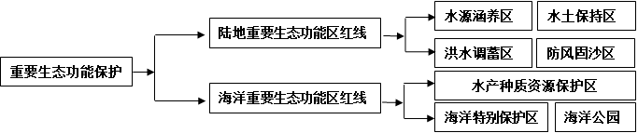
三、system of ecological red line
Water and soil conservation area
Water conservation
Red line of important eco-function area in land areas
→
Flood water storage area
Wind prevention and sand fixation
Protection of important ecological function
→
Aquatic germplasm resources protection area
Red line of important eco-function area in sea areas
→
special marine protection area
Marine park

Slide 32
项目组/Research Group
 | 中方团队/Chinese group | 外方团队/International group
组长/Chair | 欧阳志云(中国科学院生态环境)/Ouyang Zhiyun, Research Center for Eco-Environmental Sciences, Chinese Academy of Sciences | Derek Thompson/加拿大不列颠哥伦比亚省环境、土地与公园部前副部长/former Deputy Minister of Environment, Lands & Park, British Columbia, Canada
成员/Member | 高吉喜(环保部南京环境科学研究)/Gao Jixi Nanjing Institute of Environmental sciences, MEP | Tundi Agardy/海洋生态系统服务项目主任/Director, Marine Ecosystem Service Program
 | 林坚(北京大学)/Li Jian Peking University | John MacKinnon/中欧生物多样性保护东盟区域中心前主任/Former Director, EU-China Biodiversity Programme
 | 张丽君(国土资源部信息中心)/Zhang Lijun Information Center, Ministry of Land and Resource
 |  | Scott Perkin/世界自然保护联盟/Regional Biodiversity Conservation Programme, Asia, IUCN Asia Regional Office in Bangkok
 | 张惠远(中国环境科学研究院 )/Chinese Research Academy of Environmental Sciences
专家组/Consultant | 王如松(中国科学院生态环境研究中心, 院士)/Research Center for Eco-Environmental Sciences, CAS
 | 傅伯杰(中国科学院生态环境研究中心, 院士)/Research Center for Eco-Environmental Sciences, CAS
 | 王毅(中国科学院科技政策与管理科学研究所)/Institute of ST policy and management, CAS
 | 夏光(环保部环境与经济政策研究中心)/Center of environmental and economic policy
 | 王斌(国家海洋局北海分局) /State Adminiatration of Ocean
 | 刘卫东(中国科学院地理科学与资源研究所)/
 | 王桥(环保部环境卫星应用中心)/
协调员/Coordinator | 郑华(中国科学院生态环境研究中心)/ Research Center for Eco-Environmental Sciences, CAS |  | 朱春全/世界自然保护联盟驻华代表/Country Representative, China, IUCN

